Slide 1
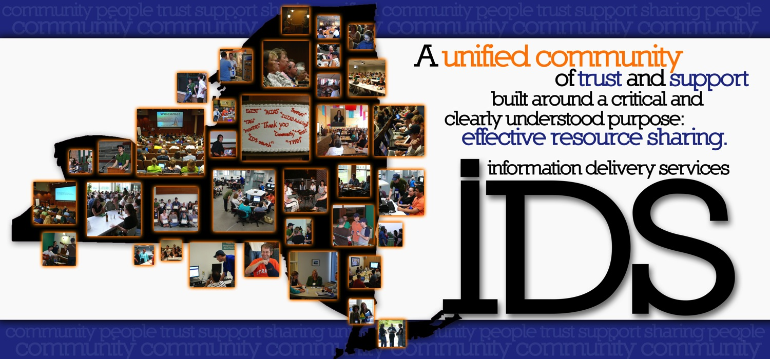
The IDS Project (idsproject.org)
Promoting library excellence through community & technology

Slide 2
Vision Statement
“The Information Delivery Services (IDS) Project strives to be an innovative model of library cooperation for effective resource sharing, promoting community engagement, staff development, best practices, and research & development.”

Slide 3
Major Features of IDS Project
Emphasis on building “a unified community of trust & support”
User-centric definition of an ILL transaction
Handle both physical items (books, media, etc) AND articles
Contractual performance standards
Real-time, multi-level ILL transaction performance data
Objective data for decision making & policy development
Trained teams of volunteer mentors (applications & technical)
Extensive sharing of eJournals via the Article Licensing Information Availability Service (ALIAS)
No startup or annual membership fees
Commitment of talent and time of members

Slide 4
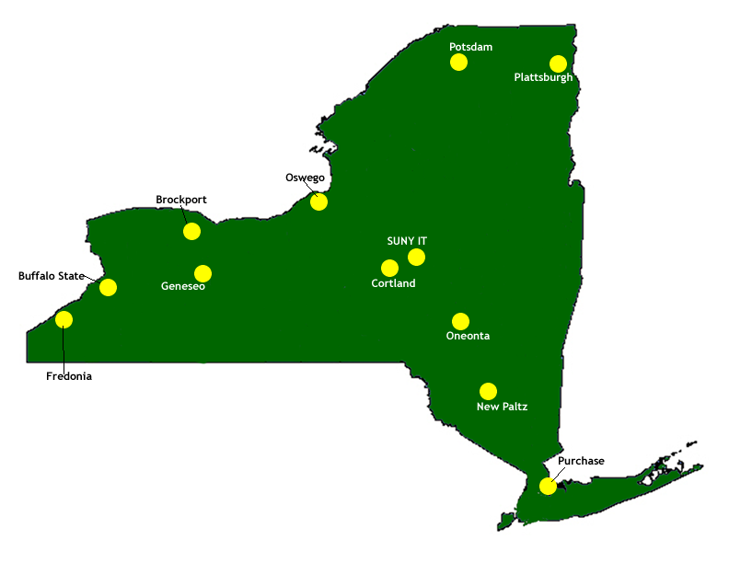
Spring 2004

Slide 5
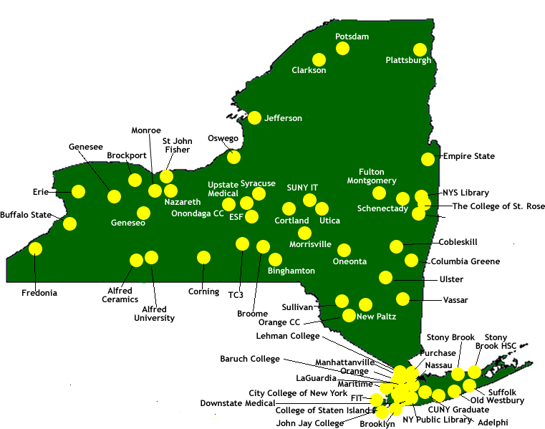
Spring 2011
Notes:
Updated 3-31-11

Slide 6
By the Numbers
Snapshot as of: April 1, 2011
Member libraries: 62
Total collection volume: 34,250,000
Student Head Count: 345,000
Faculty Head Count: 19,000

Slide 7
Current Members
Adelphi University
Alfred University
CUNY Baruch College
CUNY Brooklyn College
CUNY City College
CUNY College of Staten Island
CUNY Graduate Center
CUNY Hostos CC
CUNY John Jay Coll. of Criminal Justice
CUNY LaGuardia CC
CUNY Lehman College
College of St. Rose
Clarkson University
Manhattanville College
Nazareth College
New York Public Library
New York State Library
St. John Fisher College
SUNY Alfred Ceramics
SUNY Binghamton
SUNY Brockport
SUNY Broome CC
SUNY Buffalo State
SUNY Cobleskill
SUNY Columbia-Greene CC
SUNY Corning CC
SUNY Cortland
SUNY Downstate Medical Center
SUNY Empire State
SUNY Env. Science & Forestry
SUNY Erie CC
SUNY Fashion Inst. of Tech.
SUNY Fredonia
SUNY Fulton-Montgomery CC
SUNY Genesee CC
SUNY Geneseo
SUNY Hudson Valley CC
SUNY Institute of Technology
SUNY Jefferson CC
SUNY Maritime
SUNY Monroe CC
SUNY Morrisville
SUNY Nassau CC
SUNY New Paltz
SUNY Old Westbury
SUNY Oneonta
SUNY Onondaga CC
SUNY Orange Co. CC
SUNY Oswego
SUNY Plattsburgh
SUNY Potsdam
SUNY Purchase
SUNY Schenectady CC
SUNY Stony Brook
SUNY Stony Brook HSC
SUNY Suffolk Co. CC
SUNY Sullivan Co. CC
SUNY Tompkins Cortland CC
SUNY Ulster Co. CC
SUNY Upstate Medical University
Syracuse University
Utica College
Vassar College

Slide 8
Outcomes
Notes:
What are the OUTCOMES – interestingly the fill rate has been consistently half articles and half loans.
Updated 3-31-11

Slide 9
IDS Project Team
Ed Rivenburgh, Director
Tim Bowersox, Coordinator of Mentors & Training
Corey Ha, Webmaster
Cyril Oberlander, Consultant
Mark Sullivan, Systems Administrator

Slide 10









Partners
Library Vendors
State Institutions

Slide 11
Community

Slide 12
Website & Listserv
http://idsproject.org/

Slide 13
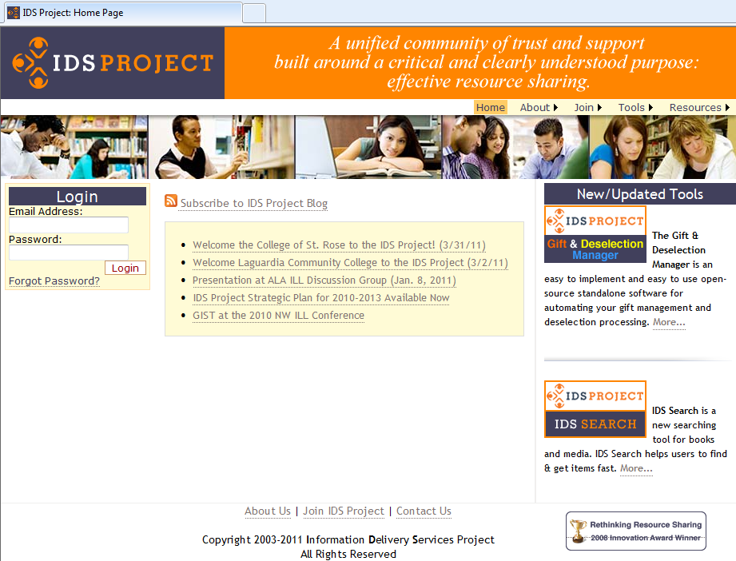

Slide 14
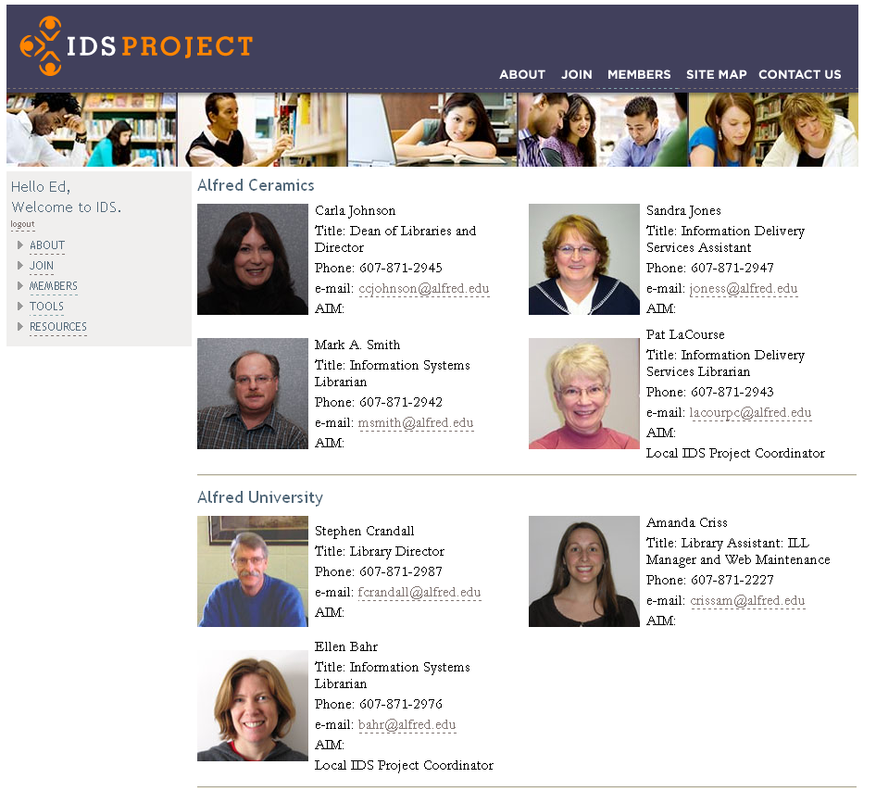
14

Slide 15
Annual Conference

Slide 16

Welcome!
To The Seventh Annual
Information Delivery
Services (IDS)
Summer Conference!
Oswego, NY
August 3-4, 2010

Slide 17
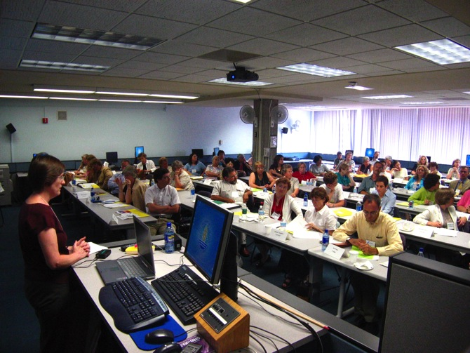
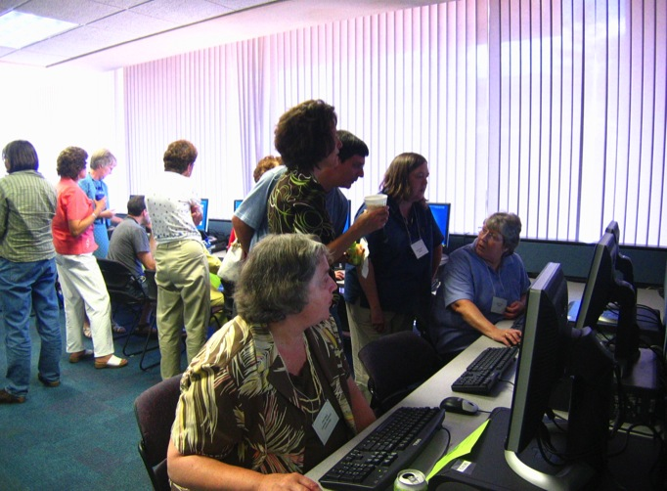

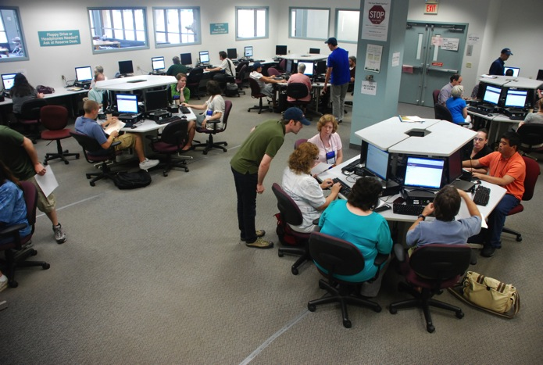

Slide 18
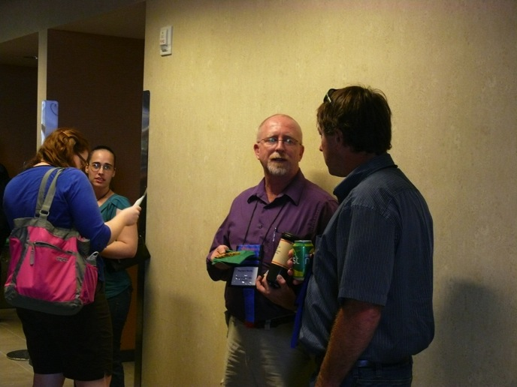
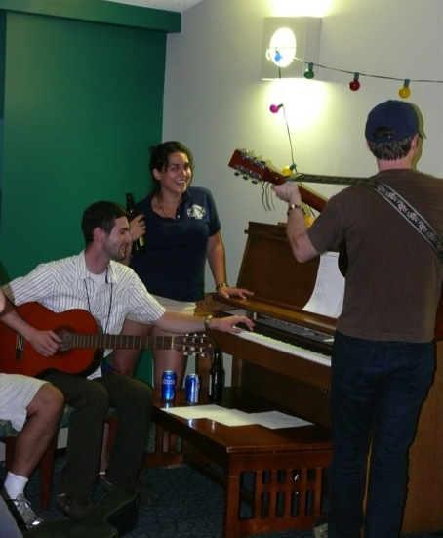

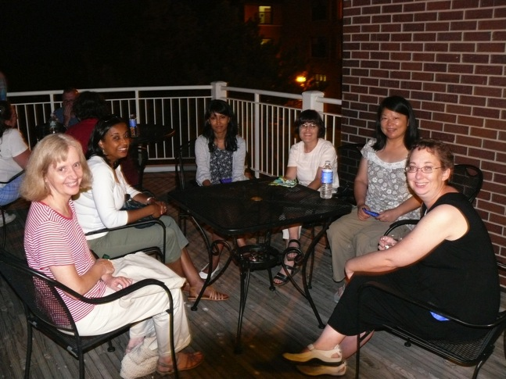

Slide 19
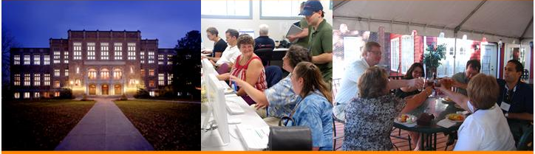


IDS Conference August 1-3, 2011
Albany Law School, Albany NY

Slide 20
IDS Conference August 1-3, 2011
Session Tracks
Acquisitions, Collection Development, and Interlibrary Loan
Innovative Technologies
Resource Sharing from an Administrative Prospective
Resource Sharing Best Practices

Slide 21
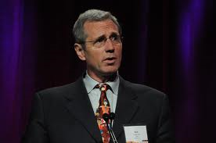
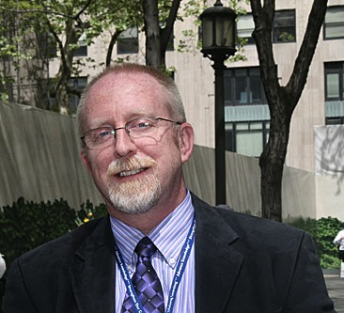
Keynote—Robert Lippincott, Senior Vice President for Education at PBS.
Matthew Sheehy, Assistant Director of Harvard University Library

Slide 22
Mentor Program

Slide 23
Mentor Program
Helps libraries adopt best practices
  Project planning & guidance
  Remote & on-site training
Strengthens the community
  Libraries assigned a mentor
  Collaborates with library liaison
Mentor Certification Program
  Core training for mentors
  Ongoing professional development
  Ensures best possible support
Mentor
Liaison
Shares info & news
Guides project management
Asks for help
Coordinates local project implementation
Checks in regularly
Identifies needs
Provides training
Shares library news

Slide 24
Current Mentors
Name | Institution
Tim Bowersox | SUNY Geneseo
Mike Curtis | SUNY Upstate Medical University
Karen Gardner-Athey | SUNY Office of Lib. & Info. Services
Kerry Keegan | SUNY Stony Brook Health Sciences Center
Andrew Leykam | CUNY College of Staten Island
Lynne Marus | Nazareth College
Philip Mui | New York Public Library
Mike Mulligan | SUNY Upstate Medical University
Beth Posner | CUNY Graduate Center
Logan Rath | SUNY Brockport
Kevin Reiss | CUNY Office of Library Services
Chris Sisak | Nazareth College
Mark Sullivan | SUNY Geneseo

Slide 25
Recommended Best Practices http://tinyurl.com/IDS-Best-Practices
Best practices inventory
  Checklist format
  Explains benefits
  Links to documentation
Optimize membership
  Reduce mediation
  Improve turnaround
  Lower ILL-related costs
Mentors are here to help
☑ | Recommended best practice
 | ILLiad borrowing & lending
 | Odyssey
 | ILLiad 8
 | ALIAS
 | Direct Request
 | Custom Holdings
 | IFM
 | Email routing

Slide 26
Mentoring Process
Setting goals & expectations
Project planning
Review & closure
Implementation & feedback

Slide 27
Workflow Toolkit
http://workflowtoolkit.wordpress.com

Slide 28
Workflow Toolkit
Repository of ILLiad best practices
  http://workflowtoolkit.wordpress.com
  Developed in partnership with Atlas Systems
Community driven via active blog & listserv
  Over 28,000 page views since October 2009
  402 WorkflowToolkit-L members
Highlights essential workflow enhancements
Connects readers to external resources

Slide 29
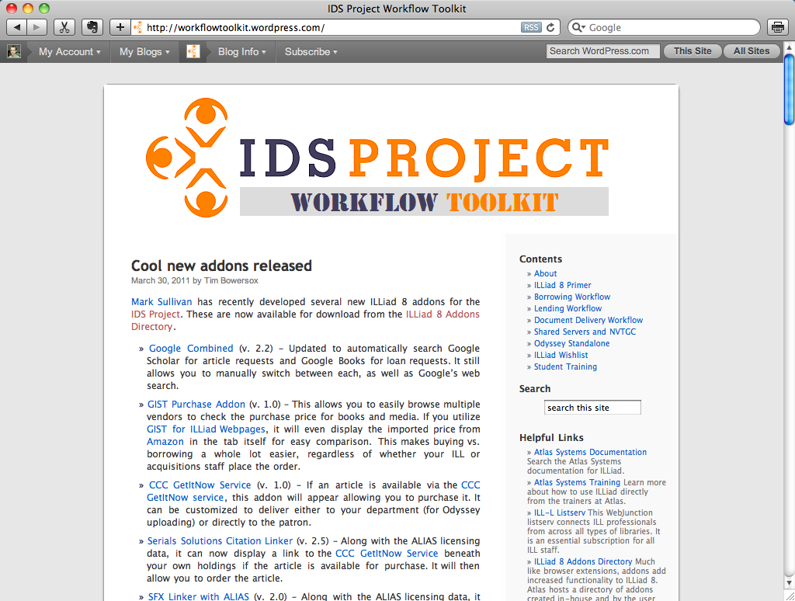
Home page
Blog with latest updates
RSS, Twitter & email subscriptions
Share & comment on posts

Slide 30
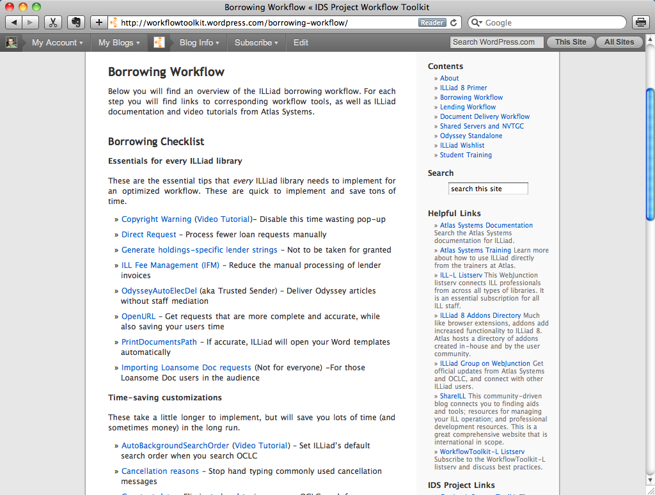
Workflows
Essentials for every ILLiad library
Time-saving customizations
Helpful tips to consider

Slide 31
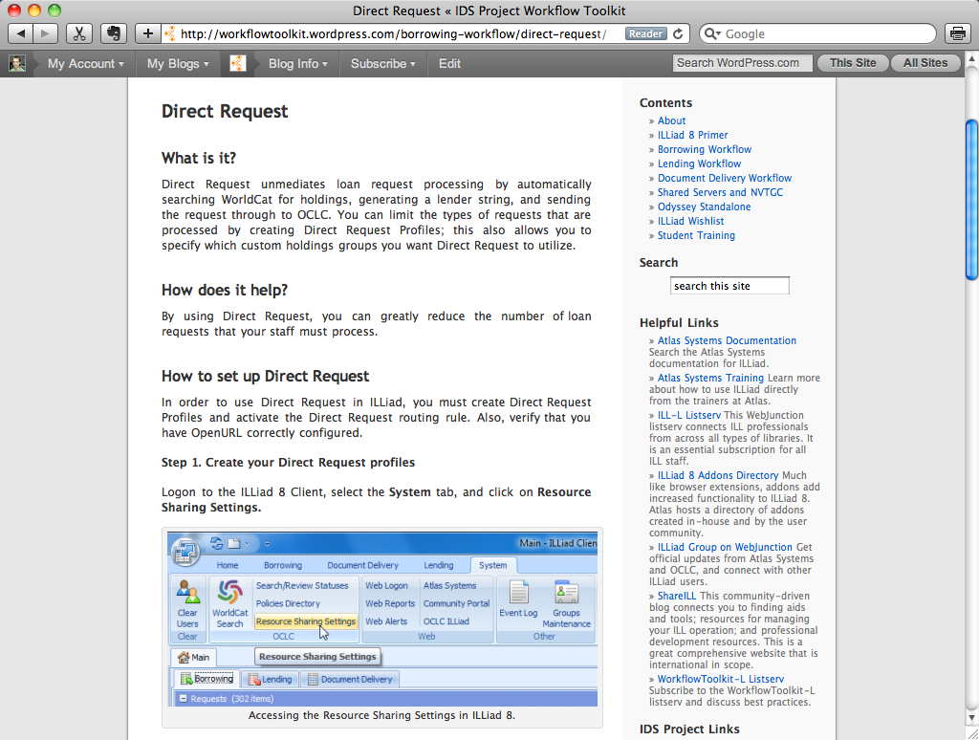
Tutorials
Introduce each best practice
Explain workflow benefits
Step-by-step directions w/ images
Samples & examples to copy

Slide 32
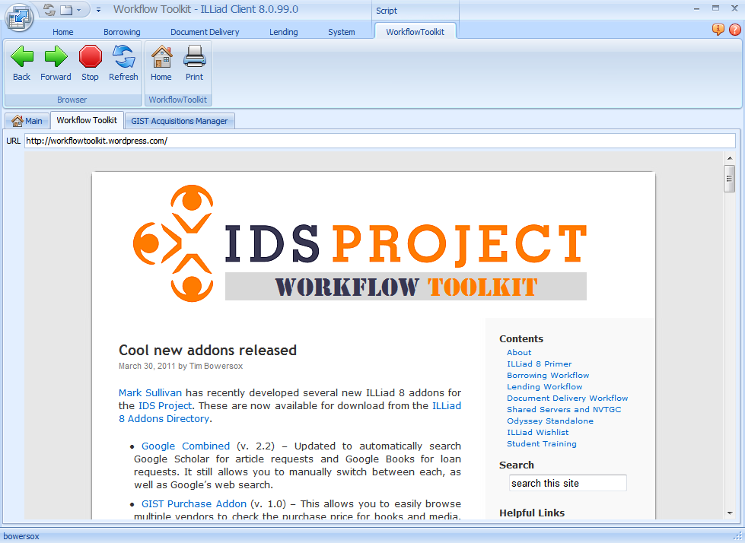
ILLiad 8 Addon
Easy-access tab for quick reference
No need for external web browser

Slide 33
Questions?
Community

Slide 34
Technology

Slide 35
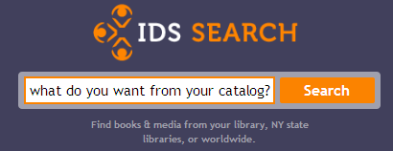

Slide 36

Why IDS Search?
The IDS Search Team set out to develop a discovery tool with the following two goals:
Provide a simple and powerful user experience
Enhance resource sharing within the IDS Project

Slide 37
IDS Search Core Functions
Provides search results and library holdings using the Worldcat Search API
Provides a real time circulation status check in library’s local ILS System (Aleph, Voyager, Innovative, etc.)
Search results are linked directly to a Library’s ILLiad service using OpenURL

Slide 38
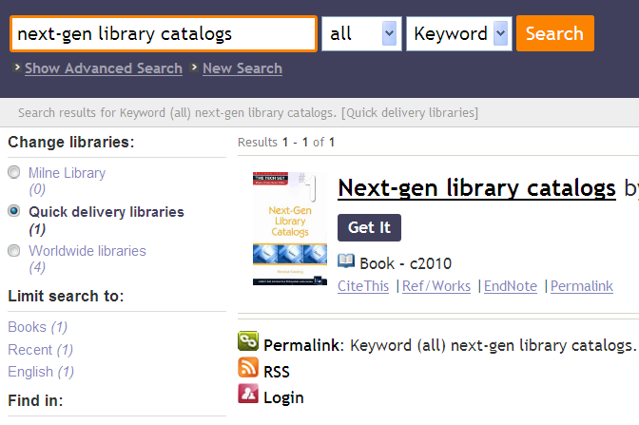
The IDS Search interface is simple and elegant with progressive disclosure of features at the point of need.
Notes:
In functional area

Slide 39
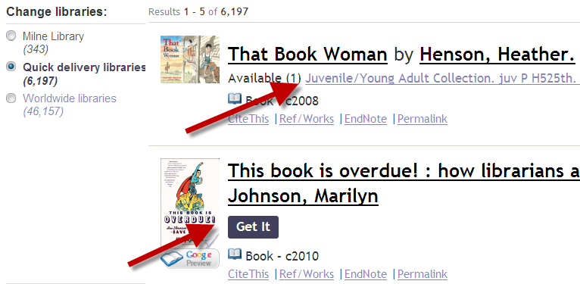
IDS Search promotes both local collections and resource sharing.
Notes:
Move to functional area

Slide 40
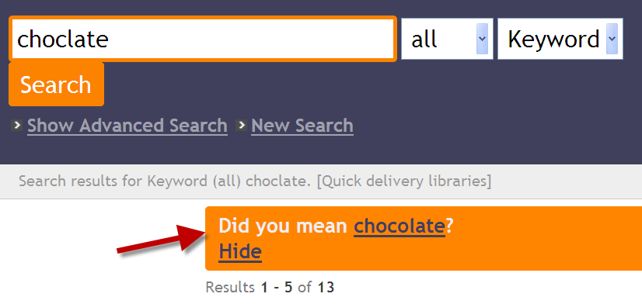
The spell check feature lets users know they have misspelled a word and provides an easy way to search again with the correct word.

Slide 41
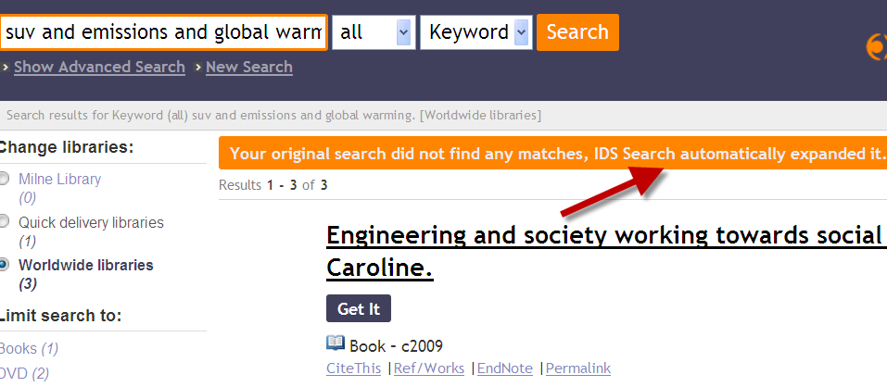
If searches do not return results, IDS Search automatically expands the search using the Autosearch Feature.

Slide 42
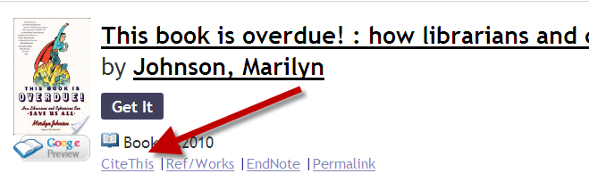
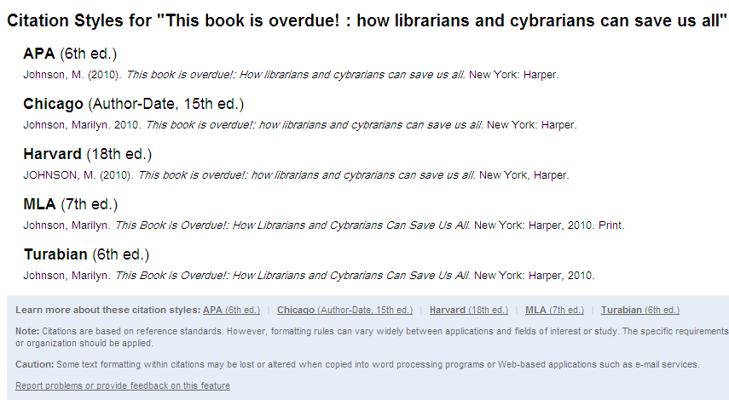
“Cite This” provides citations for major citation styles.

Slide 43
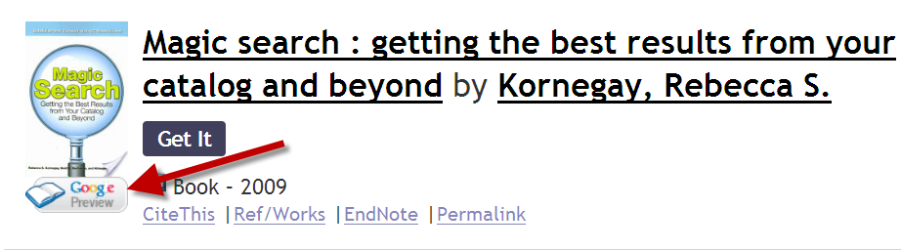
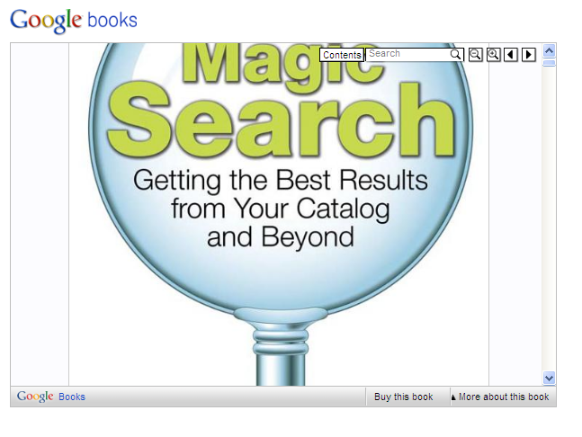
Google Books Previews are linked and embedded throughout results.

Slide 44
IDS Search has undergone extensive usability testing in its development process.
IDS Search was beta tested in 2009 by several libraries
  extensive feedback was received from librarians and library staff.
IDS Search was also tested in 2009 and 2010 by a usability team at University of Rochester.
In 2010, researchers at SUNY Geneseo conducted usability testing using eye tracking software and eye movement miscue analysis (EMMA).
Further eye tracking studies are planned for April 2011.
The default IDS Search interface has been heavily tested and refined as a result of this process.
Notes:
How developed
Testing is an integral part of continuous development process.

Slide 45
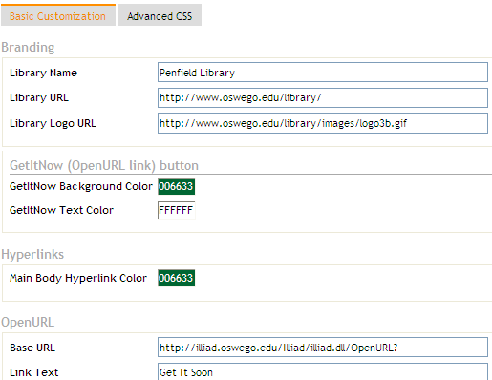
Customize the appearance of the search and brand it with your logo in a matter of minutes.
Notes:
Dashboard, customization

Slide 46
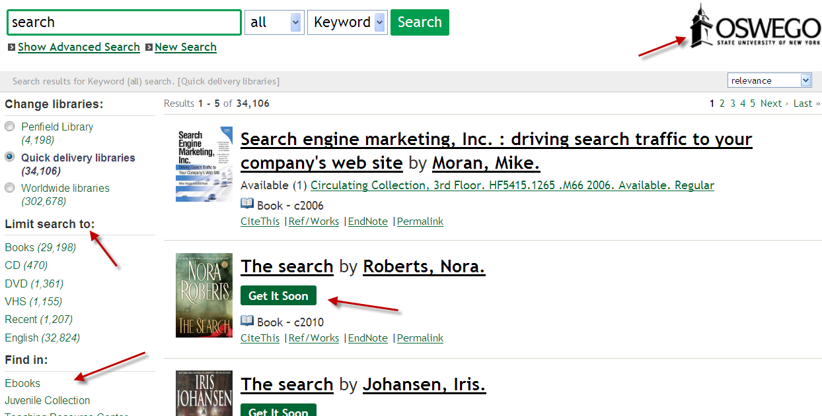
Customization Examples: Oswego

Slide 47
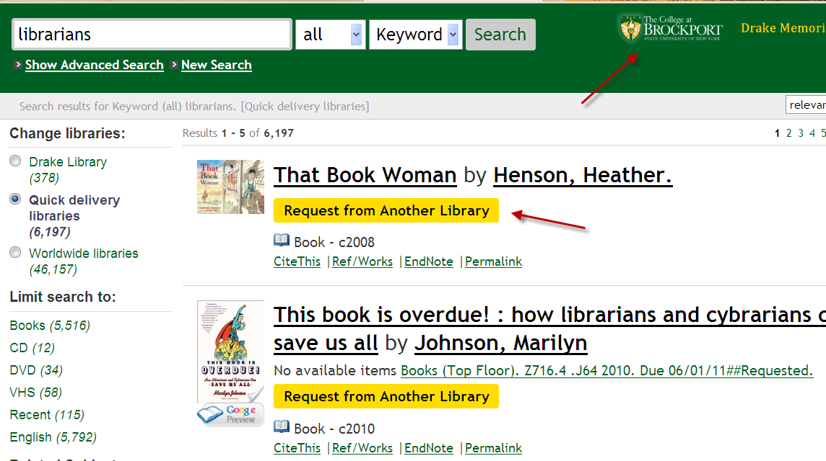
Customization Examples: Brockport
Notes:
Customization
For each interface, use red arrows for each changed, and then blow out the graphic for each slide.

Slide 48
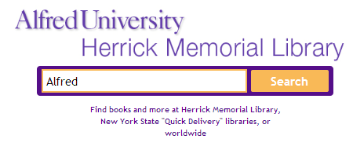
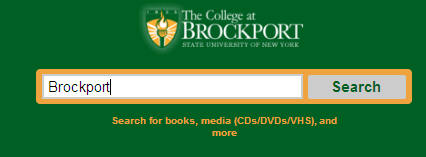
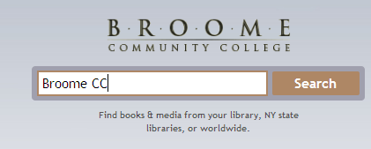
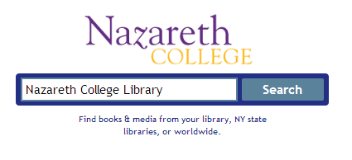
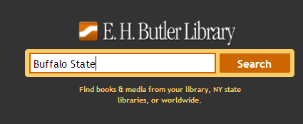
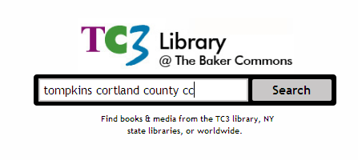
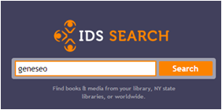
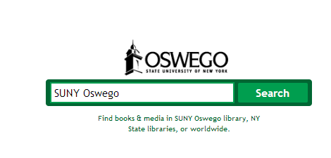
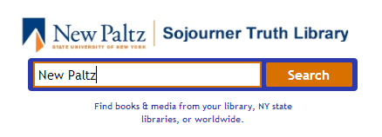
Who’s Currently Using IDS Search?
1,084,739 Searches since August of 2010 (180,066 in March 2011)

Slide 49
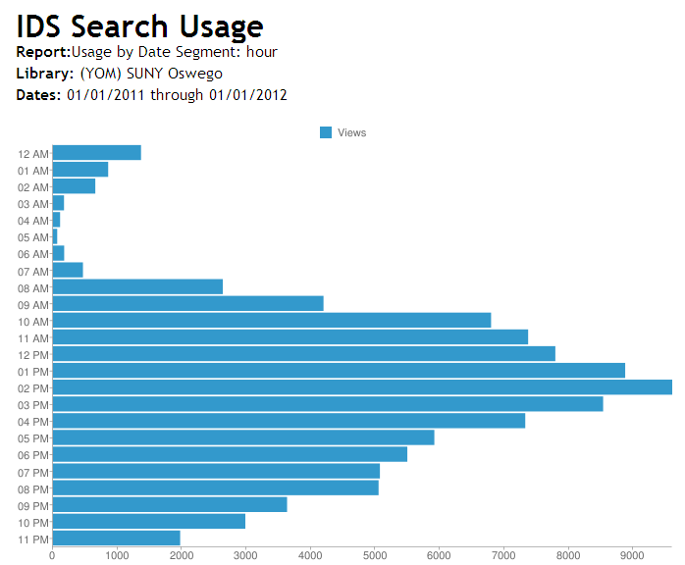
Find out how your users are interacting with your search tool
Notes:
Dashboard, Customization
3 slides

Slide 50
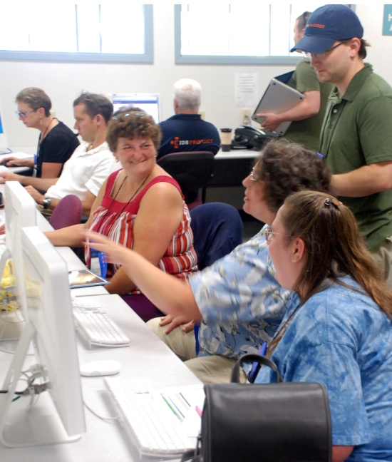
Minimal staff set up time or ongoing maintenance is needed for IDS Search.
Set up IDS Search within a few hours.
IDS Search is fully hosted with updates and maintenance by IDS Search team.

Slide 51

Learn More about IDS Search
IDS Search Blog
http://idssearch.wordpress.com/
IDS Search Site
http://idsproject.org/Tools/IDSSearch.aspx
IDS Search Listserv http://mail.geneseo.edu/mailman/listinfo/idssearch-l
Notes:
Make

Slide 52
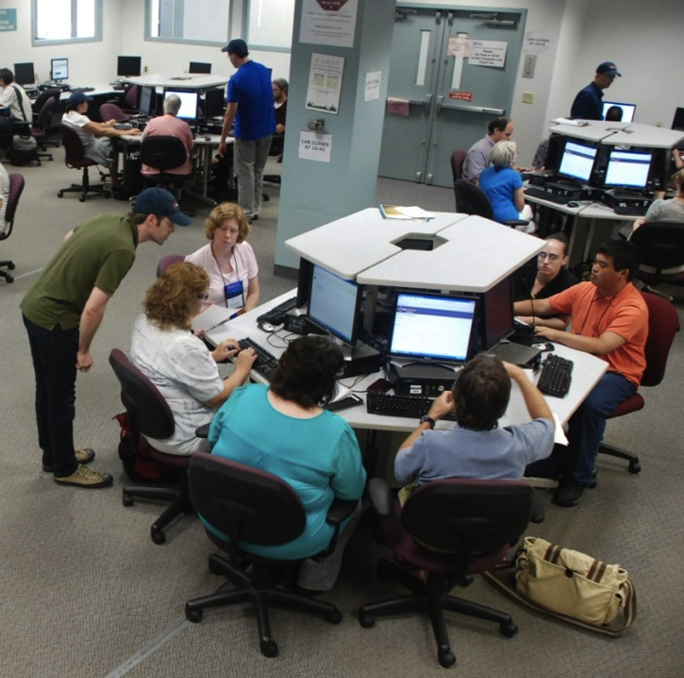
IDS Search Developer sessions at conferences and meetings give opportunities to set up your search.
Upcoming Conferences:
CUNY IDS Search Hands-on Orientation (May 2011 – Date TBD)
SUNYLA (June 15-17 2011 at SUNY Plattsburgh)
IDS Conference (August 1-3 2011 at Albany College of Law)

Slide 53
ALIAS
Article Licensing Information Availability Service

Slide 54
Article Licensing Information Availability Service (ALIAS)
Patron Request
IDS Service
Query ISSN, date
ILLIAD
ALIAS: Licensing Database
Awaiting Request Processing – Manual Process
Article Direct Request – Automatic Process
Library Codes for valid dates and licenses
Request Sent to OCLC
Local Holdings Queue
Notes:
We partnered with Atlas Systems to enhance the ejournal availability service with much needed automation.
Outline process
The IDS Service was developed by wonderful Atlas Staff to help us accomplish what we set out to do.
The IDS Service runs every 60 sec. automating the requesting process and discovery of materials we own – yes, even with open URL resolvers, we still get 10% requests for materials we own. At our request, Atlas solved another big problem with traditional ILL process – the problem of load leveling…

Slide 55
ALIAS Time Comparisons
January 1, 2011 – March 31, 2011
 | Without ALIAS |  | With ALIAS |  | Difference
Library | Requests | Avg. Hours before sent to OCLC | Requests | Avg. Hours before sent to OCLC using ALIAS | % Reduced Time
Brooklyn College | 95 | 19.6 | 57 | 15.1 | 23%
City College | 263 | 11.9 | 158 | 2.8 | 76%
College of Staten Island | 221 | 10.7 | 28 | 0.3 | 97%
CUNY Graduate Center | 1650 | 11.8 | 668 | 3.4 | 71%
John Jay | 184 | 18.4 | ALIAS not active
LaGuardia CC | 15 | 18.7 | ALIAS not active
Notes:
http://www.oclc.org/news////releases/200929.htm
Mark Update

Slide 56
ALIAS: Time Saved
Jan 1, 2011 – March 30, 2011

Slide 57
You Need ALIAS, ALIAS Needs You!
National Scope: ALIAS included in Serials Solutions and SFX Addons for ILLiad
20 people from 12 libraries reviewed the license data last year
We need more people willing to help this year!

Slide 58
TPAM
Transaction Performance Analysis Module

Slide 59
User-centric Definition of IDS Transaction
From the time the user places a request until the time the user is notified the loan is ready for pickup or the article is ready to be retrieved from the Web

Slide 60
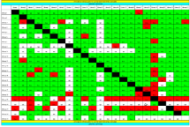
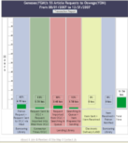
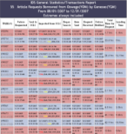
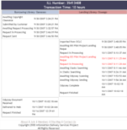
IDS Transaction Performance Analysis Module (TPAM)
Now also being used by Maryland IDS, & Kudzu/ASERL
Notes:
TIM
TPAM provides libraries with a series of hierarchically linked charts.

Slide 61
TPAM
Total borrowing transactions: Jan 1, 2011 – March 30, 2011
Loan Transactions: 38,209
  Borrowing Loan Transactions within Project: 20,422
  Percent Loaned within Project: 53%
Article Transactions: 31,211
  Borrowing Article Transactions within Project: 21,171
  Percent Delivered within Project: 67%

Slide 62
TPAM Turnaround Analysis
 | Outside IDS Project | Within IDS Project | Difference
Articles within 48 hours | 49% | 79% | 30%
Loans within 96 hours | 19% | 43% | 24%

Slide 63
Lender String Analysis for Loans
Jan 1, 2011 – March 30, 2011
Notes:
Something interesting about the loans…
It adds up to 114%! Why?
Some libraries will let an item age and move on to the next library in a lender string before actually filling it themselves. Many of the unfilleds were filled after they expired by the one of the libraries in the lender string.

Slide 64
Lender String Analysis for Articles
Jan 1, 2011 – March 30, 2011

Slide 65
Questions?
Technology

Slide 66
Bridging community & technology

Slide 67
ILLiad Addons
Enhancements by users for users

Slide 68
Addon Development
18 out of 29 Addons written by IDS Project

Slide 69
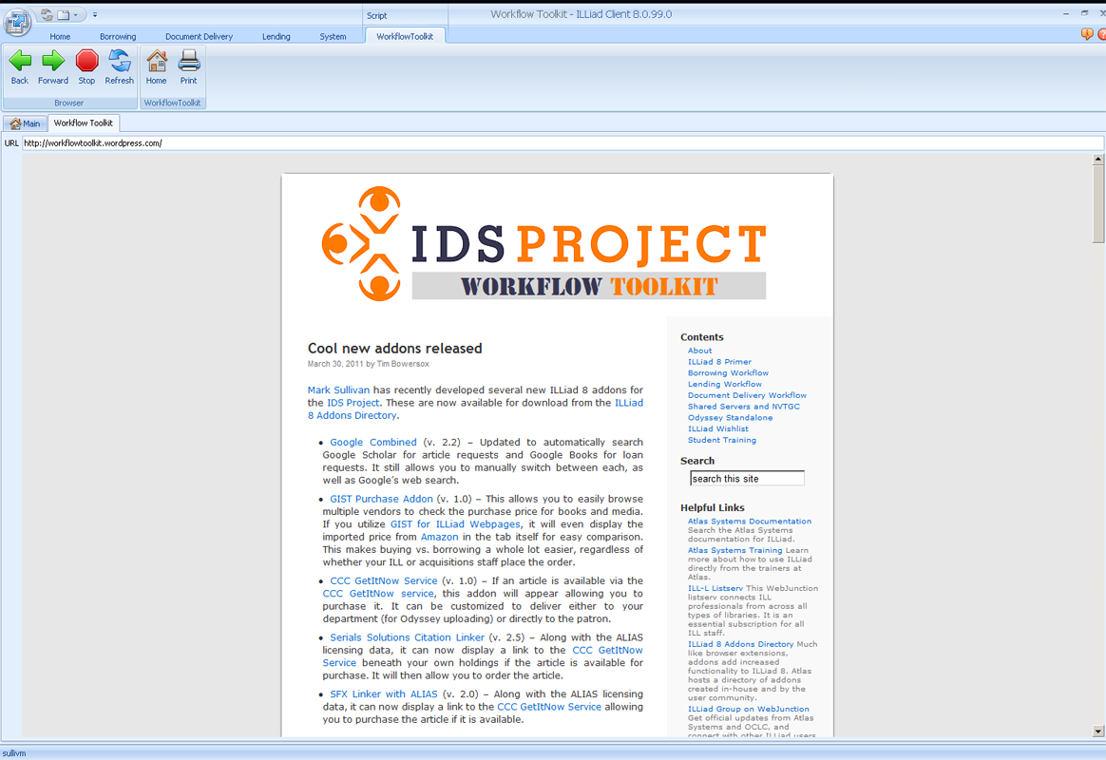
Addon Development

Slide 70
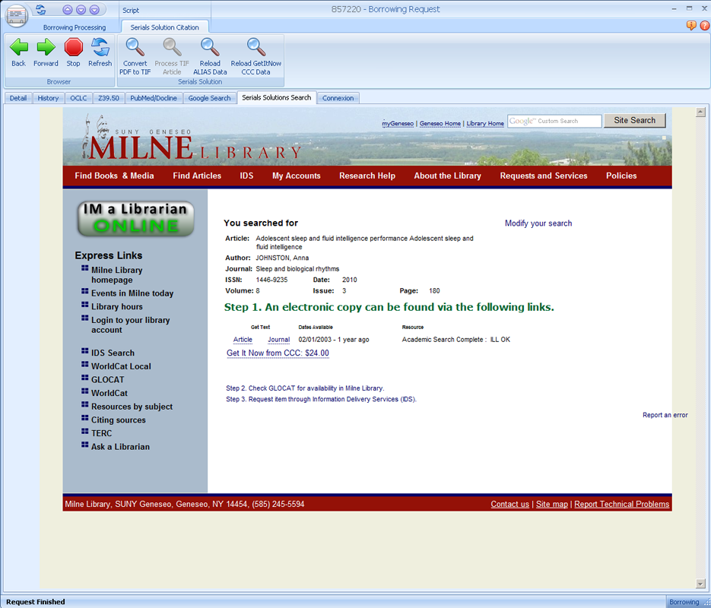
Addon Development
ALIAS License
Automatically loads for all known publishers/providers.
Provided free through Addons for SFX and Serials Solutions
Copyright Clearance Center
Get It Now Service
Purchase on demand automatically loaded if CCC has article available

Slide 71
Getting It System Toolkit
http://gist.idsproject.org

Slide 72
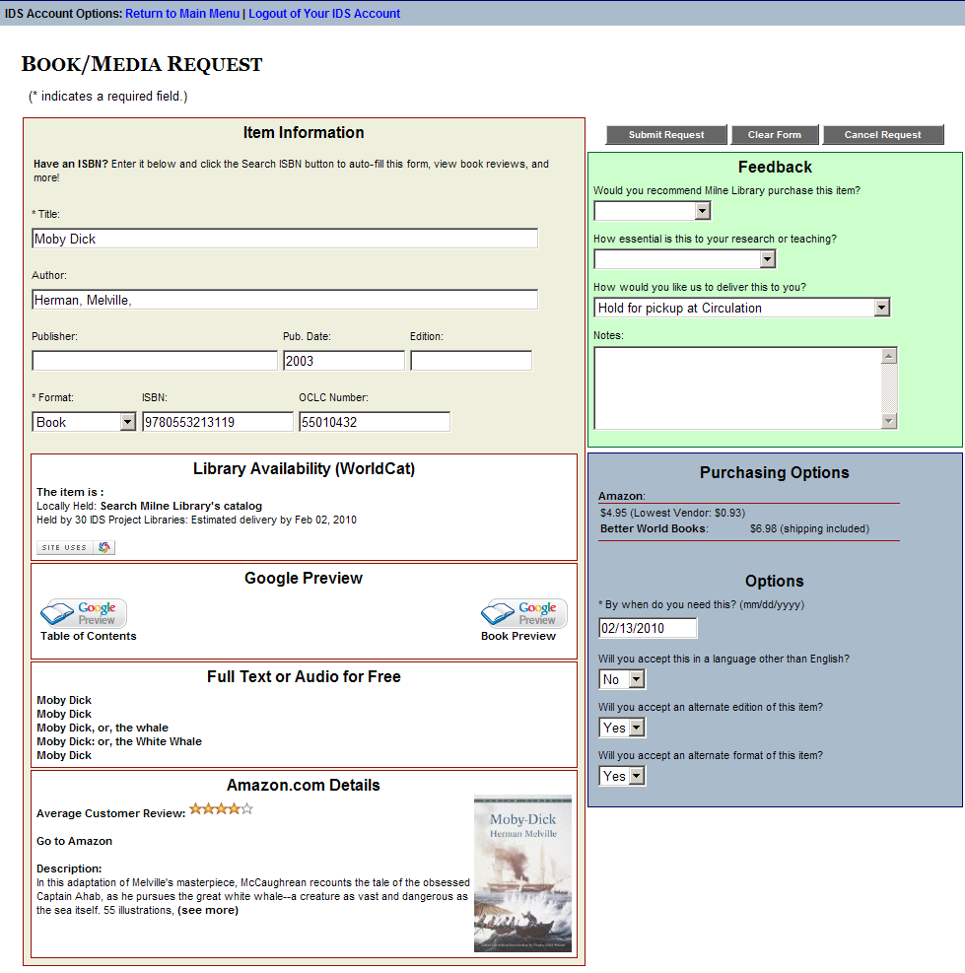
GIST for ILLiad Webpages
Worldcat API – Library Availability
User sees if owned locally, easy click to catalog, and sees estimated turnaround time.
ILL & Acquisitions staff see if held locally, and # holdings in 2 configurable groups (consortia, state, etc.)
ILLiad ILL
Request Form
Custom, Standalone, OpenURL, Status Specific
Google Books
User sees Table of Contents, No-Partial, & Full Text Views.
Staff see if full text in Google (GOOGL) OCLC symbol
Index Data
User sees if full text or audio version in Open Content Alliance, Gutenberg, Internet Archive, etc.
Staff see if full text OCA (INARC) OCLC symbol
Hathi Trust
User sees link to full-text version from Hathi Trust
ILL & Acquisitions staff see if held at Hathi Trust, and GIST 1.1 embeds the direct link to the work using a TinyURL API
Purchasing Options
User sees price to purchase from Amazon API with New & Lowest Price listed (used) – user may want to purchase from this link. If they do, Amazon provides our AWS account a credit for referring someone to purchase.
ILL & Acquisition Staff see the New & Lowest Price in the ILLiad requests. Better World Books, Google APIs are also currently used for pricing.
Amazon API
Enhances users request evaluation with Reviews, Ranking, Cover, and quick link to Amazon.
Price was moved into Purchasing Options window.
Notes:
There are 5 API components in the GIST interface; Worldcat API, Google Books, Index Data, Amazon, and purchasing options. By default, they are activated, however, the library can simply turn off any component they do not want to see, and how the data from each component is highly configurable for end-user, as well as, staff within the ILLiad request.
The Worldcat API – Terry Reese, Oregon State University and Kyle Bannerjee, Summit originally developed the Worldcat API for GIST, later modified and configured to work with ILLiad by Mark Sullivan. The purpose of the Worldcat API component is to bring back holdings information to the user – if held locally, it says so and the Please check your catalog is a one click into a search of your catalog using the OCLC#. The availability and estimated delivery time is set to 2 configurable groups – you might want one for your resource sharing consortia (of which turnaround times might be consistent), and the other is your state.
Google Books API enhances the user’s evaluation of the material they are requesting with additional data, such as Table of Contents or Partial Text Available, however, the user may also discover that the item they need is Full Text Available. Both ILL and Acquisitions staff see GOOGL (Google’s OCLC symbol) when a requested item is available full text, and at Geneseo, a routing rule automatically places the request in a specific queue – the staff will send the user an email using ILLiad that has the Google Book URL, and copies the electronic resources librarian to please catalog the resource. Similarly with Index Data API, a combined search of various free full text and audio sources from Open Content Alliance, Internet Archive, Gutenberg, etc. is performed and results may interest the user. The staff see INARC (Internet Archives OCLC Symbol) when a requested item is available from the Index Data sources, and again, a routing rule places that request in a specific queue for staff.
Amazons API was initially designed by Portland State University as the Price Grabber, but Mark Sullivan remade that program in .NET to be the Amazon Price Reviewer and more. This enables users more evaluation data to help their request decision making process. It also provides data for the purchasing options.
Purchasing Options is a combination of API data from Amazon, Better World Books, and Google Books. This service enables users to see price data, and click through to buy. If they buy from Amazon or Better World Books, our accounts are given credit for referring buyers. What the ILL and Acquisitions staff see in the ILLiad request is Amazon’s new and lowest cost to buy the item – which for ILL helps them determine if buying is less expensive than borrowing – there are a lot of libraries out there that charge $20 / request. For Acquisitions staff, the purchasing data eliminates the need for searching various prices. We have asked many of the book jobbers and dealers for APIs, so as we hear back from them, we plan to incorporate more, and enable easy configuration so that a library with preferred or specific vendors can activate only those purchasing APIs.
Last point we want to emphasize is that all this is very flexible, where it appears, how it looks to user and staff, so we see this as really the first template of many, as libraries adapt this, as they customize views to specific user status; faculty, student, administrator, etc.

Slide 73
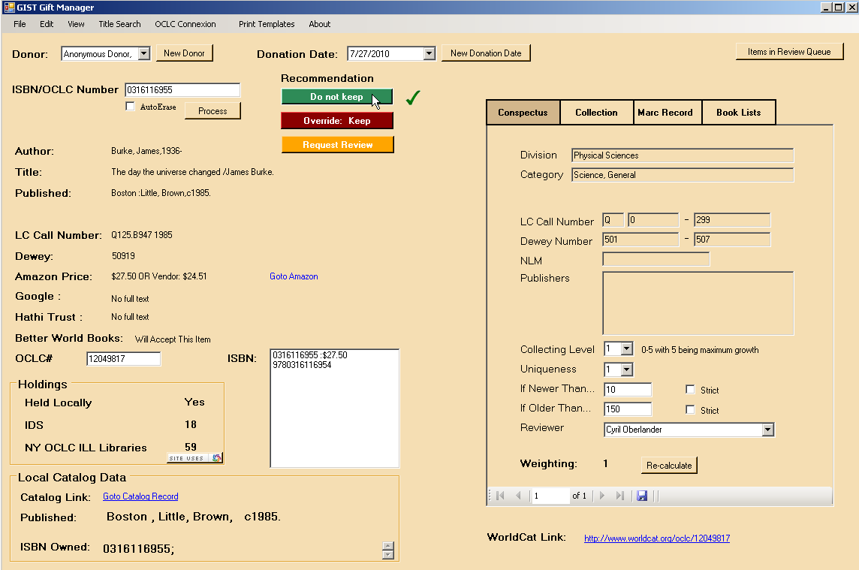
GIST Gift & Deselection Manager
Select Donation Date
Select Donor
Recommendation based on Conspectus and Weighting
Do not keep
Keep
Options: Override and Review
Wand in ISBN, or OCLC#, or do a Title Search for donation
Item Information:
Author, title, series title, imprint, LC Call no. & Dewey
Item Views:
Conspectus (subject analysis)
Collection (donation collection)
MaRC record
Book Lists – awards & custom book list alert service
Item Information:
Amazon Price;
Full-text: Google & Hathi Trust;
Better World Books acceptance of Library discard
Holdings Information:
Held Locally – do you hold work (FRBR-ized)
“IDS” or Group 2 is a configurable set of OCLC symbols like consortia or local area. (FRBR-ized)
“NY OCLC ILL Libraries” or Group 3 is a configurable set of OCLC symbols like a state. (FRBR-ized)
Local Catalog link and imprint to compare editions of gift & holdings.
Worldcat Link to the right
Conspectus View: is your subject and configurable decision weighting tool
Subject analysis matches on LC and Dewey, best matching conspectus values utilized.
Collecting level evaluates item against configurable level of interest in growing the collection in this subject area.
Uniqueness evaluates item against configurable level of interest in duplicating your holdings. (group 2 & 3 holdings matter to weighting, but not uniqueness)
“If Newer Than” limits, by a factor or strictly, by the publication dates of donated works.
“If Older Than” limits, by a factor or strictly, by the publication dates of donated works.
As you process gifts, you can adjust factors and re-caculate the weighting to see the effect on the recommendation.
The navigation bar at the footer allows you to view multiple conspectus values, if applicable.
Notes:
The GDM interface may look complicated initially, but it is designed to make decision making as easy as wanding in an ISBN and letting the system recommend the next step based on your collection building profile. So let’s start by selecting a donor – anonymous may be the most common, if you have a donation box outside.
Then select a donation date – this allows you to continue on yesterday’s boxes delivered in the afternoon for large donations.
Wand in a book’s ISBN, or OCLC#, or do a title search and press Process – GDM calls out to Worldcat API and other APIs to gather all this data for evaluation.
First the Item information, which shows the author, title, series title, imprint, Library of Congress call number and Dewey. Alongside is the price of the book in Amazon, with a link to view more, and full-text indicators at Google Books and Hathi Trust, with a link to view more directly. It also checks Better World Books to see if they will accept this title if you do not. Lastly, an OCLC# and related ISBNs appear.
Below that is the holdings data, the first box comes from OCLC and allows you a FRBR-ized lookup of your holdings, and that of two groups; in our case IDS is the consortia group, and NY OCLC ILL libraries is the state, but defined as those symbols that use OCLC ILL. The next holdings box comes from a lookup of your local catalog, showing a link, and imprint data – to compare editions – sometimes you see the gift is an older edition, sometimes newer. It also shows which ISBN you own.
6. The conspectus view will be covered in more detail in another slide, but it is essentially a collection building profile that matches on the best call number or Dewey classification, using OCLC conspectus, and adds a weighting formula to calculate recommendations to keep or not based on simple values; how much does duplication, publication date, growth in this subject area matter? The Conspectus also provides you with a reviewer component that designates reviewer by subject area.
7. The GDM results and conspectus provide a recommended Keep, do not keep, however, the Request Review allows the person processing these to send the reviewer, assigned to that subject, an email or print a slip to go with the book to the reviewer, to await their decision. Although GDM recommend an action based on your collection building conspectus, you can override the recommendation. Lastly, as you are viewing a wealth of information about this item, you have 4 tabs that provide even more; the collection tab shows what you have been processing for this donor, the MARC record provides a detailed view, and Book Lists are designed to flag important books with a red tab; Book lists are currently configured with Caldecott and Newbery awards, you can add a list of textbooks, professional and society core lists, or wish lists.
0316116955
Conspectus: www.oclc.org/collectionanalysis/support/conspectus.xls

Slide 74
GIST Acquisitions Manager
Purchase Addon
Multiple vendors
Import price from most
Some informational sites such as IMDB
Amazon price in the tab
Acquisitions Addon
Track purchase
Update budget and funds
Linked to Conspectus for collection building information
OCLC Connexion
Search OCLC for record
Add symbol to record
Prepare record for import into your local catalog.
ILL/ACQ Request:
Item too new to borrow?
# of copies in region?
Purchase request?
Conspectus growth area?
Cheaper to buy than borrow?

Slide 76
Import Price
Can be set to push price to MaxCost field or…
to the GIST Acquisitions Tab and tables.

Slide 78
Item Information
Standard request details from Detail Tab
Call number filled in from GIST Web API
Pricing Information
Default values from Amazon and Better World Books
Has place for actual purchase price
Availability
Locally held?
Full text?
Consortial holdings
User Feedback
User data from GIST Web pages
Budget
Fund loaded based on Status and Department of user
Secondary library fund also available
Updates Commitments and Expenditures
Displays money left in account
Vendor Information
Data from the GISTVendor Table
Allows quick access to vendor data for contact and billing
Conspectus
Collection building data
Weighting included consortial holdings calculations

Slide 79
Thank You
For more information, visit: http://idsproject.org/
Or contact Ed Rivenburgh, Director: edr@geneseo.edu or 585-245-5172

