Slide 1




The Information Delivery Services (IDS) Project:
Creating a Highly-effective &
Innovative Resource Sharing System
2008 Innovation
Award Winner
IDSProject.org
40th Annual Colorado Interlibrary Loan Conference April 30, 2009
2009
Notes:
A quick note: All our PP images and notes will be available on the conference section of the IDS Project website—IDSProject.org.
Cyril and I want to thank you for inviting us to speak at this conference today.
The IDS Project was born out of the sheer frustration -- and desperation--of twelve academic library directors at one of our State University of NY (SUNY) conferences. We had been made aware that a several year effort to create a universal borrowing system using Aleph was never going to work.
That night we met at a bar – stayed too long--drank much too much—and admitted to each other that now we faced only 2 choices–- radically change the way we do business with each other or accept that we are going to fail.
All academic library directors live daily with the painful implications of charts such as this one from ARL. (Comment)

Slide 2
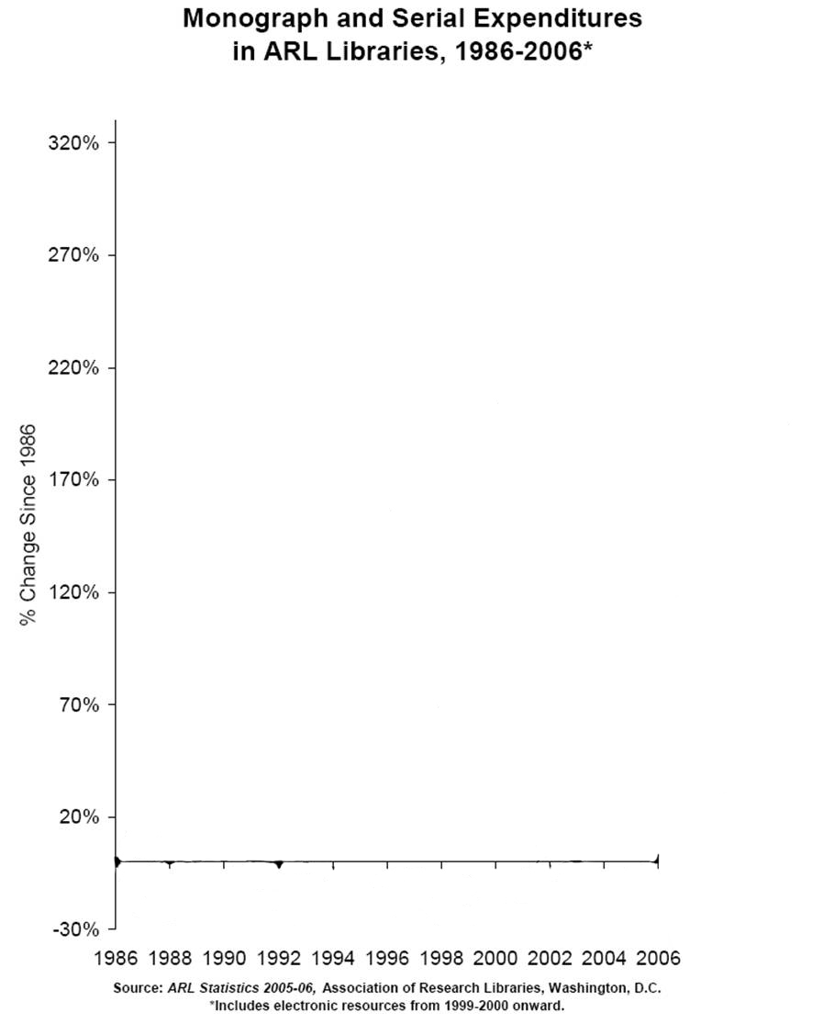

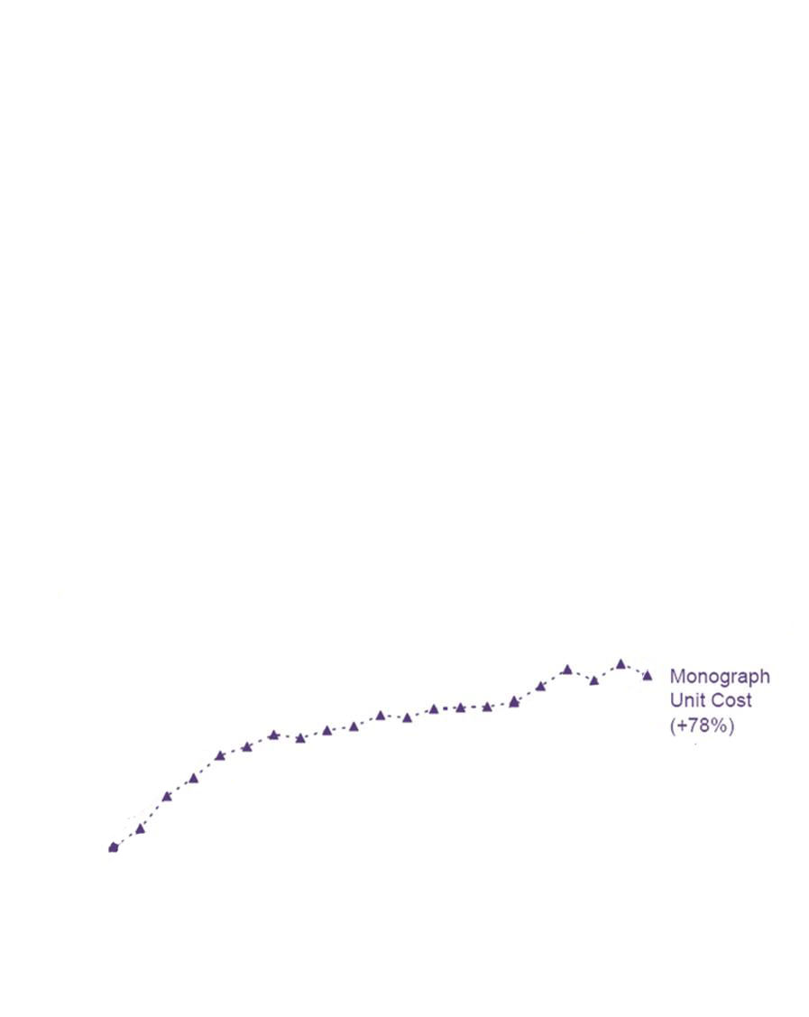
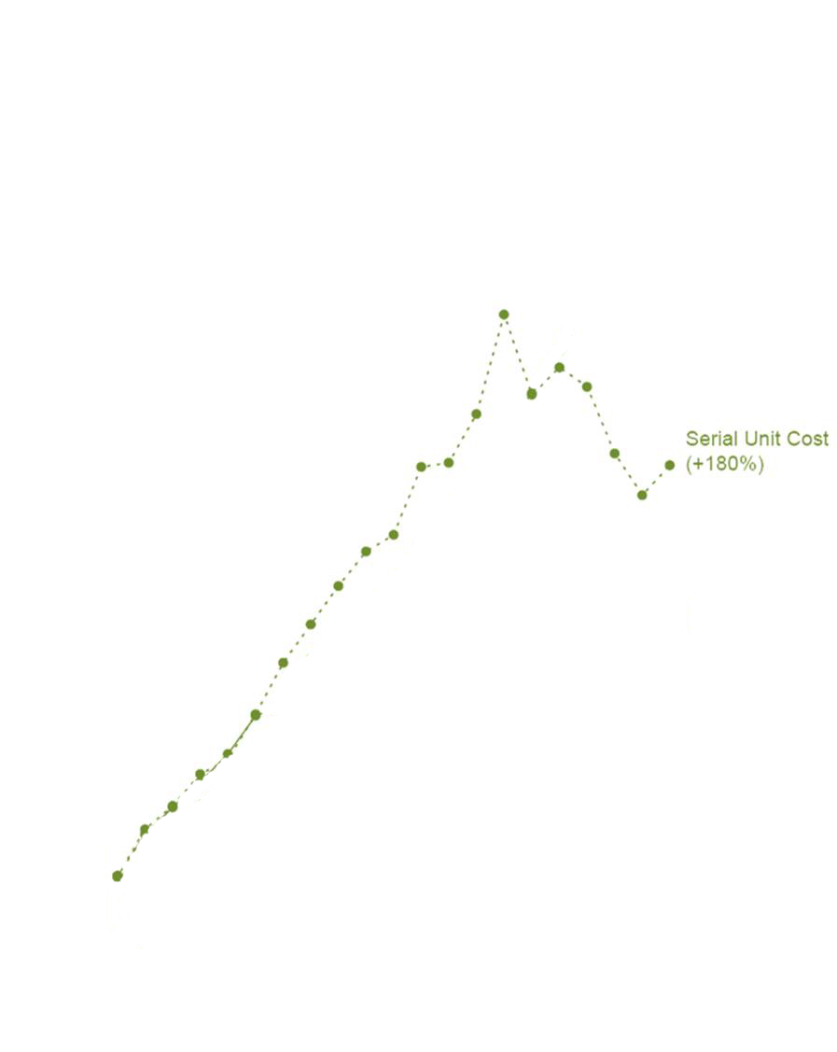
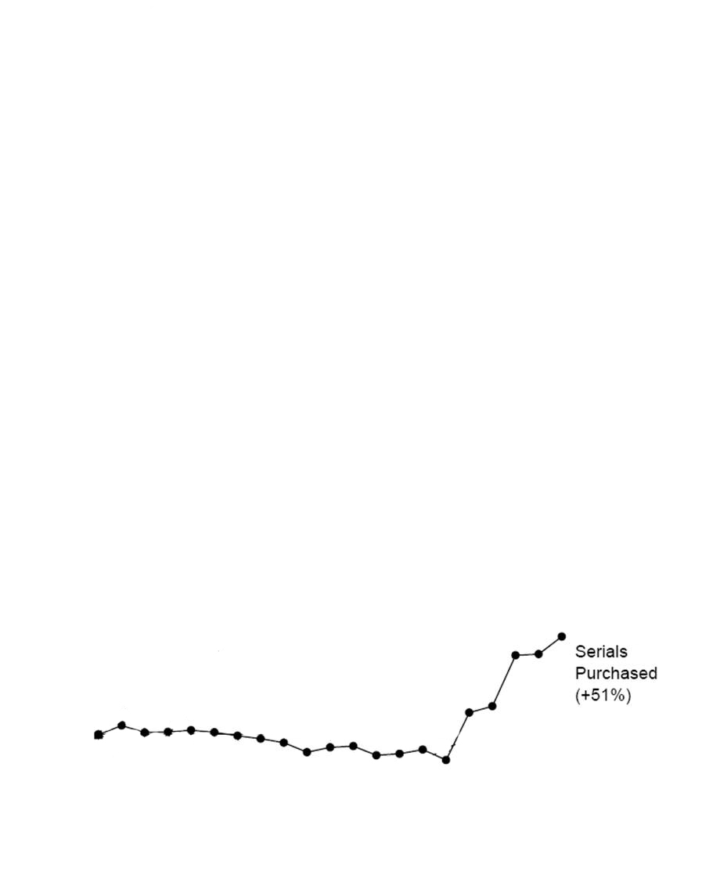
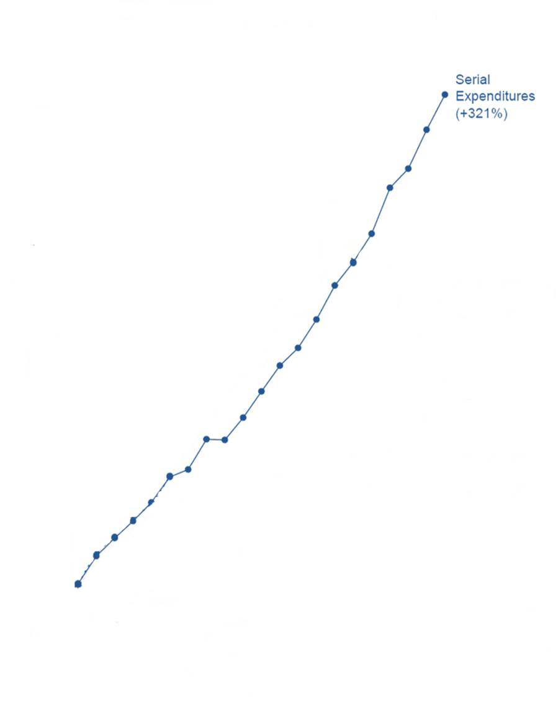
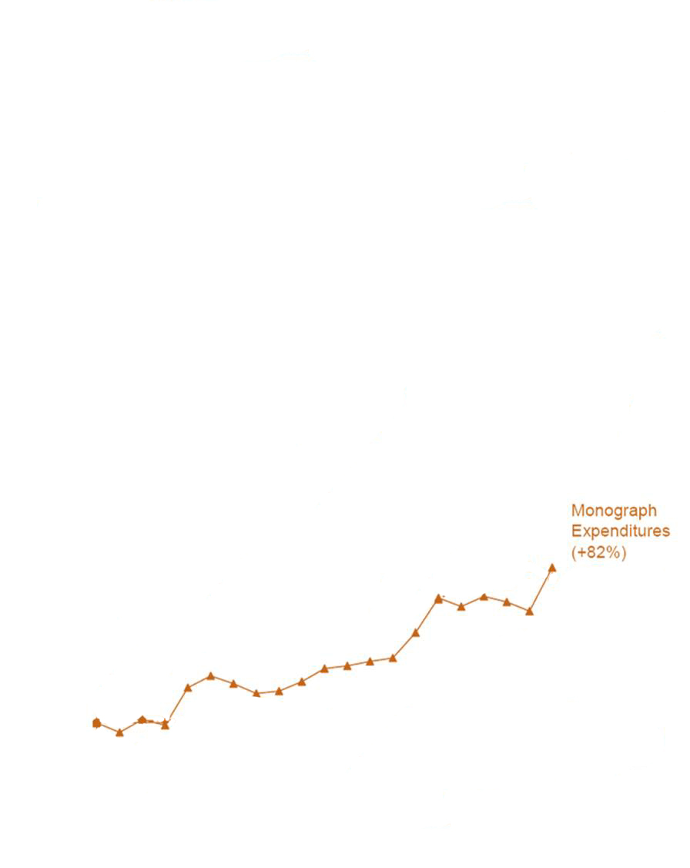
Serial Expenditures (+321%)
Serial Unit Cost (+180%)
Monograph Expenditures (+82%)
Monograph Unit Cost (+78%)
Serials Purchased (+51%)
Monographs Purchased (+1%)
Notes:
Need URL of source - Ed

Slide 3
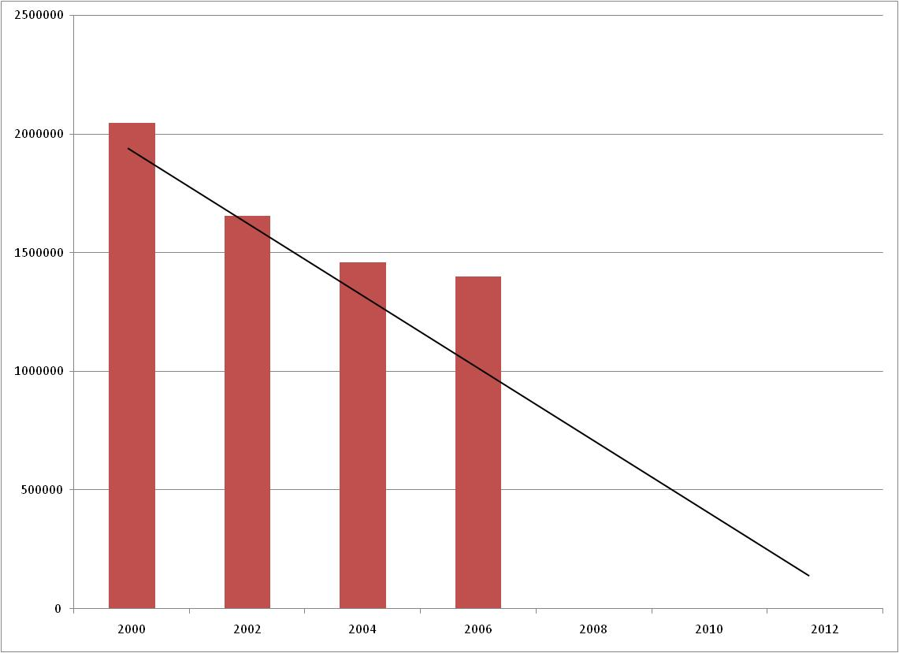
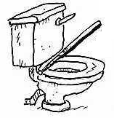
SUNY Arts & Sciences Libraries
Monograph Purchase Comparison
Trends
Notes:
Or this one showing the available funding for monographs for our 12 libraries since 2000.
In addition for years we had faced many heavy pressures on our libraries:
--many more students being enrolled,
--faculty being pushed to conduct more research and secure more grants
--the exponential growth in knowledge
--dramatic curriculum revisions
--distance learning programs
Last month we received notice that because NY State has a multi-billion dollar shortfall this year, our budgets this coming year will be cut an average of 10%.

Slide 4
Problems with “Regular" Interlibrary Loan
Hat-in-hand approach to acquiring needed resources
Fees for loaning materials or they don’t loan at all
Frequently limited staff time is committed to local ILL operations
Borrowing first priority--lending later
Quality of reproduced material uneven
Time of delivery undependable
Offers no guarantees to users
Does not fit undergraduate (or our) last minute research requirements
Information retrieval expectations build around speed of Internet and perceived “abundance of resources.
Notes:
The 12 library directors wondered if there was any way to modify our historic ILL operations to achieve much greater resource sharing among our libraries.
Yet we all had such negative reactions to regular ILL operations.

Slide 5
Contractual performance standards
Rigorous transaction
data analysis at each library leading to informed decision-making
Mutual accountability – “trust but verify”
IDS PROJECT
SUCCESS
Active leadership of library administration
Continuous “real-time” monitoring of project activities & effectiveness at each site
Handle both returnable and non-returnable items
Extensive involvement and training of support staff
Transmitted items
meet requirements for bibliographic
accuracy and high-quality
reproduction
Notes:
So on stained cocktail napkins we sketched out what it would take to implement a truly effective resource sharing system.
This type of radical change would only be successful if the directors took a strong leadership role.
IDS would electronically collect all the needed transaction data and convert it into such simple graphical representations that even directors could understand it’s implications.

Slide 6
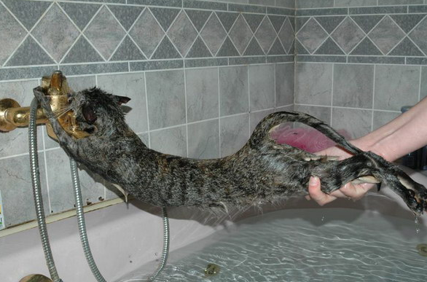
Notes:
What were we thinking?
Let me out of the crazy venture!

Slide 7

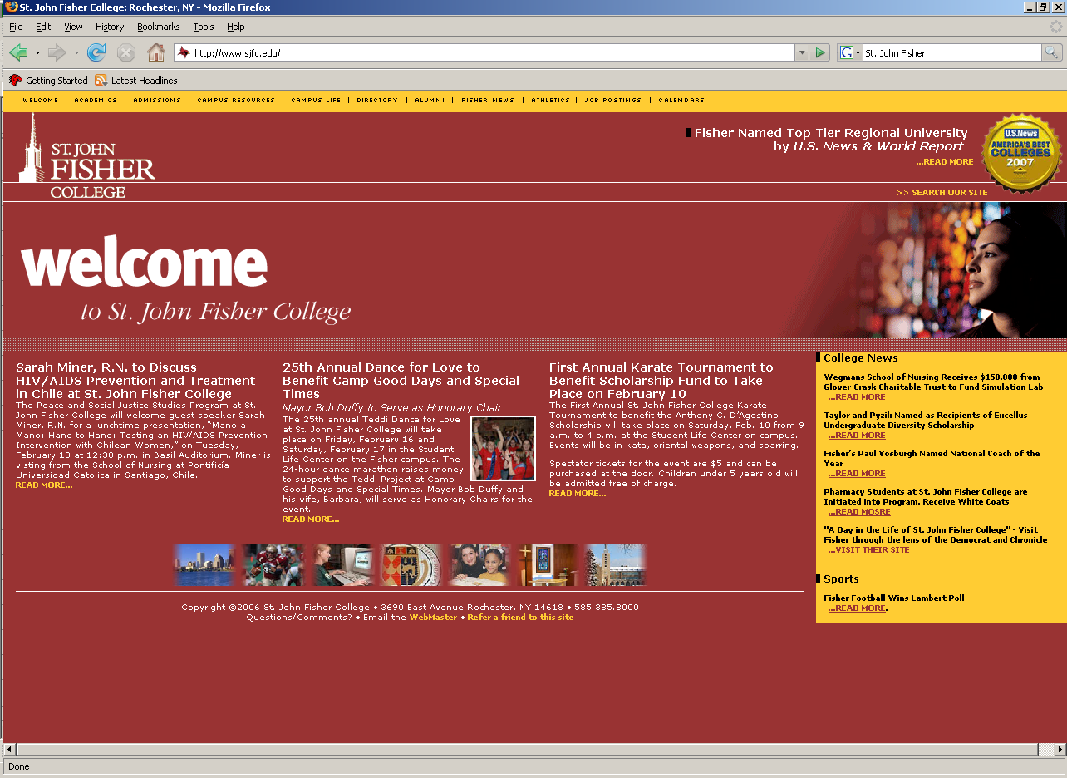



















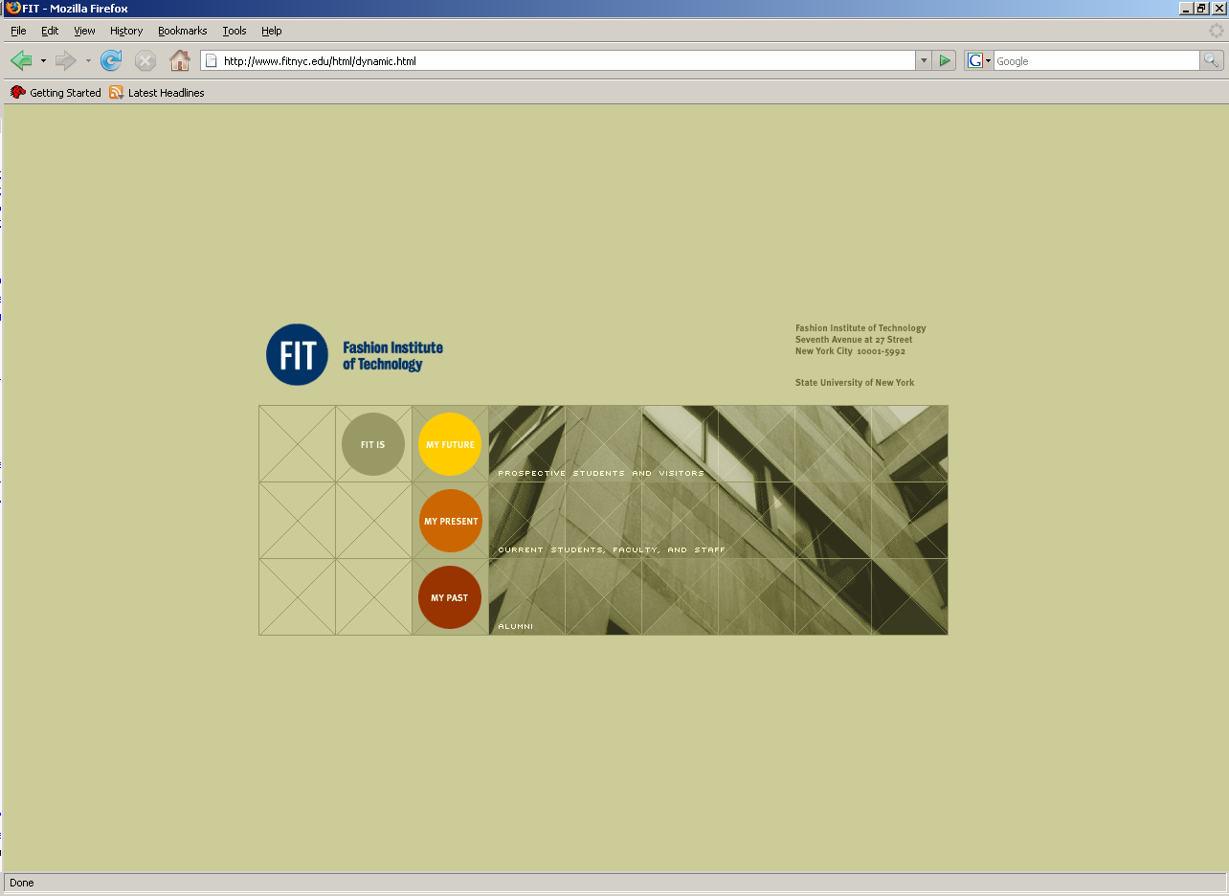
















IDS Project
Spring 2009
Student Head-Count: ~ 210,000
Faculty Head-Count: ~ 13,000
Total Volumes: ~ 35,000,000
CUNY
Notes:
However, 5 years--and thousands of hours of hard work later--we currently have a IDS Project membership of 39 New York State libraries.
Our membership includes over 50 % of SUNY’s 64 colleges —including university centers, comprehensive colleges. community colleges and specialized colleges
IDS membership also includes private colleges, the City University of New York graduate center, the New York State Library and the New York Public Library.
Approximately 35 million volumes
We have 6 to 8 more libraries joining within the next 6 months. How did we do it?

Slide 8
IDS Project Strategy
Emphasis on building “a unified community of trust & support”
Total voluntary participation—annual contract
No startup or annual membership fees
Commitment of talent and time of members
Trained teams of volunteer mentors (applications & technical)
User-centric definition of an ILL transaction
No library-to-library charges
Extensive sharing of eJournals
Very nimble organization—move quickly to seize opportunities
2009
Notes:
Seize opportunities
I need to strongly emphasize—the IDS Project is not fundamentality a technology project.
IDS is focused around the much more difficult challenges of-- human will and organizational change.
We are trying to create a new Resource Sharing Model

Slide 9

IDS PROJECT.ORG
Do we have the individual and collective will to meet today’s users’ demands for information by dramatically transforming the current operations within our individual libraries—and by radically reshaping the historic organizational relationships among our libraries?
2009
9
Notes:
The IDS Project is built around this challenge. To answer this question in the affirmative require that we confront and embrace two very scary ideas:

Slide 10
Scary Ideas
Scary Idea #1
“My Library is Your Library!”
“Your Library is My Library!”
Scary Idea #2
“My Fate is in Your Hands!”
“Your Fate is in My Hands!”
Notes:
Interdependency model:
We were accepting a state of complete interdependency as a strategy.

Slide 11
A unified community of trust and support built around a critical and clearly understood common purpose: effective resource sharing.
2009
11
Notes:
To have any real chance of success we had to build a unified community of trust and support around effective resource sharing.
How did we do this? …

Slide 12
IDS PROJECT.ORG
2009
12
Notes:
One way was building an extensive website.

Slide 13
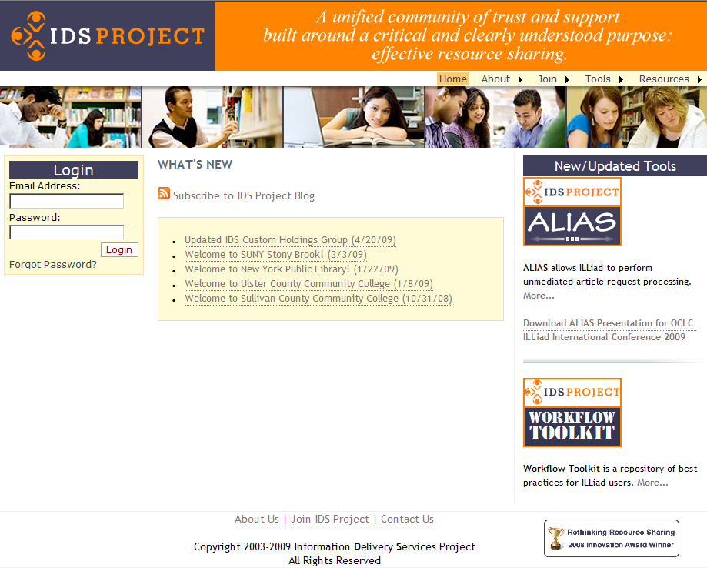
13
Notes:
Public and private pages provide valuable content, resources, and services to member libraries.

Slide 14
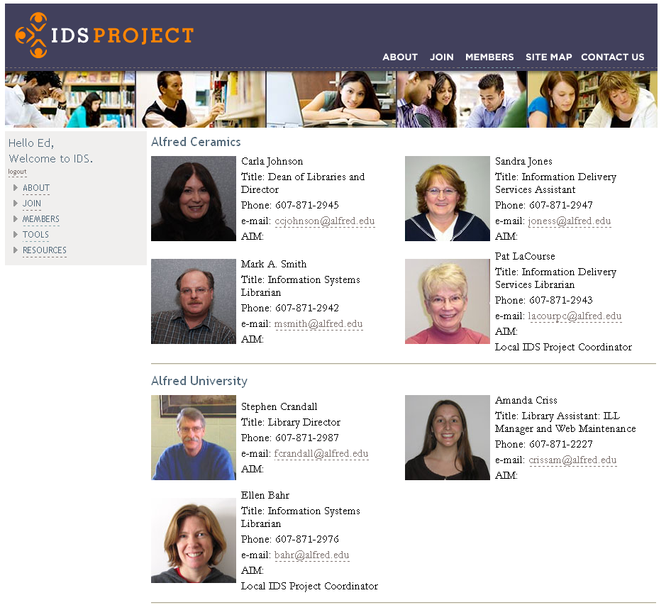
14
Notes:
The members only website includes extensive contact information for member libraries to communicate.

Slide 15
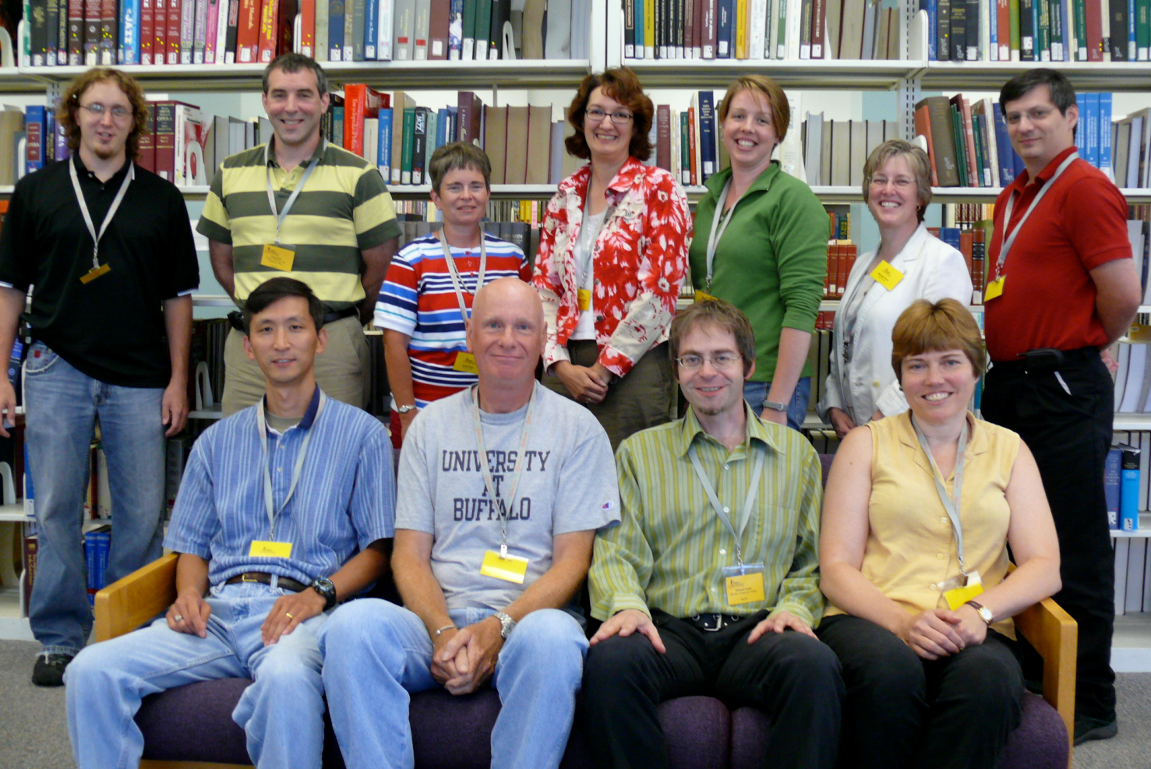
IDS Project Mentors 2009:
Back row (l-r): Adam Traub (St. John Fisher), Gregg Kiehl (Tompkins Cortland CC), Janet Ferry (Fredonia), Christine Sizak (Nazareth), Carrie Eastman (Purchase), Michelle Parry (Oswego), and Mark Sullivan (Geneseo)
Front row (l-r): Corey Ha (Geneseo), Andy Perry (New Paltz), Mike Curtis (Broome CC), and Pam Flinton (Oneonta)
Missing from the picture: Beth Posner (CUNY Graduate Center) and Kevin Reiss (CUNY Graduate Center)
15
Notes:
TRAINED TEAMS of volunteer mentors – applications and technical mentors – this compliment of competencies ensures maximum transfer and exchange of knowledge required to improve resource sharing significantly.
Mentor teams visit libraries – to help with ILLiad post-installation workflow training, implementing various IDS workflow and resources, as well as troubleshooting various technical issues that library staff want to address.

Slide 16

Welcome!
To The Sixth Annual
Information Delivery
Services (IDS)
Summer Conference!
Oswego, NY
August 4-5, 2009
Notes:
IDS Project offers member and even guests, high quality and very inexpensive two day summer conference.

Slide 17
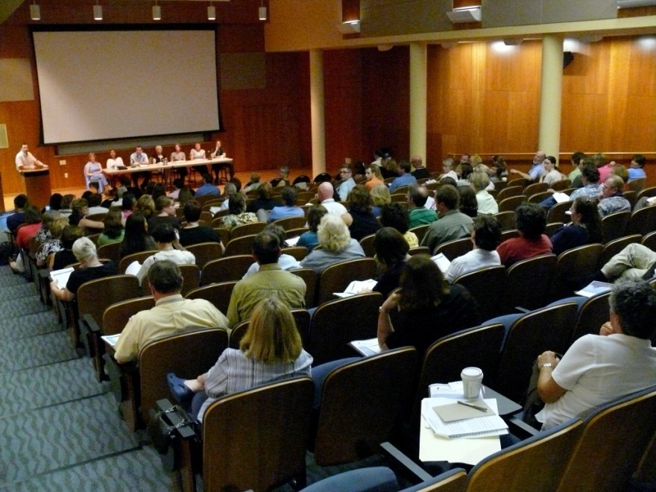
Notes:
An example of the all member conference programs

Slide 18
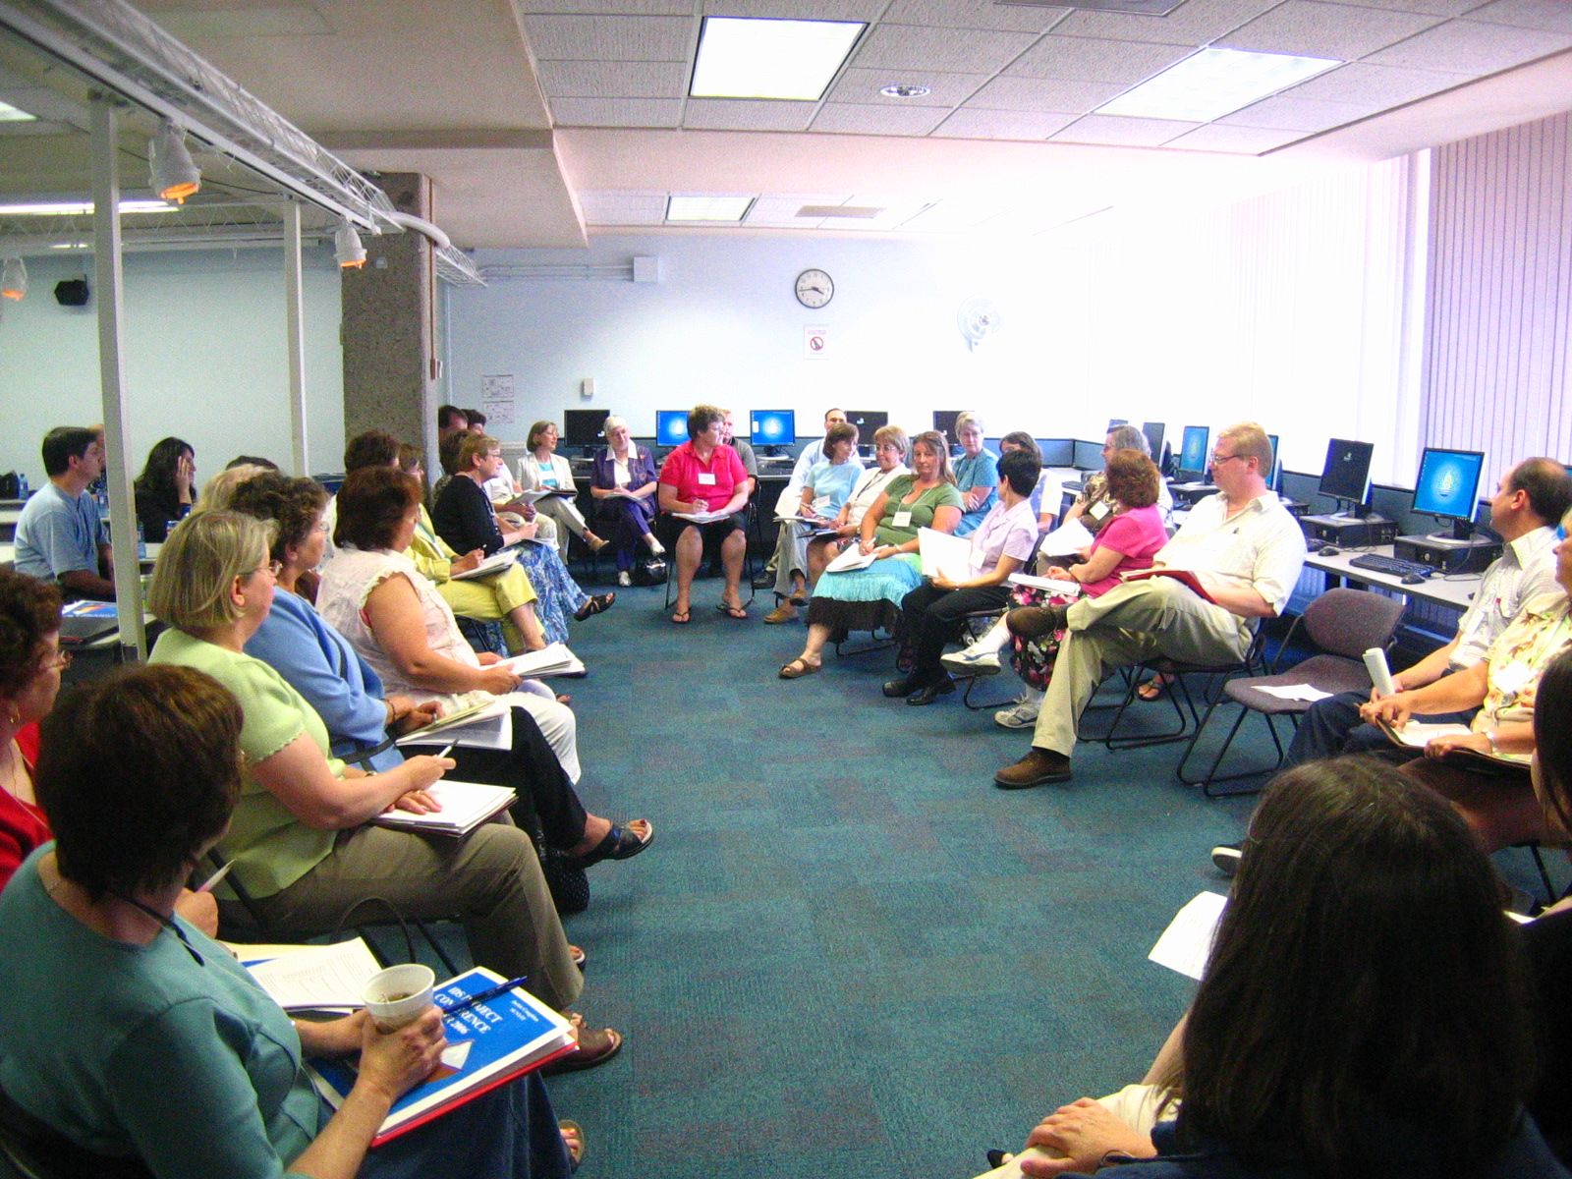
Notes:
Example of resource sharing practitioners meeting to discuss workflow and share best practices.

Slide 19
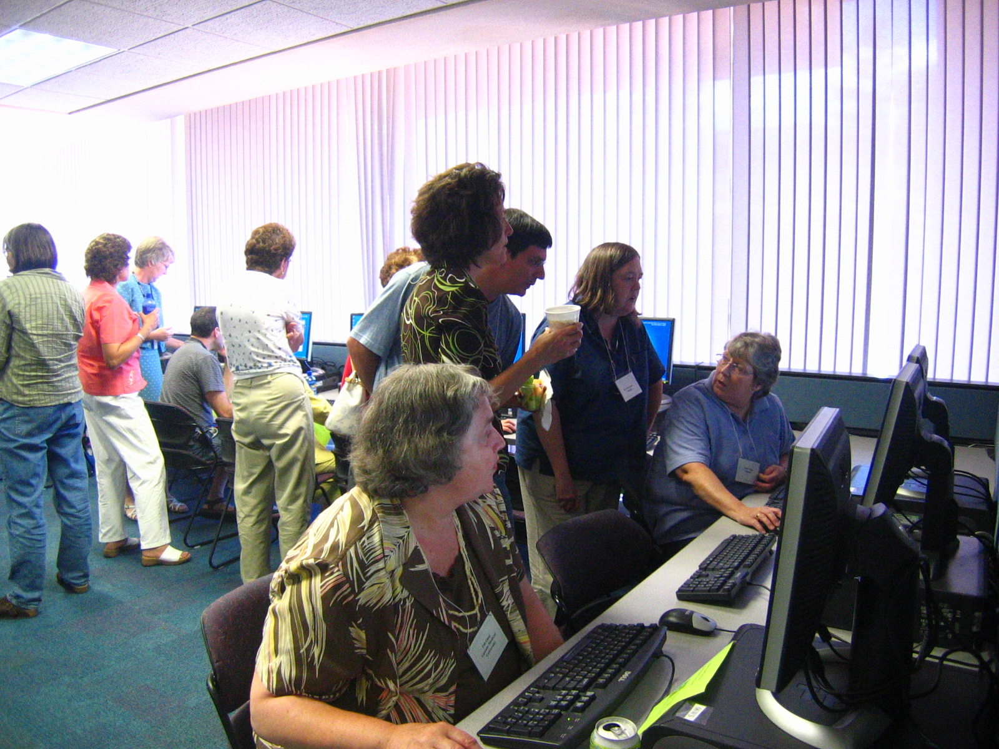
Notes:
Hands-on-training at the conference, this summer Atlas staff and our mentors will provide ILLiad 8 training.

Slide 20

Notes:
xxxx

Slide 21
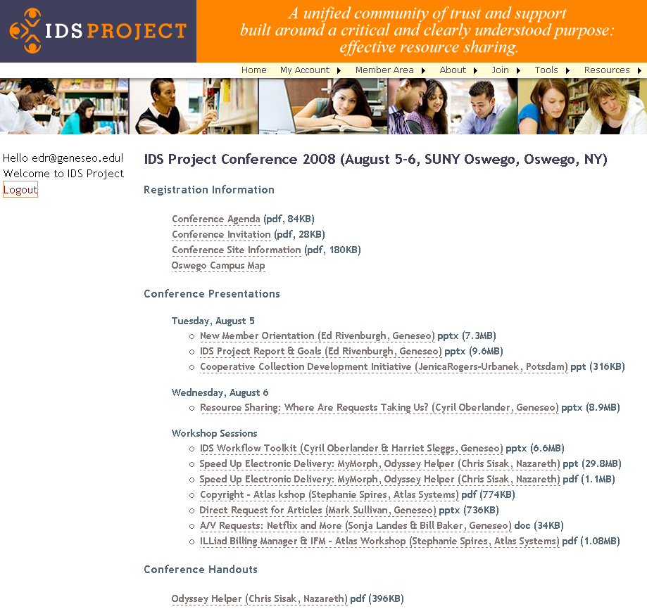
21
Notes:
All conference program presentations, evaluations, etc. are available on the public side of our website, in case you are interested.

Slide 22
User-centric Definition of IDS Transaction
From the time the user places a request until the time the user is notified the loan is ready for pickup or the article is ready to be retrieved from the Web
2009
Notes:
Another part of the project’s strategy was to define how we would measure the turnaround time of an ILL transaction.
We didn’t expect this seemingly common sense definition became a controversial issue for the project.
Parenthetically, the other major controversy that quickly erupted was providing total transparency to ILL processes that before were completely hidden within individual library operations.
It appeared that the capacity to finally do real library science--despite the name on our degrees--was not as welcomed as we expected.

Slide 23
Adherence to contractual performance standards
Articles: 48 hours
Loans: 72 hours
(Weekends and Holidays Excluded)
2009
23
Notes:
These are the IDS Project benchmarks for resource sharing.

Slide 24

SQL
Server
SQL
Server
SQL
Server
SQL
Server
SQL
Server
SQL
Server
SQL
Server
SQL
Server
SQL
Server
SQL
Server
SQL
Server
SQL
Server
SQL
Server
SQL
Server
SQL
Server
SQL
Server
SQL
Server
SQL
Server
SQL
Server
IDS Project
Web Server
Atlas Systems
SQL
Server
Web
Browser
SQL
Server
SQL
Server
SQL
Server
SQL
Server
SQL
Server
SQL
Server
SQL
Server
SQL
Server
SQL
Server
SQL
Server
SQL
Server
SQL
Server
SQL
Server
SQL
Server
SQL
Server
SQL
Server
SQL
Server
SQL
Server
SQL
Server
SQL
Server
Notes:
But how do we actually collect the data?
Real time SQL queries into member ILLiad libraries with a web interface at IDS Project.org

Slide 25
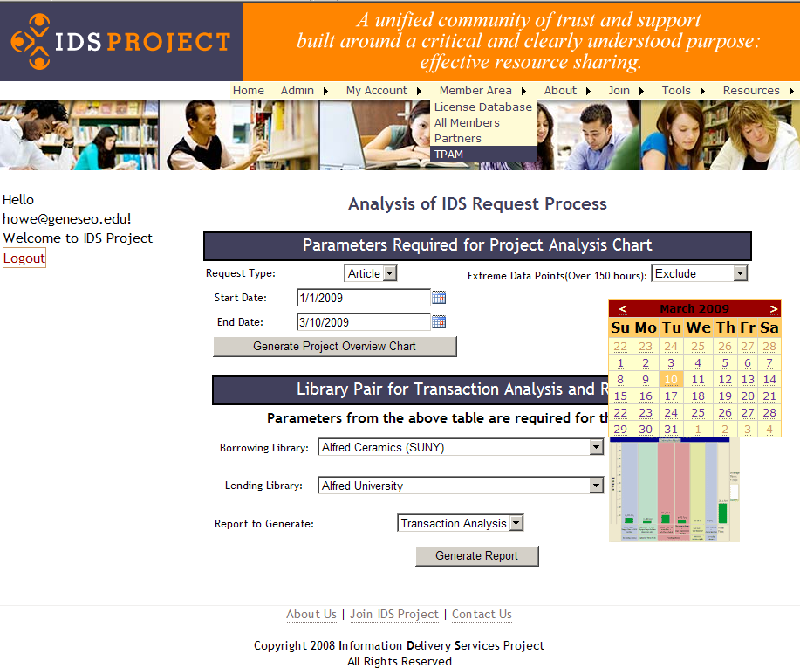
25
Notes:
The tool is named Transaction Performance Analysis Module—”TPAM”
Span of time is totally adjustable– a month, a semester-two years.
Handout: http://idsproject.org/Tools/TPAM.aspx

Slide 26
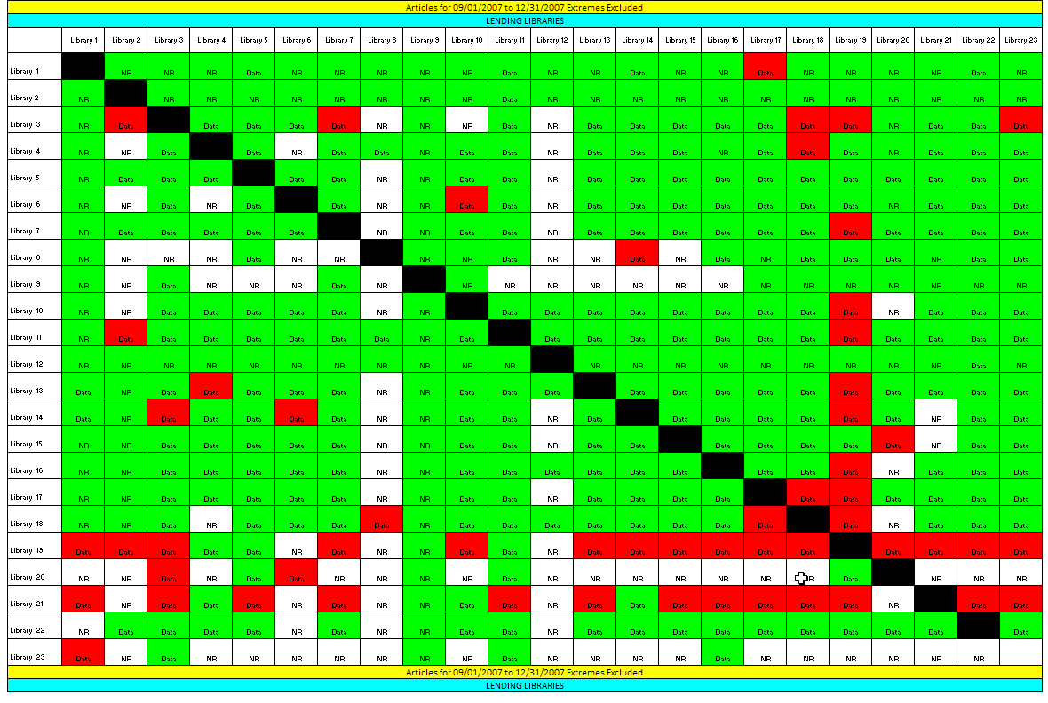
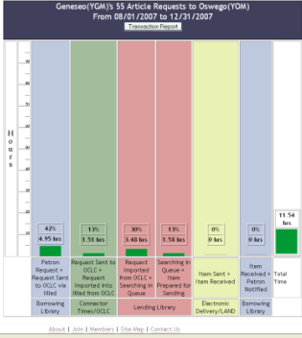
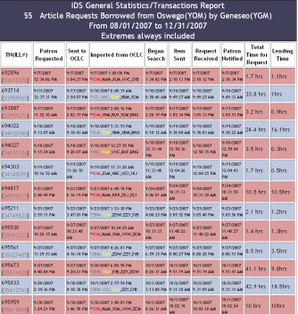
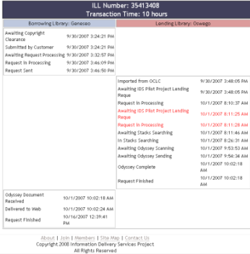
IDS Transaction Performance Analysis Module (TPAM)
2009
26
Notes:
Hierarchically linked charts

Slide 27
Project Overview Chart
Borrowing Library : 10
Lending Library: 13
18.1 hours for 5 Article(s)
Notes:
Green– AVERAGE total transaction time meeting performance standards
Tremendous real time overall ILL transactions system monitoring capacity

Slide 28
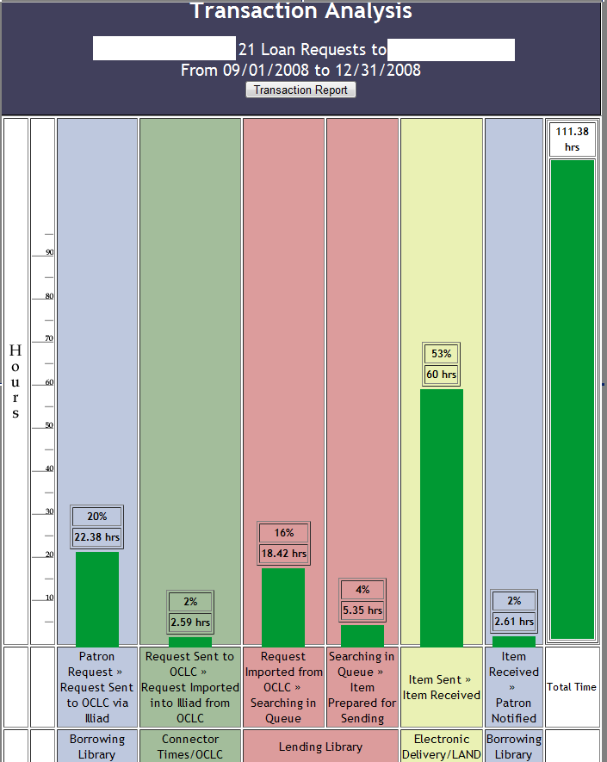
Notes:
The average process times within a lending borrowing transactions between 2 libraries are graphically represented in easy to use charts.

Slide 29
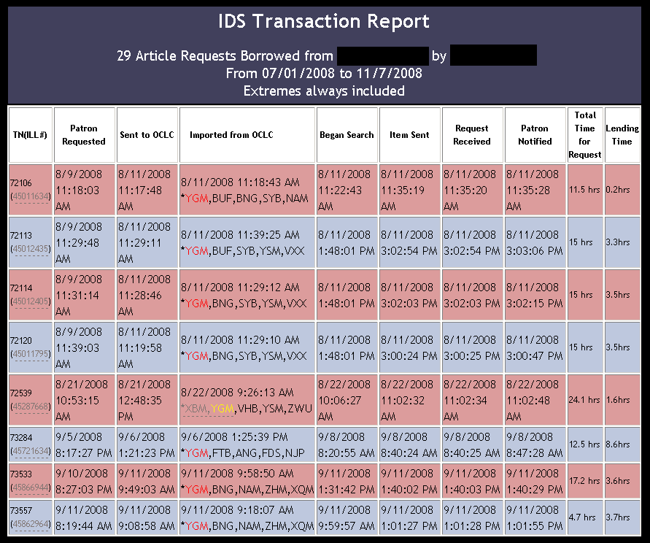
Library 1
Library 2
Notes:
For more details, you can see each request, and for a specific request, you only need to click on the individual ILL transaction number.
Notice that the lender string is also shown, depicting which lender filled the request.
Click on individual ILL transaction number

Slide 30
Tracking History
Notes:
Unique and important view two-way perspective of each ILL transaction. No other system looks across the entire process with such detail and ease.

Slide 31
Library staff allocation and responsibilities – cross training
Work flow modifications
Staffing schedules
Odyssey Trusted Sender
31
2009
Notes:
Some improvements and changes made after analyzing the process and transaction data from TPAM.

Slide 32
Outcomes
2009
Notes:
APRIL 2009 Total ~252,000

Slide 33
Fall 2008
Request Type | % filled within the Project
Loans | 49%
Articles | 48%
2009
33
Notes:
We believe by next year we will achieve a 65 % fill rate.

Slide 34
Notes:
Speed of delivery – how did we do matching our benchmarks?

Slide 35
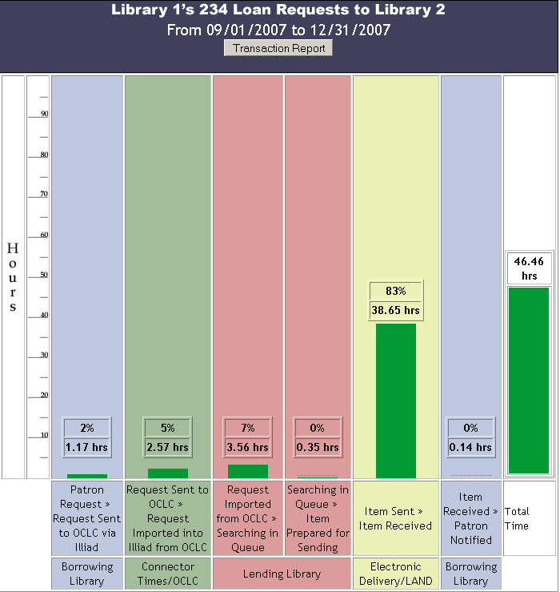
Notes:
Evidence of high quality performance on the average of over 200 loan transactions.

Slide 36
Notes:
Articles – note that almost 50% of articles are delivered within 24 hours.

Slide 37
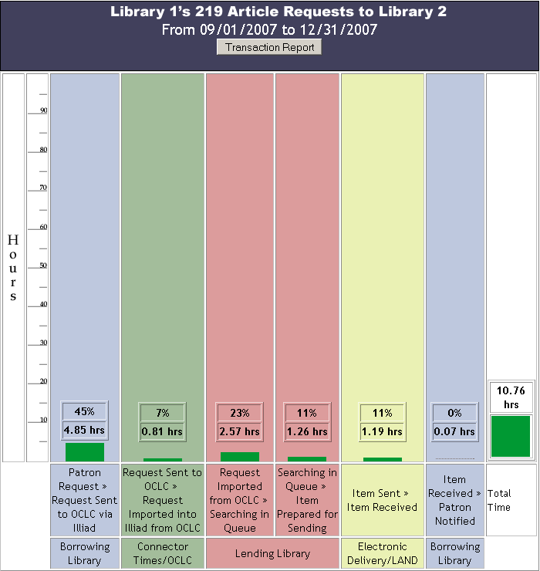
Notes:
This is excellent performance with articles, and later, when we talk about ALIAS, you will see that even this time can be improved for filling articles almost immediately.

Slide 38
KUDZU/IDS Pilot Project Participants
1. Clemson University
2. Mississippi State University
3. University of Alabama at Birmingham
4. University of Kentucky
5. University of Mississippi
6. University of North Carolina at Charlotte
7. University of North Carolina at Greensboro
8. University of Tennessee
9. Vanderbilt University
10. Wake Forest University
11. University of Central Florida (ASERL)
12. University of South Florida (ASERL)
2009
Notes:
IDS Project is interested in working with other library networks, currently, we are working with Kudzu and ASERL libraries – who are testing the use of TPAM. Each new group brings the potential for new partnerships, and sharing best practices, innovative designs, etc.
Shareback concept.
We are feeling pretty satisfied about these components of the IDS Project, but we still have major challenges to overcome.

Slide 39
Fill Rate Analysis
Article Fill Rate 33%
Fall 2004
Notes:
2004 – soon after the Project started, we looked at some of the new benchmarks and statistics, for articles we found it interesting that the group didn’t appear to fill as many requests as we thought possible – as you can imagine, the data left us questioning – we must have more journals than that…
As you might have guessed, the problem was that electronic journals are not as discoverable in OCLC ILL workflow practices – and because libraries have many more electronic titles than print (Oswego for example has 300 print journal titles, and 35K ejournal titles) ILL focuses on the print serial holdings records, electronic holdings records services incomplete, and without licensing terms, using electronic articles are problematic.
The problem isn’t local - this is one of the most critical problems with sharing articles.
By looking more closely at the data, we found that had we discovered the ejournal titles with permissions…

Slide 40
Potential Fill Rate – if eSerials discovered
Electronic Articles Could Increase
Fill Rate up to 66%
Fall 2004
Notes:
Our fill rate could have doubled – this is significant, because it means that we were not making the best use of our consortia, and in order to improve this situation,
the IDS Project team decided to tackle this problem with a locally developed generic rights management tool and a discovery tool called the eJournal Availability Service.

Slide 41

Generic License Management
Generic License Management
TARGETS | URL | License | Date Checked | Checked by | Comments
INSTITUTE OF PHYSICS JOURNALS | http://www.iop.org/EJ/librarians/-page= librarians/0031-9120/1#print | P | 2/28/2007 | Tiede | Under “librarians” page
Search for
Provider
in a
Search Engine
Enter
Information
in Database
Yes, No,
Silent, etc.
This License
is Paper
Copy Only
1.
3.
2.
http://www.iop.org/EJ/librarians/-page=librarians/0031-9120/1#print
Q. What about interlibrary loans?
  A. Institutions October use hard copies derived directly or indirectly from the electronic edition of the publications for the purpose of inter-library loan with the same limitations that apply to paper copies for that purpose made from the print edition of the journals. Specifically, copies must be made in compliance with Section 108 of the Copyright Act of the USA and Technological Uses of Copyrighted Works (CONTU Guidelines), the text of which is available as part of USA Copyright Office Circular 21. The electronic transmission of copies of articles for inter-library loan purposes is not allowed.
Record
response
in database
Can’t find?
4.
2009
41
publisher
Notes:
Generic License Management is a unique approach developed by the IDS Project. Instead of using a local electronic rights management that essentially provides an empty database that you must add all the fields from individual contracts…
The IDS Project took a very innovative approach and created a generic licensing management database that looked at the public policies declared by publishers, providers, and other targets. This approach assume that libraries would never restrict their use more than what the publisher publicly proclaims your rights are with their content.
The generic license management system is updated annually, initially by librarians at Geneseo, but this year we successfully added volunteer librarians from other libraries in the project. These librarians check the publisher or providers website from a database of targets, they add the URL for the website and determine the license attributes according to a set of standards emerging from the Digital Library Federation – ERMI. Whenever there are no public license terms, the librarians will send an email to the publisher/provider asking them for the rights – and often will get them. The surprising results are…

Slide 42
ILL Rights
2,107 Targets = Aggregators, providers, & publishers for over 93K journal titles
2009
42
Notes:
Most publishers, aggregators, and providers allow ILL rights,
In our latest annual review of all licenses, only 12.2% denied ILL use.
So the generic rights management is only half the solution, the other piece is the need to make holdings and permissions discoverable in the ILL workflow.

Slide 43
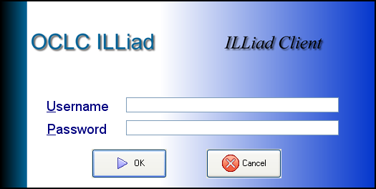
eJournal Availability Service
IDS Project eJournal Availability Service (aka ALIAS)
IDS eJournal Availability Service
Z39.50 catalog displays ILL availability
Title, Year, Volume, Issue, License
Database of eJournals held by IDS Project libraries
Licensing Database
OpenURL
Resolvers
Notes:
Our first eJournal Database was a simple web interface that queried multiple library openURL resolvers, however, to better integrate the discovery in the ILL workflow, we developed the eJournal Availability Service which is a Z39.50 catalog using Zebra index that could be searched from ILLiad’s Z39.50 catalog utility.
The eJournal Availability Service combines holdings data gathered from openurl resolvers – we want to thank Serials Solutions for making that easier with group reports, the data is normalized with licensing data and includes print holdings, where libraries add print holdings to their serials solutions.
So what does this all do…

Slide 44
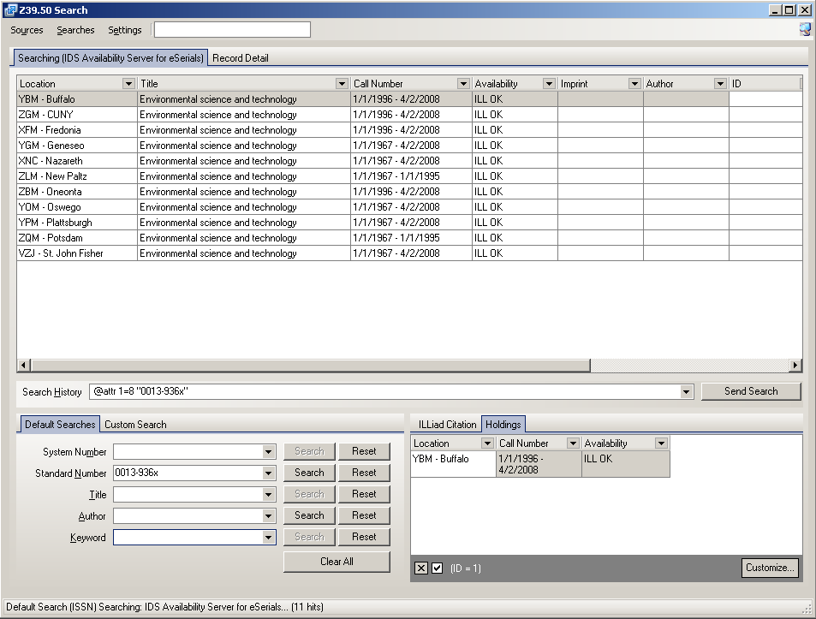
Discovery in ILL – Eureka ! but…
Which Library has it
Year & ILL Permissions
Notes:
In the mediated client side of ILL borrowing, ILLiad’s Z39.50 client can now initiate an ISSN or title search and provide the following results great to see OCLC symbol, years covered and ILL terms. The lending side could now quickly determine ILL rights for titles they received borrowing requests for.
The Eureka is that we now could discover holdings and terms of use, the remaining problem was the workflow was mediated and meant hand keying in 5 OCLC symbols from this list – who likes remembering 5 OCLC symbols each request?

Slide 45
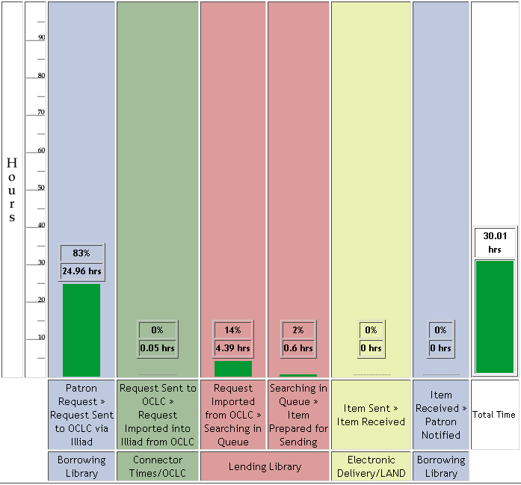
Unmediated requesting eliminates 1 day delay
Pre-ALIAS Article Borrowing
25 hours (avg.) before requests sent to Lending Library
Total turnaround time: 30 hours (avg.)
ALIAS can reduce that to: just 5 hours…
http://www.atlas-sys.com/company/newsletter/archive/OracleNewsletterWinter2009.pdf
Notes:
The much needed improvement was to reduce the processing time that articles took on the borrowing side – we wanted direct request for articles, and this Transaction Performance Analysis Module shows the average times for ILL pre-processing was well worth our time to unmediate requesting.
This project was called ALIAS – Article Licensing Information Availability Service. As you will see, we are big on acronyms.

Slide 46
Article Licensing Information Availability Service (ALIAS)
Partnering with Atlas Systems, Inc.
Patron Request
IDS Service
Query ISSN, date
ILLIAD
ALIAS: Licensing Database
Awaiting Request Processing – Manual Process
Article Direct Request – Automatic Process
Library Codes for valid dates and licenses
Request Sent to OCLC
Local Holdings Queue
Notes:
We partnered with Atlas Systems to enhance the ejournal availability service with much needed automation.
Outline process
The IDS Service was developed by wonderful Atlas Staff to help us accomplish what we set out to do.
The IDS Service runs every 60 sec. automating the requesting process and discovery of materials we own – yes, even with open URL resolvers, we still get 10% requests for materials we own. At our request, Atlas solved another big problem with traditional ILL process – the problem of load leveling…

Slide 47
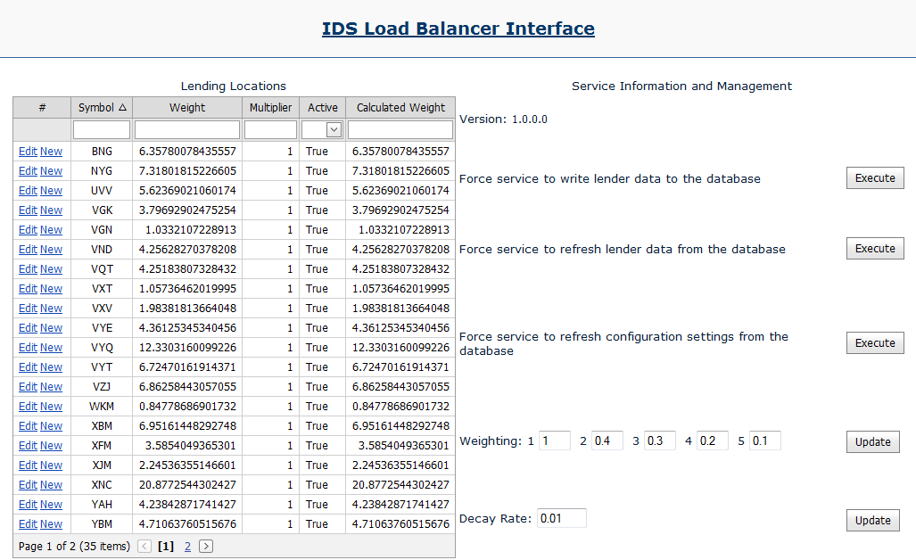
Configurable Load Leveling
Atlas Systems, Inc.
Atlas solves Load Balancing
Notes:
Dustin and Curtis, Atlas Staff, developed a load balancer, the configuration interface enables a custom multiplier that is relative to the number of requests the service has sent that library, an active status, and a decay rate.
-The multiplier allows us to customize the number of requests that libraries should receive in comparison to other libraries. For instance, a larger library can be weighted higher than a smaller library, thus routing more requests to them.
-Active allows us to disable libraries from being returned by the load balancer.
-The decay rate ensures that if a library suddenly receives a high demand for something that only they own, it will eventually be routed more requests.

Slide 48
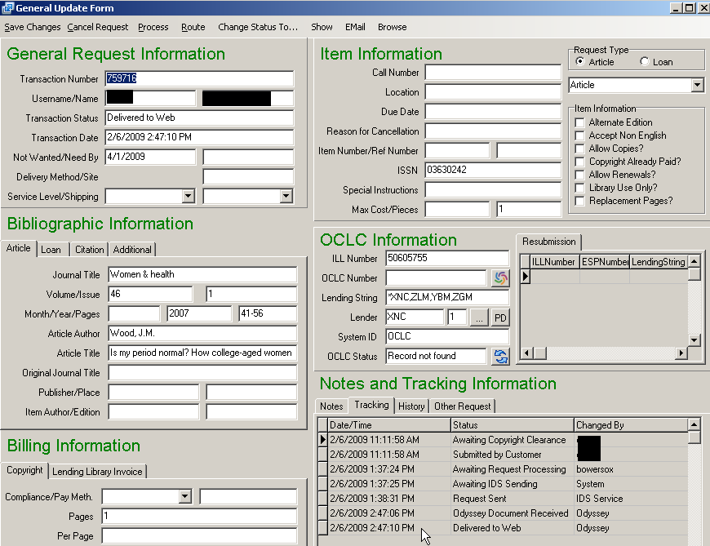
Tracking example of successful transaction in ILLiad Client
Success
Sent to Request Sent in 1 minute & filled in 3 ½ hours
(after copyright clearance)
Notes:
Now that you have a better idea of the IDS Service and ALIAS, we want to show you the results. Here is a tracking example of a successful transaction as seen from the ILLiad client.
Note that the query service and sending it through direct request takes a total of 1 minute, and in this case, the request is filled within 3 ½ hours from when the user submitted the request.

Slide 49
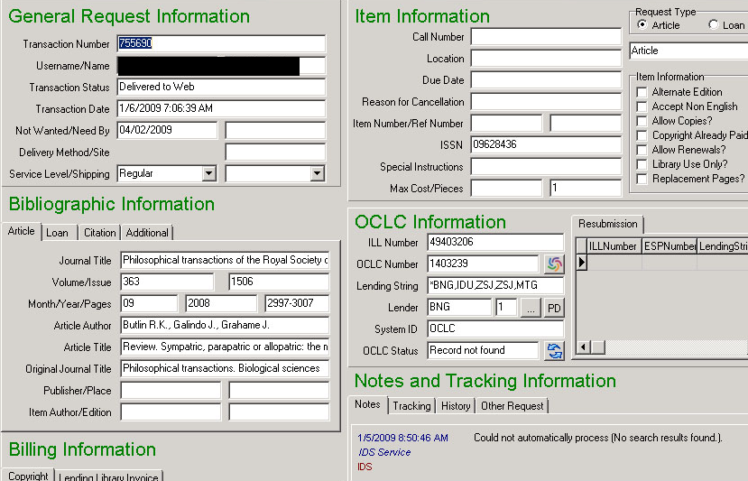
Tracking example if unable to process w/ ALIAS in ILLiad Client
ALIAS tries, but no match
Notes about no ISSN match, etc.
Notes:
If a request is unable to process within ALIAS, maybe there is no matching ISSN or title in the eJournal holdings service, then that means the request moves to Awaiting Request Processing – ready for the mediated process.
However, added to the Notes is an explanation of why the service could not process this.
Again, note that if the item is held locally, either in print or electronic, the request will not be sent.

Slide 50
ALIAS Article Direct Request & Odyssey Trusted Sender
  Look – no hands
Patron Request
The patron receives the requested article within a few hours…
Borrowing Library
The borrowing library never touches the request…
The lending library downloads from eJournal and sends through Odyssey. The staff never photocopies or goes to the stacks…
Lending Library
Notes:
Now, the borrowing library staff often never handle article requests because ALIAS provides the discovery and requesting work, while Odyssey trusted sender provides the receiving and notifying work.
Why is this so important?
Saves at least 11-24 hours of average processing time.

Slide 51
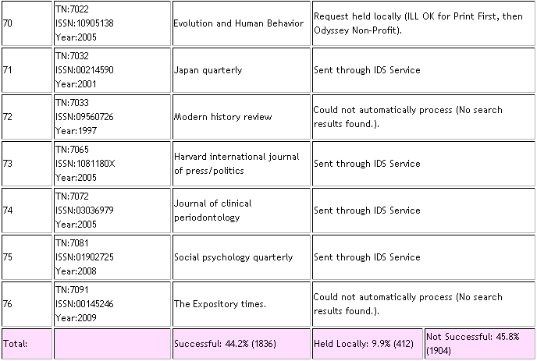
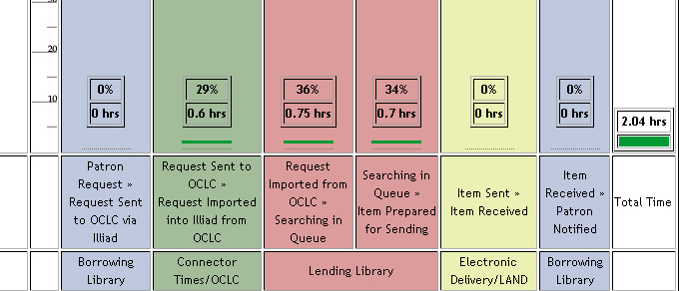
Results so far
Results: 50% unmediated
& 2.04 hours avg. turnaround time
Notes:
Highlight the numbers
50% of the article requests are now processed through ALIAS with significant reduction in the turnaround time between when a user places the request, and when they can pick it up.
ALIAS is currently in the final phases of beta testing among IDS mentor libraries, with plans of complete roll out to IDS Project Libraries in May 2009. What next gets more interesting…

Slide 52
Future of ALIAS
OCLC, Atlas & IDS Project
Problem Statement
The main problem is that ILL community (OCLC WRS/ILLiad) workflow lacks essential tools for effective article requests, i.e.:
Direct Request for Articles
Discovery of libraries actual journal holdings (and provisions);
  license terms are local, except for libraries adding ILLOK to summary holdings (LHR)
  library holdings in print, microform, and electronic are not FRBR-ized, so borrowing libraries lack the tools they need for efficient article resource sharing.
Solution
Develop the IDS Service like service in partnership with Atlas & OCLC as a service that can be utilized by WRS & ILLiad libraries.
Explore adding local ERM functionality to the generic ERM service.
Notes:
We realize that while its great to have this type of functionality within the IDS Project, the scale of solution needed for resource sharing within larger networks will provide the necessary effectiveness needed for interlibrary loan.
However, replication of our current model only adds to the problem at hand, we live in a very fractured environment that doesn’t lend itself easily to solving the need for an intelligent direct request for articles at a large scale. Discovery should be so easy that a computer can and will do this so we can move to other problems that warrant our attention. Discovery among and across groups and individual libraries has always been the key to success for libraries successfully sharing resources.
That is why in order to meet the needs of many other libraries, the IDS Project in conjunction with Atlas Systems, Inc., is helping OCLC develop a similar service to unmediate the discovery and requesting of articles among libraries. While the details of the solution are still being determined, we can share that the expectation is that by January 2010, a prototype will be available for free to libraries using Worldcat Resource Sharing and ILLiad.

Slide 53
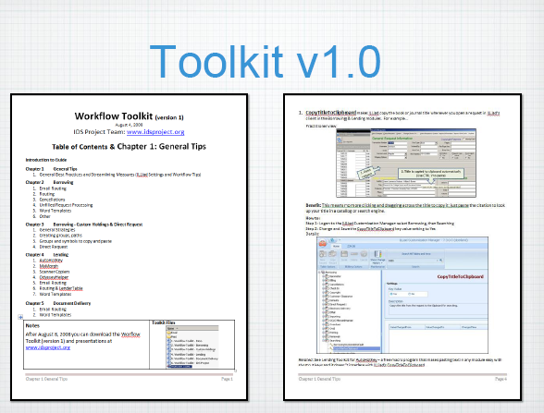
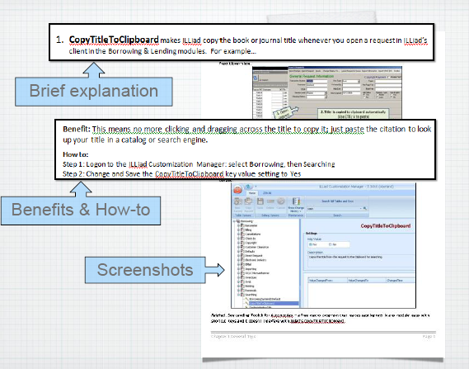
Workflow Toolkit
Notes:
In the last 10 years, we have seen ILL technologies radically evolve, in fact, we often focus on the technology, however, one of the most important factors in our success, is our community. Our willingness to share resources is fantastically successful, to extend that effectiveness, we must also find ways to better share best practices and tips for getting the best use of these technologies.
Everyone know ShareILL? http://www.shareill.org/index.php/Main_Page
That is a wonderful source of information – we need tools like these to share specific and procedural tips for resource sharing.
While at Portland State University, I organized an ILLiad users group meeting as one method to help me and colleagues with figuring out ILLiad. From that experience, visiting numerous libraries, and seeing the need for practical workflow specific documentation for the IDS Project mentors, the IDS Project team created the workflow toolkit. CLICK In August 2008, we released 5 chapters of over 100 tips and best practices for using ILLiad, OCLC custom holdings, and Direct Request. It was a widely distributed and used by ILLiad libraries.

Slide 54
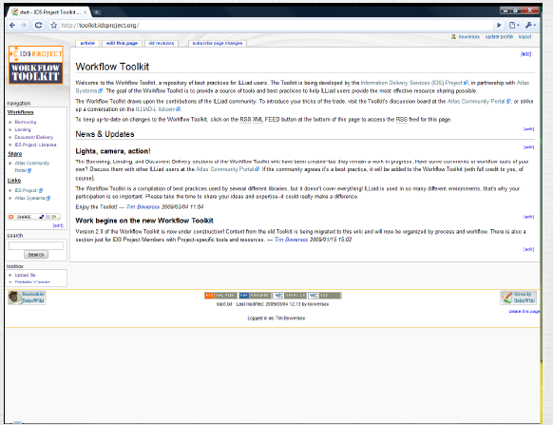
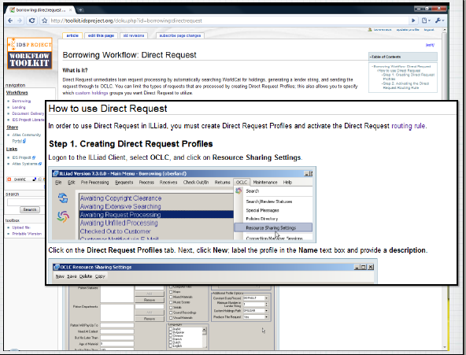
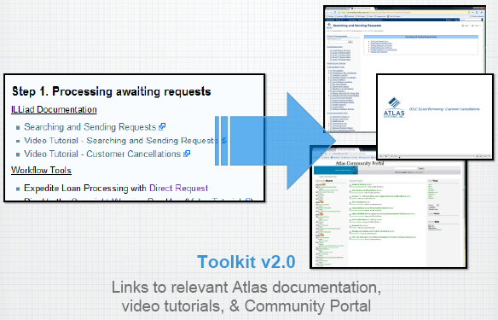
Workflow Toolkit version 2 http://toolkit.idsproject.org/
Notes:
Tim Bowersox, our IDS Librarian at Geneseo recently converted the Workflow Toolkit from a downloadable word based tool, into an interactive wiki – he also made extensive linkage between Atlas documentation and video tutorials.
For the IDS Project, one of our most important objectives has been to continual improve resource sharing – tools like these are developed and shared because we feel strongly that the overall effectiveness of resource sharing is to cooperatively problem solve local and network practices.

Slide 55
Continual Innovation
Projects in Progress…
Technology Advisory Group (TAG)
IDS Search Engine – consortia catalog based on Worldcat API & other services.
Workflow enhancements
GIST Project
Getting It System Toolkit (GIST)
Notes:
Our IDS Project has several important works this year ahead… Our recently formed Technology Advisory Group includes programmers and ILL technologists that are working on developing a consortia catalog using Worldcat API and other services, among their many tasks, is evaluating what workflow enhancements can benefit IDS and other libraries – most recently was the OCLC# routing rule tip that included a java script for passing OCLC#’s through Serials Solutions into ILLiad.
Perhaps the most complicated project ahead is the Getting It System Toolkit – it arises from the reality that ILL is no longer the only option that makes sense.

Slide 56
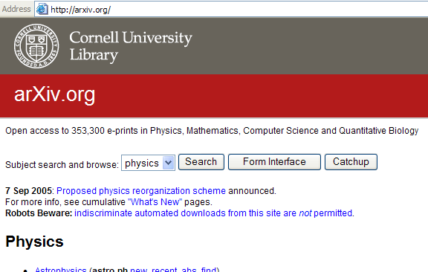
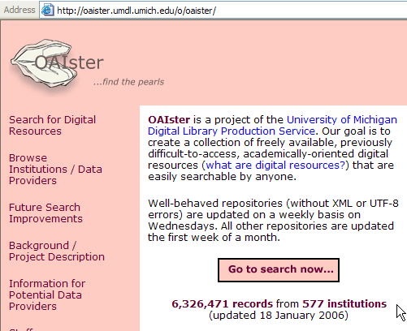
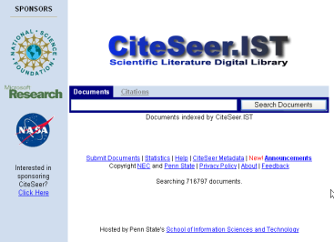
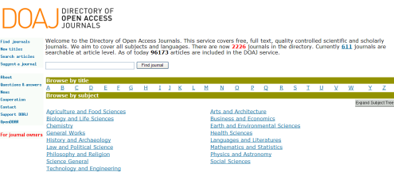
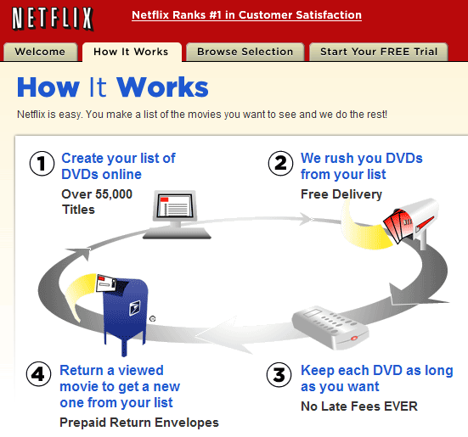
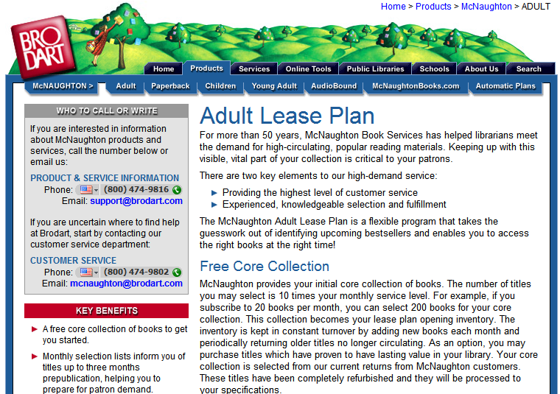
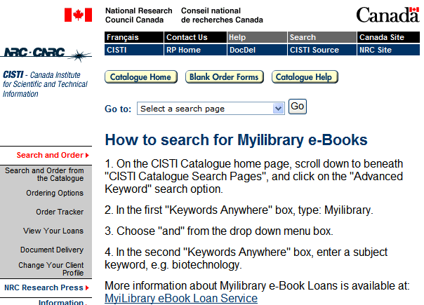
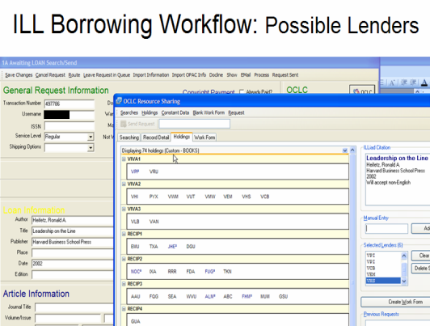
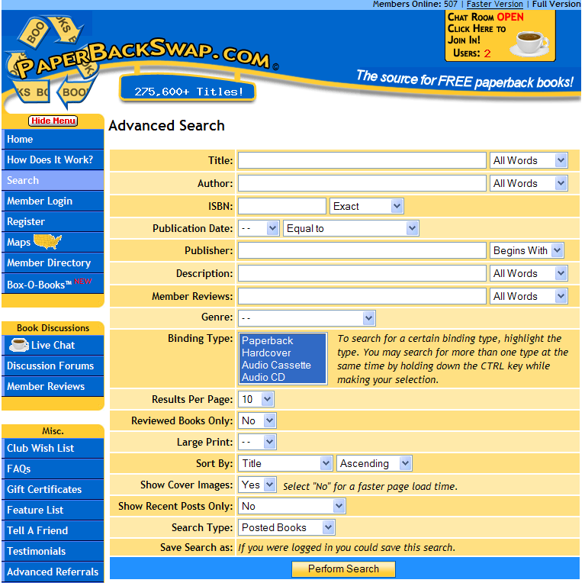
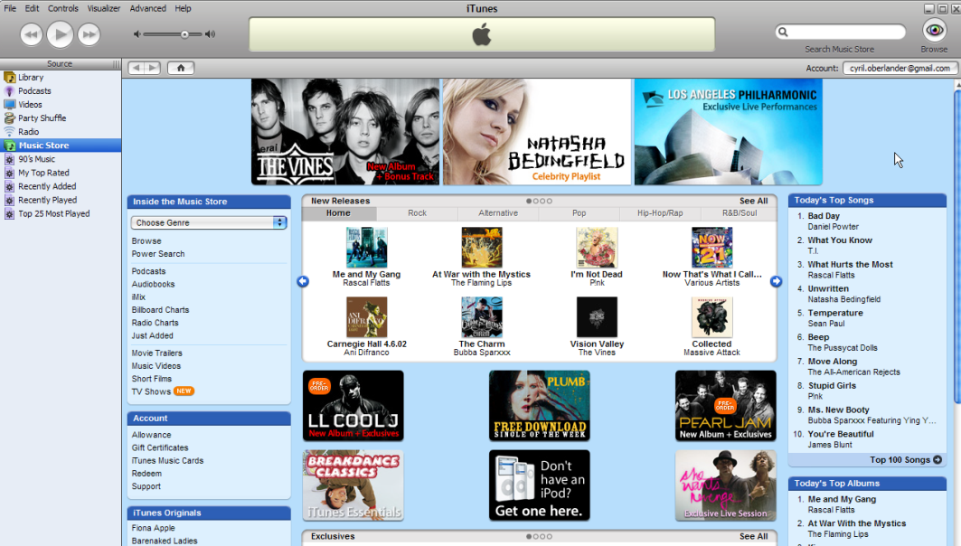




Sense-making for us & users
Free Domain
Context
Sensitive
Workflow
Borrowing / Library Domain
Renting
Domain
Buying Domain
Notes:
Briefly Explain domains –
Much like focusing on discovery, Libraries ILL workflow still focuses on the traditional borrowing domain, GIST is a transforming workflow designed to incorporate all four domains, with a focus initially on buying and borrowing options.

Slide 57


Getting It System Toolkit (GIST): http://idsproject.org/Tools/GIST.aspx
Focuses on enhancing Acquisition, Collection Development & ILL workflow
Purchase Request
Interlibrary Services Request
Strategy?
Email from php website
Requests managed with;
  automation,
  links to Worldcat,
  email system (custom & canned),
  transparent process to user.
Staff mediated process
Black box process for user
OR
Notes:
GIST is a set of tools being developed by a team at SUNY Geneseo and programming consultants, the project is funded many thanks to RRLC. GIST will provide libraries with a set of customizable templates and tools that enhance and ideally, transform acquisition, collection development and ILL workflows.
Why - Library Services are fragmented by Request Systems that Reinforce functional divisions, take purchase request forms and ILL forms as an example…
CD Librarian get an email from their web form, Library Clerk looks up prices in Amazon or Gobi, looks up holdings in SUNY Catalog, looks up department budget, Decision tree may require a bibliographer or subject selector, or liaison review, and a few conversations, then it becomes an approved selection, which could mean handing it off to an acquisitions and/or cataloging person, and so on. The user is meanwhile in the dark about the status of this request, and what communication there is, is often made from someone’s email, rather than a system generated email that eliminates rekeying information.
On the other hand, ILL which had a similar website email system 10 years ago, now has a system that manages user requests and enables automated processes that free staff time and enables customizing and adding value to the service.
Transforming traditional ILL and collection development workflow depends on the local strategies that make sense.

Slide 58


Strategies – Cost, Uniqueness, Use
Why Purchase on Demand / Just in Time Acquisition…
One study of Purchase on Demand books found that within 5 months:
28.7% ILL Purchase on Demand books checked out again.
18% Regular Acquisition books were checked out once.
Ward, 2002
Notes:
From an ILL borrowing perspective, purchasing strategies can make a lot of sense. This graph is a look at Geneseo’s borrowing when we requested materials not held by our network of libraries, and requests with lending charges. The opportunity cost between borrow and buy, plus the collection diversification are key values useful for transforming ILL and collection development processes.
CLICK – here are some of the titles from the graphed sample. Opportunity cost is a great strategy, however, it is best at the point of need.
CLICK – Lastly, if use is a measure of success in collection building, then Just in Time Acquisition has been shown to lead to subsequent use. How does that compare to many libraries selecting just in case that are fortunate if 50% of their new titles are ever checked out.

Slide 59




Getting It System Toolkit – conceptual framework
$
Proposed Integrating Services within ILL workflow
User Recommendations
Just in Time Acquisition:
  Cost
  Buy for Library, attach OCLC symbol, &/or download to ILS
Collection Development:
  Refer to selector for review,
  Collection building data profiles; LC#, Language, Publisher, Growth factor, etc.
Other options: rent for user, Google Book, OCA, etc.
Notes:
This is a conceptual framework of GIST that looks at transforming and combining various processes to streamline our work.
Requests undergo a series of decisions that are made easier because web services bring in data at the point of request and handling.
Illustrate.

Slide 60



GIST starts with user interface development
Asking questions to promote dialogue
Recommend Library Acquire button
Add purchase price and current department/faculty resource budget to request form.
Note availability among IDS Project Libraries and/or area libraries
Ask questions?
  How important is this work for the library to consider buying? Moderately Useful to Essential
  How long might you expect this work to be relevant?
  Using a rating (1 low – 5 high) how important is this to your students?
  Did a colleague recommend this?
Notes:
Key to GIST development is an iterative process of transforming the idea of a request by asking useful questions.
With answers from our users, we can apply workflow rules that automatically prioritize requests, or better inform decision making.

Slide 61


GIST Test Interface
Amazon Ranking Test
ILLiad Client View: Price to Purchase
Open URL &/or Standalone Request
What are the best questions?
Notes:
This is our GIST test interface that is used to explore what custom ILLiad forms and bundled data services make sense to our users for a hybrid acquisition and ILL form. For instance, using ILLiad, you can customize pages to certain status, say librarian, faculty, department recommender or even students might have various GIST forms.
ILLiad allows you to create a separate request form, and/or work with ILLiad’s Open URL request form, which makes it easy for selection from any library database with no rekeying by the user.
CLICK you can ask important questions – why should we consider acquiring this book? How important is this to your research, or what format preference? During the first two weeks of asking the question about How important is this to your research in our regular ILLiad request, we had over 300 requests intentionally tagged essential, and 29 unessential.
CLICK By using ILLiad’s Open URL request form, it is relatively easy to call upon data sources of interest, such as Amazon Ranking, reviews, etc. CLICK
Mark Sullivan recently re-wrote the Amazon Price Grabber – originally written by Portland State University, so that the Amazon price, Vendor price appear, with more data on it’s way. What else do we collectively want to see in our staff workflow? Gobi, Baker & Taylor?

Slide 62

Iterative process: GIST Test #2
Notes:
Here is our second version – as I said, iterative process, we are about ready to have some faculty focus groups and usability on this interface.

Slide 63




GIST ver. 1 (Target: Aug. 2009)
GIST data services include:
Amazon Price Grabber (Built by PSU, modified by Mark)
Display’s cost to buy item
Rank/Review
Condition, etc.
Worldcat API
Displays # of NY, RRLC & IDS Project Libraries holding item
Other Data
Google Books & more, see ver. 2…
User input
Ask user if the library should collect this – using variety of criteria such as essential readings for teaching and learning, etc.
Ask user format preference? Audio-book, eBook, etc.
@ points of Discovery
ILLiad web request forms
ILLiad workflow
(with data services added)
Hybrid workflow
Custom queues
Custom email routings & text files
Purchase on Demand workflow
Notes:
Our target date for releasing GIST version 1 is August 2009 at the IDS Conference.
Besides Amazon data, the goal is to have data from Worldcat API to automatically look up where items are held locally and provide an estimated turn-around time to our users, it will also look up Google Books, and ask users to input data.
Amazon PriceGrabber: http://www.atlas-sys.com/products/illiad/newsletter/archive/OCLCILLiadNewsletterFall2008.pdf

Slide 64

GIST ver. 2 (target: Aug. 2010)
@ point of Discovery…
Version 2 Features
Budget Management: Grant, individual, and department budgets can be shown and selected i.e.: This item costs $45.43; your department book budget is $567, do you want to continue with this order? Includes budget and account transaction tracking, review & approvals systems.
Other Data: Book Burro, IDS Project Data, Copyright Clearance, book jobbers, OCLC Holdings & record download to ILS.
Gift Management Processing: Automate gift selection and acknowledgement processing with collection building profile services.
ILLiad web request forms
ILLiad Client workflow
(with extra data pulled in)
Hybrid workflow
Custom queues
Custom email routings & text files
Purchase on Demand & Purchasing workflow
Notes:
Looking at the long of it… by August 2010
GIST Version 2 goals include a set of budget management features that allows users and approvers tracking of their budgets, other services, such as attaching OCLC symbols,
and a set of gift management tools that automate gift selection within collection building targets, provides automated donor letters with lists of items, and slices and dices…

Slide 65

GIST is customizable
You choose and adapt the tool around what works for your setting.
Library A
Library B
Library C
Library D
GIST tools used to enhance ILL Purchase on Demand only.
GIST used by Librarians.
GIST also used only by Librarians to help their selection.
GIST used selectively.
GIST also used by Faculty, with Librarian Review.
GIST default with collection building parameters.
GIST used by all users, with some Librarian review for certain status. Collection building profiles, cooperative data, and gift management features used.
Notes:
GIST has to be customizable modules so that libraries can adapt the workflow based on local practices and politics, various vendor requirements, etc.

Slide 66
Where to next…
Community aspects of the IDS Project
How do we best identify current and emerging needs of our member libraries, and respond with cooperation?
Is volunteer training & mentoring sustainable for sharing best practices?
How many more libraries can be added and still maintain the project’s major goal of having a--“unified community of trust and support…”?
How can we join forces with other innovative groups to jointly address critical challenges surrounding cooperative resource sharing?
Notes:
Beyond the technology, what is more important to discuss is the reality of cooperation – how do we effectively work together…

Slide 67
Thank you
IDS Project Contact Information
URL: IDSProject.org
67
2009
Notes:
We are interested in your comments, questions and suggestions through out this wonderful conference – and congratulations on the 40th year.

