Slide 1
Getting It System Toolkit
The GIST of making informed decisions and workflow of buying, borrowing, downloading or viewing.
Tim Bowersox, Cyril Oberlander, Kate Pitcher, Mark Sullivan
State University of New York, Geneseo College
Charleston Conference
November 2009
Notes:
Cyril
Today we’re going to be talking about the Getting It System Toolkit—or GIST, for short—which integrates acquisitions and ILL processing using ILLiad.

Slide 2
What is GIST?
A system for:
enabling user-initiated purchasing requests for acquisitions and interlibrary loan;
enhancing coordinated collection development;
Merging Acquisitions and ILL request workflow using ILLiad (ILL request management software)
Notes:
So just what is GIST?
GIST is a customizable set of tools and workflows for ILLiad 8 that will enhance:
interlibrary loan and just-in-time acquisitions services;
purchase request processing;
and coordinated collection development efforts.
GIST allows acquisitions staff to benefit from ILLiad’s request management
And it makes ILLiad an even more powerful tool for ILL

Slide 3
Why we need GIST
Bringing users to the conversation
Too many lame request interfaces, no real context
Speculative selection is a lot of manual work
Most of the collection is never used
Shrinking budgets, rising material costs and increasing needs
Just-In-Case model is not sustainable
Ineffective de-duplication across systems
Delivery time is a mystery
Scary proposition…
  Your library is my library, my library is your library
  ILL and Acquisitions are ideal together
  The conversation is with users not bibliographers
Notes:
Kate
How does ILL data currently help Acquisitions?
Look over data to see what was requested previously and purchase those items
Break requests down into LC classification to see what areas are heavily borrowed
See which departments are borrowing the most

Slide 4
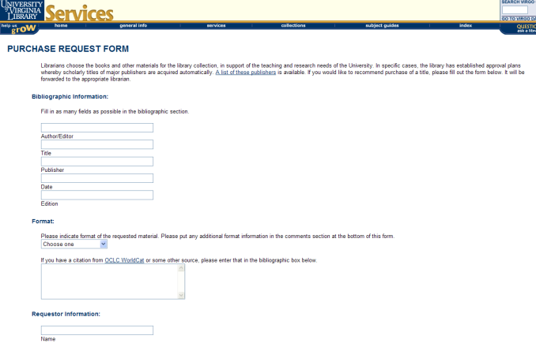
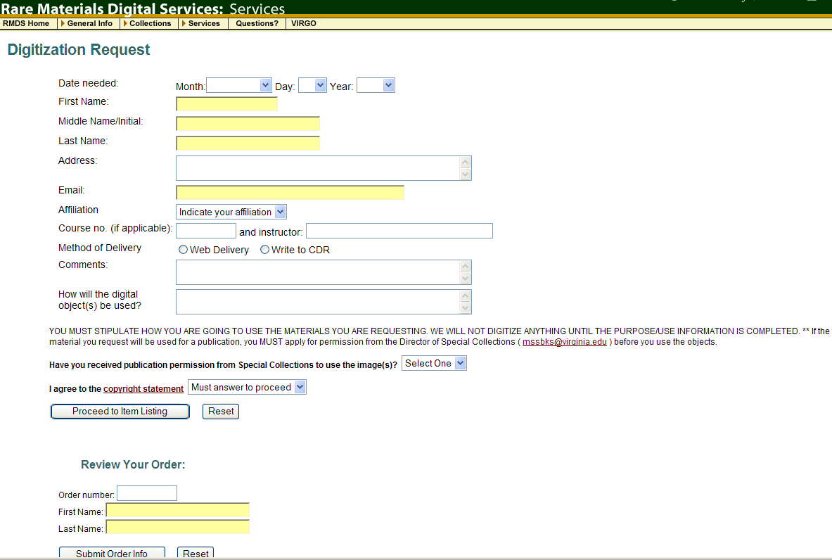
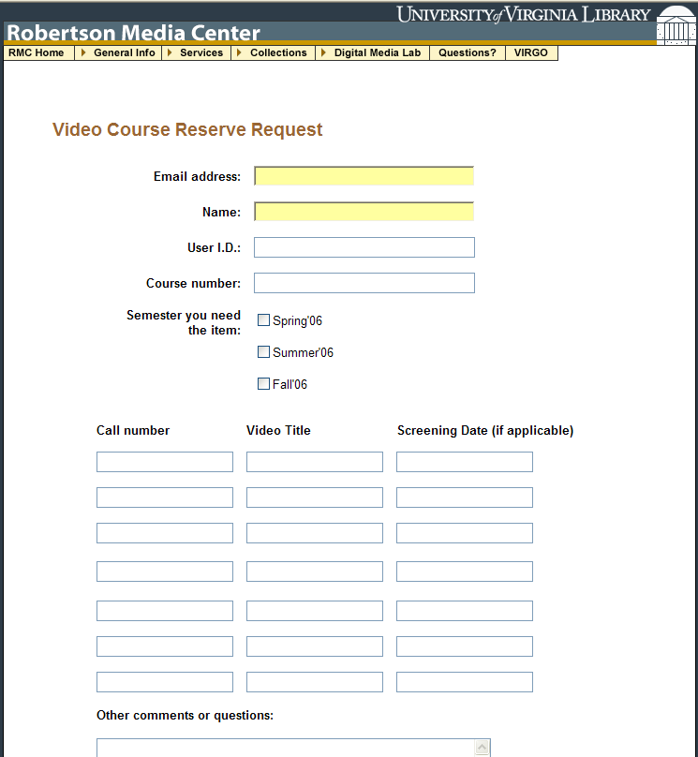
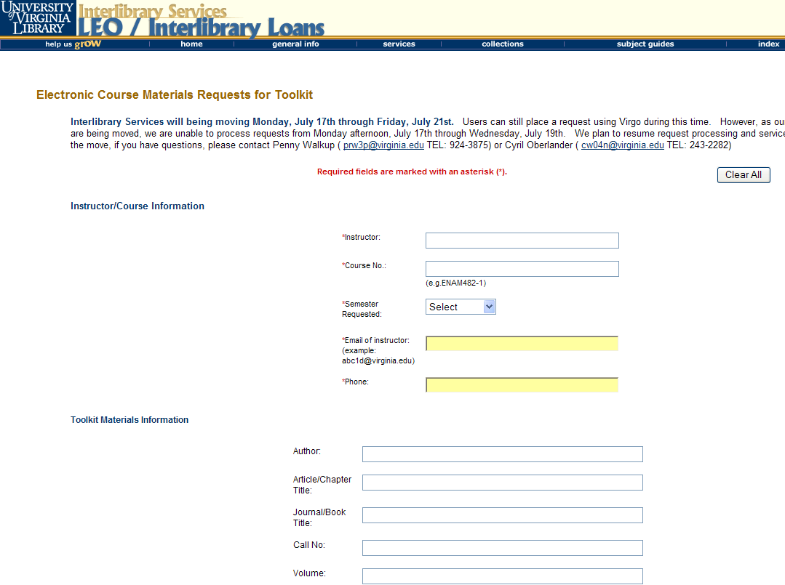
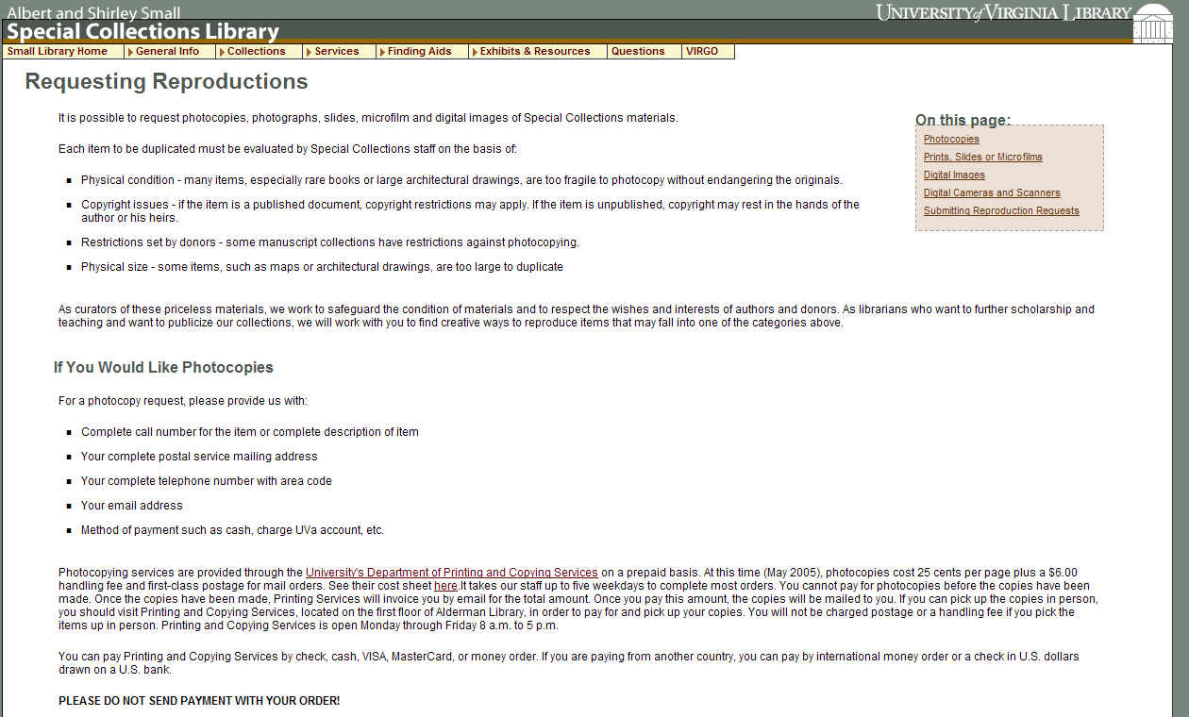
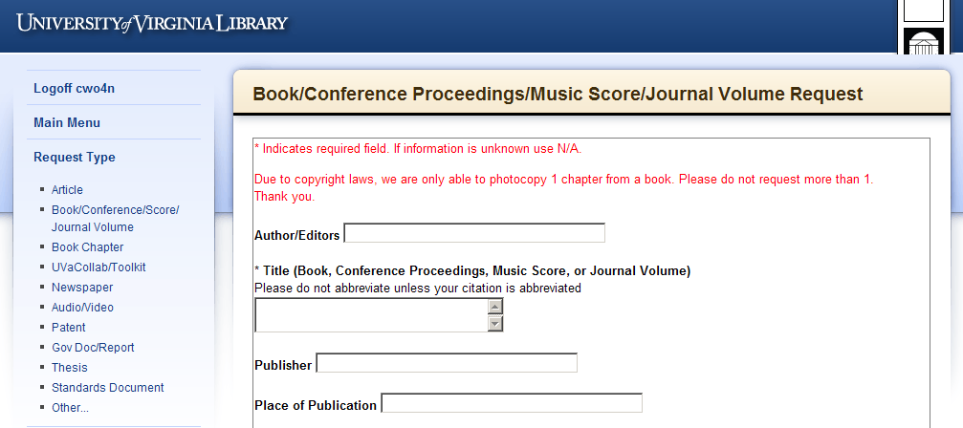
Service Request – what context?
Rare Materials Scan Request
Purchase Request
Video Booking Request
Library Services are fragmented by
Request Systems that
Reinforce functional divisions
E-Reserve Request
Special Collection Duplication Request
Interlibrary Services Request
Notes:
The reality of our numerous disparate request systems, which serve as vehicles for end user services, sends the message that our creativity, well intentioned, has run amok with functional divisions.
How does the very fractured service design or request environment we offer make any sense to our users? Does it serve us well in user’s information environment? Perhaps by reversing the situation, we have our strategic window…

Slide 5
We need a strategy that leverages strengths
Purchase Request
Interlibrary Services Request
Strategy?
Email from php website
Requests managed with;
  automation,
  links to Worldcat,
  email system (custom & canned),
  transparent process to user.
Staff mediated process
Black box process for user
OR
Notes:
GIST provides libraries with a set of customizable templates and tools that enhance and ideally, transform acquisition, collection development and ILL workflows. The initial focus is on two important library services; ILL and selection, looking at converging request management systems using ILLiad – why?
CD Librarian get an email from their web form, Library Clerk looks up prices in Amazon or Gobi, looks up holdings in SUNY Catalog, looks up department budget, Decision tree may require a bibliographer or subject selector, or liaison review, and a few conversations, then it becomes an approved selection, which could mean handing it off to an acquisitions and/or cataloging person, and so on. The user is meanwhile in the dark about the status of this request, and what communication there is, is often made from someone’s email, rather than a system generated email that eliminates rekeying information.
ILL which had a similar website email system 10 years ago, now has a system that manages user requests and enables automated processes that free staff time and enables customizing and adding value to the service.
Why GIST will have to be very customizable is because transforming traditional ILL and collection development workflow depends on the local strategies that make sense, oh, and did I mention there are always politics – sort of the 400 lb gorilla in the room and on the elephant we are all trying to figure out.

Slide 6
It’s the Economy…
April 6, 2008 a day in the life of ILL…
110 borrowing requests for loans came into SUNY Geneseo, of these…
79.1% or 87 items could be purchase from Amazon; about 46% could be purchased for under the ARL unit cost for borrowing: $17.50
Over 1/3 could be purchased for less than $10 used
(almost 1/5 for less than $5)
Over 1/5 could be purchased new for less than $10.
Price of lending charges is often higher than the price to buy.
Massive weeding of libraries is exponentially increasing the availability and reducing prices of buying.
Libraries increasing their lending charges are more reliant on revenue that is going away.
“retrospective buying projects are feasible… and for monographs, purchase may be a reasonable substitute for interlibrary loan.” Holley & Ankem, 2005
Notes:
First, consider what I found searching 110 ILL book requests from one day last spring. Highlight screen findings
Explain that the reality of weeding for 10-20 years will have a significant impact on the used book market, and possible strategies.
But don’t let an old ILL Librarian just say that… CLICK Acquisitions and collection development librarians are saying that too.

Slide 7
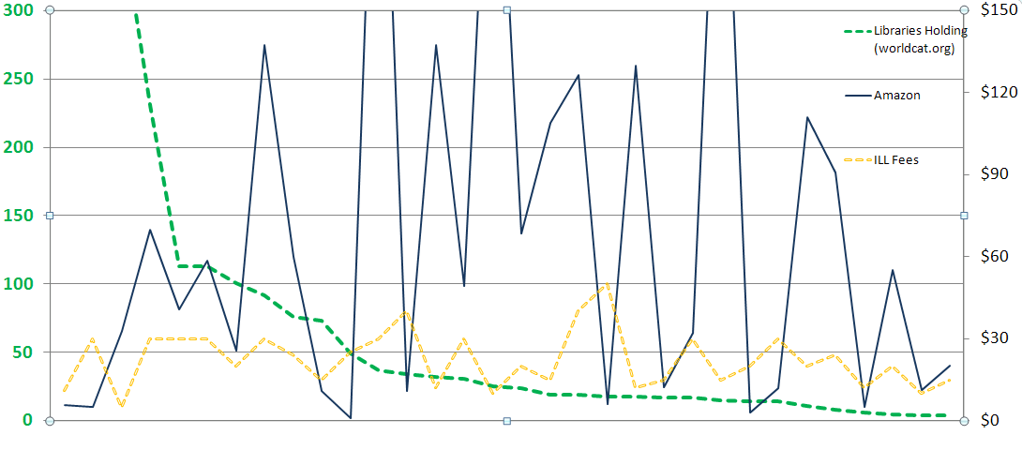
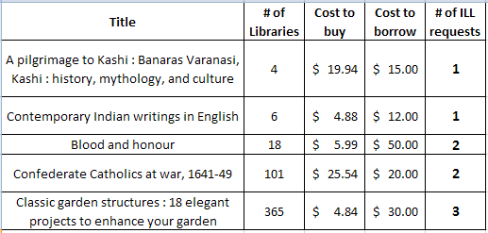
Strategies – Cost, Uniqueness, Use
Why Purchase on Demand / Just in Time Acquisition…
One study of Purchase on Demand books found that within 5 months:
28.7% ILL Purchase on Demand books checked out again.
18% Regular Acquisition books were checked out once.
Ward, 2002
Notes:
From an ILL borrowing perspective, purchasing strategies can make a lot of sense. This graph is a look at Geneseo’s borrowing when we requested materials not held by SUNY and IDS libraries, and there were lending charges incurred for the request. The opportunity cost between borrow and buy, plus the collection diversification are key values useful for both ILL and collection development processes.
CLICK – here are some of the titles from the graphed sample. Opportunity cost is a great strategy, however, it is best at the point of need.
CLICK – Lastly, if use is a measure of success in collection building, then Just in Time Acquisition has been shown to lead to subsequent use. How does that compare to many libraries selecting just in case that are fortunate if 50% of their new titles are ever checked out.

Slide 8
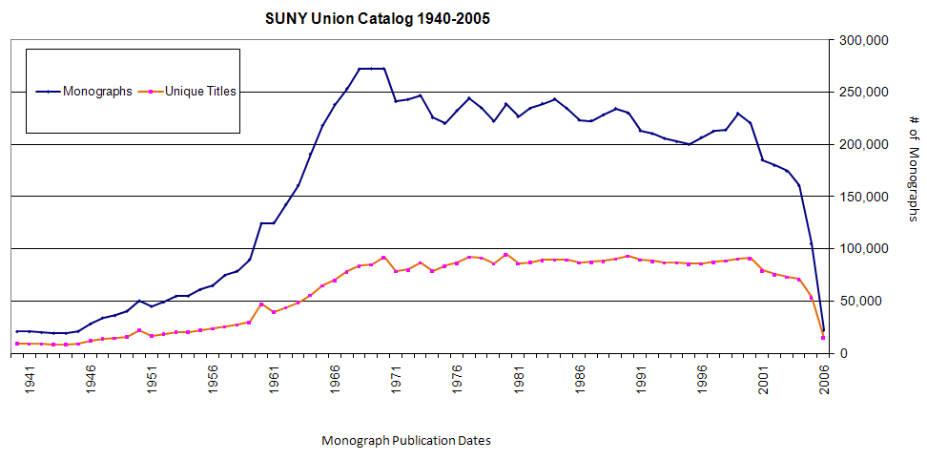
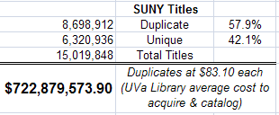
SUNY Union Catalog – Rough Uniqueness Estimates…
Cost of Duplication
As of 12/18/08 over $722 Million
Interlibrary Loan Matures
How much duplication is critical?
Can we afford Just in Case?
Notes:
What price duplication? CLICK
This is an extremely rough estimate of the price of duplication of the SUNY Collection; if even half of this figure approximates the actual cost of duplication is significant. CLICK Add to this the cost of collection maintenance, including the cost of weeding duplication – which is an ongoing activity at most libraries, typically selecting duplicated items, all of this adds to the following figure (& I didn’t add the cost of selector librarians looking up title by title how widely held a title is in the consortia),; However, CLICK
We have to understand the context changed recently; the importance of local collections was significantly reduced as Interlibrary Loan systems began to really mature, initially with OCLC, RLIN, and WLN, and later with robust request systems like ILLiad, and consortia borrowing systems. Mature ILL systems have made consortia borrowing an effective strategy for sharing resources among faculty and students at large.

Slide 9
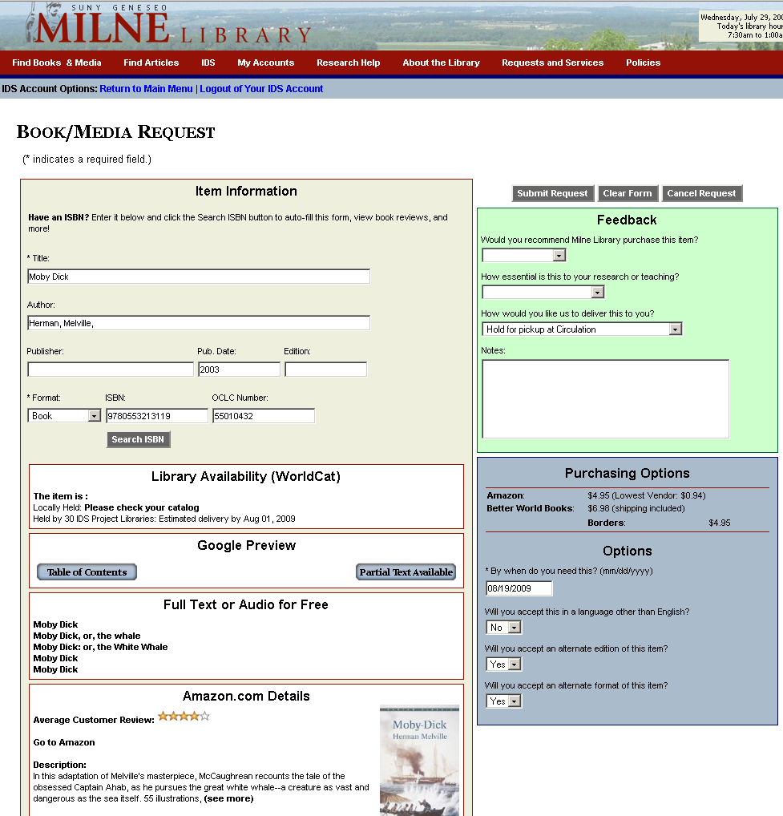
User Interface for GIST at Geneseo
Very customizable
Status specific
Context sensitive
  Stand alone
  Default Loan Form
  OpenURL
  Book Chapter Form
Elements a la carte
Notes:
Cyril

Slide 10

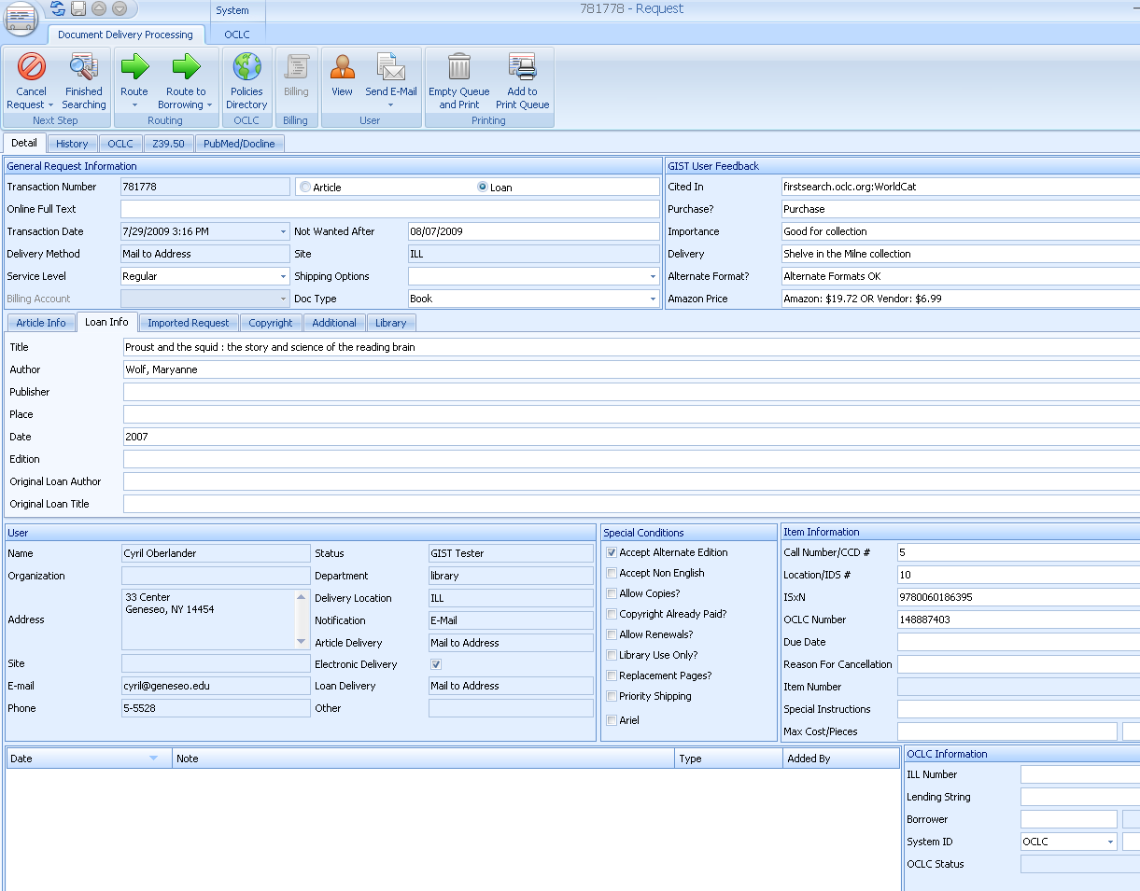
Customizable GIST Request Form
User
Interface
(Customizable display & fields)
Staff
Interface
(Customizable display & fields)
User Interface
Runs from ILLiad web server, all components can be turned off and/or hidden from user view.
Display text is configurable
Works with your style-sheets
And more…
Staff Interface
ILLiad 8.0 allows customizing field names.
You can configure data the way you want staff to see the data from user interface side, and run routing rules based on the values; i.e. available full text, purchase request suggested, etc.
And more…
Notes:
Basic view of the GIST Form, important to know that the components that pull in data from other services, i.e. Worldcat, Google, Amazon, etc., will not be shown if no data is matched during the requesting process, and in the configuration file, it is easy to turn a component on or off, or customize it. Why did we put a lot into the interface? To add elements of that data into the other side CLICK – STAFF VIEW pre-searched data added to the staff view mean that routing rules can be applied to route requests into specific process queues, or to make it easy to compare the cost of buying with borrowing. So let’s look at the details…

Slide 11
Purchasing Options
User sees price to purchase from Amazon API with New & Lowest Price listed (used) – user may want to purchase from this link. If they do, Amazon provides our AWS account a credit for referring someone to purchase.
ILL & Acquisition Staff see the New & Lowest Price in the ILLiad requests.
Better World Books, Google APIs are also currently used for pricing, we have asked other vendors for APIs.
Worldcat API – Library Availability
User sees if owned locally, easy click to catalog, and sees estimated turnaround time.
ILL & Acquisitions staff see if held locally, and # holdings in 2 configurable groups (consortia, state, etc.)
ILLiad Request Form
Custom, Standalone, OpenURL, Status Specific
Google Books
User sees Table of Contents, No-Partial, & Full Text Views.
Staff see if full text in Google (GOOGL)
Amazon API
Enhances users request evaluation with Reviews, Ranking, Cover, and quick link to Amazon.
Price was moved into Purchasing Options window.
Index Data
User sees if full text or audio version in OCA, Internet Archive, etc.
Staff see if full text OCA (INARC)
Notes:
[MARK]
There are 5 API components in the GIST interface; Worldcat API, Google Books, Index Data, Amazon, and purchasing options. By default, they are activated, however, the library can simply turn off any component they do not want to see, and how the data from each component is highly configurable for end-user, as well as, staff within the ILLiad request. Also important is that each component has a switch – if no values are returned, the window is not displayed, and if the data takes time to retrieve, a status bar appears.
Worldcat API – SUNY Geneseo contracted Terry Reese, Oregon State University and Kyle Bannerjee, Summit to develop the Worldcat API for GIST. Mark Sullivan configured it to work with ILLiad. The purpose of the Worldcat API component is to bring back holdings information to the user – if held locally, it says so and the Please check your catalog is a one click into a search of your catalog using the OCLC#. Especially helpful considering about 10-15% of ILL requests are for materials owned by the local library. The availability in IDS Project libraries and estimated delivery time is a configurable set of two groups – you might want one for your resource sharing consortia (of which turnaround times might be consistent), and the other is your state. While the user might only want to know when they might expect it, Acquisitions staff no longer have to look up holdings in their preferred cooperative collection groups to determine how widely these are held before making a decision to cancel. In fact, not only is the decision easier, the cancel email from ILLiad incorporates those numbers automatically into the emails.
Google Books API enhances the user’s evaluation of the material they are requesting with additional data, such as Table of Contents or Partial Text Available, however, the user may also discover that the item they need is Full Text Available. Both ILL and Acquisitions staff see GOOGL (Google’s OCLC symbol) when a requested item is available full text, and at Geneseo, a routing rule automatically places the request in a specific queue – the staff will send the user an email using ILLiad that has the Google Book URL, and copies the electronic resources librarian to please catalog the resource.
Similarly with Index Data API, a combined search of various free full text and audio sources from Open Content Alliance, Internet Archive, Gutenberg, etc. is performed and results may interest the user. The staff see INARC (Internet Archives OCLC Symbol) when a requested item is available from the Index Data sources, and again, a routing rule places that request in a specific queue for staff.
Amazons API was initially designed by Portland State University as the Price Grabber, but Mark Sullivan remade that program in .NET to be the Amazon Price Reviewer and more. This enables users more evaluation data to help their request decision making process. It also provides data for the purchasing options.
Purchasing Options is a combination of API data from Amazon, Better World Books, and Google Books. This service enables users to see price data, and click through to buy. If they buy from Amazon or Better World Books, our accounts are given credit for referring buyers. What the ILL and Acquisitions staff see in the ILLiad request is Amazon’s new and lowest cost to buy the item – which for ILL helps them determine if buying is less expensive than borrowing – there are a lot of libraries out there that charge $20 / request. For Acquisitions staff, the purchasing data eliminates the need for searching various prices. We have asked many of the book jobbers and dealers for APIs, so as we hear back from them, we plan to incorporate more, and enable easy configuration so that a library with preferred or specific vendors can activate only those purchasing APIs.
Last point we want to emphasize is that all this is very flexible, where it appears, how it looks to user and staff, so we see this as really the first template of many, as libraries adapt this, as they customize views to specific user status; faculty, student, administrator, etc.

Slide 12
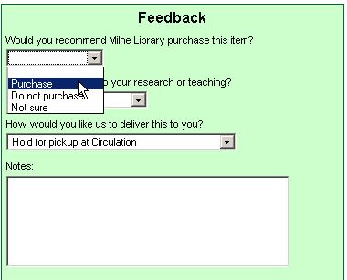
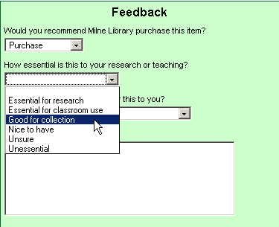
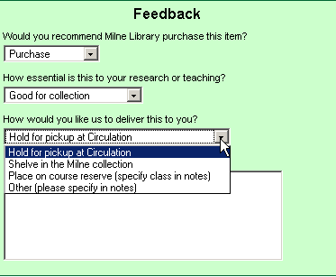
Notes:
[MARK]
Feedback or tagging, users are willing to add value into their requests if only we ask.
An ILL request in ILLiad’s web pages becomes an Acquisitions request when the user selects Purchase to answer “Would you recommend Milne Library purchase this item?” As we said before, all the text, answers, and routings are customizable, but these are where various iterations brought us. The selection here is default blank, so unless the user specifies, it will be a borrowing request.
Second feedback question is how essential is this to your research or teaching? Would it surprise anyone that people are actually clicking on the unsure and unessential? We wanted some way to have user evaluate the priority of their request, and we are finding that although many are leaving this blank, there are lots of people tagging their request essential, etc.
Final feedback is finding out their delivery preference, and for the case of course reserves, they simply add the class info to the notes so when the purchased item comes in, it can be immediately placed on reserves and an email sent out from ILLiad.

Slide 13
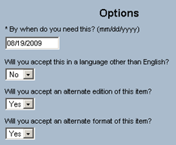
Notes:
[MARK]

Slide 14
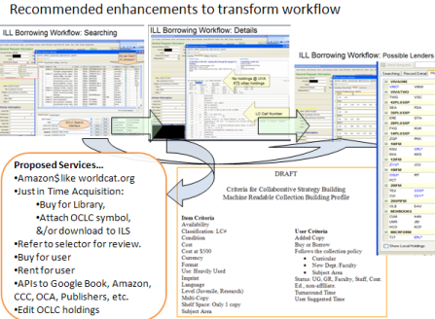

Adapt GIST to your setting
You choose and adapt the tool around what works for your setting.
Library A
Library B
Library C
Library D
Range of customization
GIST tools used to enhance ILL Purchase on Demand only.
GIST used by Librarians.
GIST also used only by Librarians to help their selection.
GIST used selectively.
GIST also used by Faculty, with Librarian Review.
GIST default with collection building parameters.
GIST used by all users, with some Librarian review for certain status. Collection building profiles, cooperative data, and gift management features used.
Notes:
Because GIST tools are customizable components, and libraries do love doing things there own way, we would expect to see a diversity of adaptation based on local practices and politics.
illustrate

Slide 15
Submitted Purchase Requests
ILL & GIST Workflow
Purchasing
Request Meets Criteria
Faculty Department Requires Review
Item Locally Held
Item Held by Too Many CCD Libraries
Route to ILL for Borrowing
Staff Evaluation
Item in Pre-Publication
Insufficient Funds Remaining
Librarian Review
Faculty Rep Review
Item Ordered, User Notified
Denied by Reviewer
Item Arrives & Processed
Item Delivered, User Notified
Notes:
TIM
If we zoom in a little more, we get a more detailed look at the acquisitions workflow.
Three things can happen to incoming purchase requests:
If the user belongs to a department that requires a faculty rep to review all requests, then it is placed in the Needs Faculty Rep Review queue
If the requested item is too widely held within your CCD group, then it is placed in the Purchase Request Exceeds CCD Limit queue
At which point, acquisitions staff can then cancel the request (unless it’s a special circumstance)
If none of the above, then the request goes to the Awaiting Acquisitions Processing queue
Requests in the Awaiting Acquisitions Processing queue are evaluated based upon the user’s status, department, budget allocation, & feedback
At this point, acquisitions staff can order the item and make it available per the user’s preference, or cancel the request
Or, if approval is required, they can contact a faculty rep or librarian first.
Requests that need or are awaiting approval are set aside in separate queues. Once a response is given, then acquisitions staff can easily find those requests and take the appropriate action.
In every case, requests are moved along using email routing—which both moves the requests between queues, and also sends an email to the user explaining the actions taken.

Slide 16
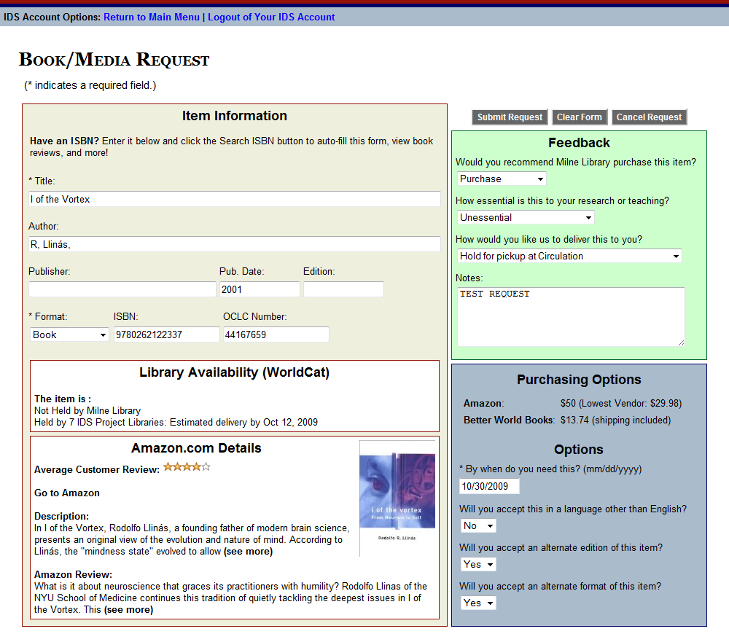
Notes:
[TIM]
Not that we’ve looked at the Workflow, let’s see it in action with a step-by-step demo.
It all begins here with the customized ILLiad web form…
I would like to request the book “I of the Vortex”
So I found it in WorldCat and place an OpenURL request.
But because this book looks so great, in the feedback I recommend this for purchase and click Submit.

Slide 17
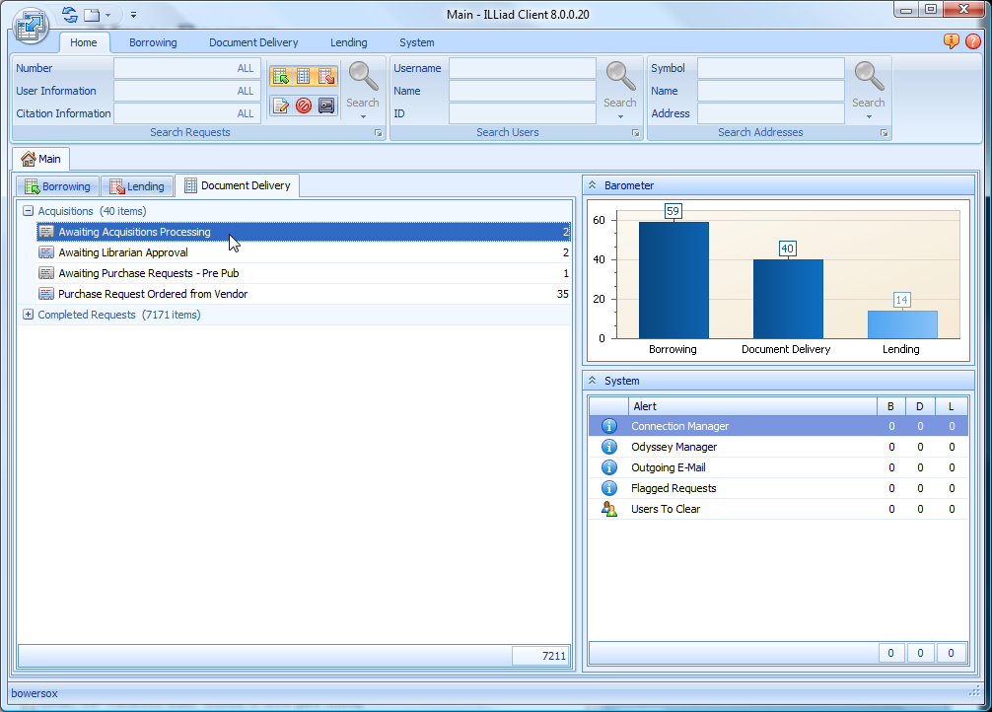
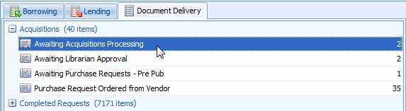
Notes:
[TIM]
With GIST, Acquisitions staff work from within the Document Delivery menu.
[CLICK]
You’ll notice that there are some custom queues specifically for purchase requests.
These queues are grouped within the Acquisitions category, which ILL staff can collapse to keep out of the way.
Likewise, the ILL queues have been similarly grouped, which allows Acquisitions staff to hide them.
In this example, my request went to Awaiting Acquisitions Processing because it wasn’t held locally and was not held by enough CCD libraries

Slide 18
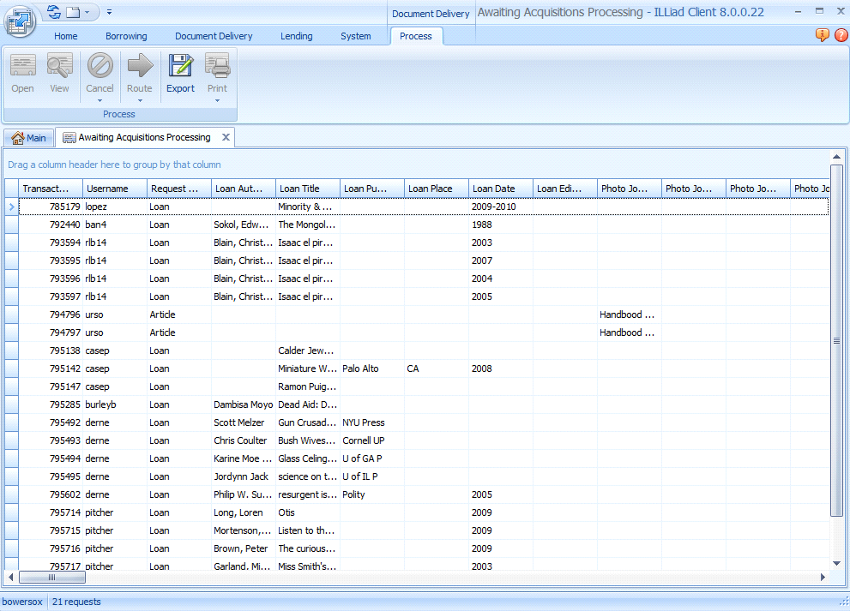

Slide 19
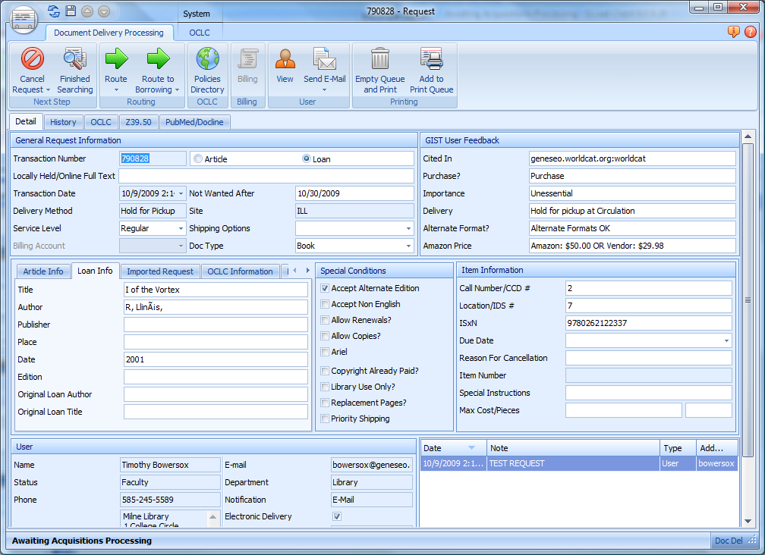
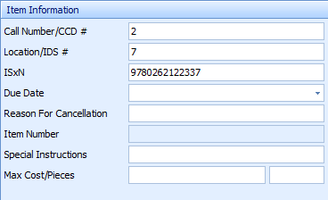
Notes:
[TIM]
How did that routing work?
[CLICK]
GIST uses the WorldCat API to see how many libraries in the CCD group own the item, then sticks that number into the Call Number field.
You’ll also notice that GIST imports the number of IDS libraries that own the item into the Location field. For ILL, this is what allowed the web request form to provide a delivery estimate for the user.
Both fields were customized in the client to include more descriptive labels. And you can customize these fields to apply to whichever groups of libraries you’d like (such as your 3R or SUNY).

Slide 20
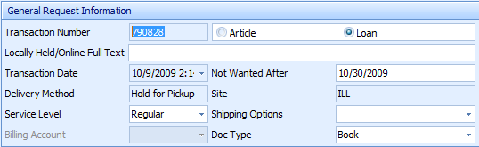
Notes:
[TIM]
There is also the Locally Held/Online Full Text field.
[CLICK]
In this case, it’s empty. But if Geneseo owned this item or if there were full text holdings in Google Books and/or the Internet Archive, GIST would put data in this field. Routing rules decipher that data (whether it be Locally Held, GOOGL, or INARC) and place the requests in the appropriate queues.
For ILL this also applies: now ILL staff will know whether or not a request is owned locally or if they can provide a full text link to the user instead of borrowing a physical copy.
[CLICK]
This is possible because GIST uses the WorldCat API to see if an item is held by GOOGL or INARC, which have full text cataloged in WorldCat.
Whenever full text holdings are found, a routing rule places the request in the Awaiting GOOGL or INARC Processing queue in Borrowing. ILL staff can then locate the item online, and use an email routing to supply the user with the URL and update the request to finished.

Slide 21
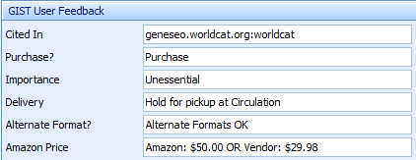
Notes:
[TIM]
While we’re here, let’s also look at some other client customizations that you’ll notice.
[CLICK]
Remember the feedback I supplied? This is where it ends up in the client.
We customized the layout so that the citation and reference number fields are appropriately relabeled.
Obviously this info helps a great deal when evaluating and processing a purchase request.
ILL staff can use this in a few ways (it’s not just for acquisitions!):
Importance: is it necessary to exceed our Max Cost to borrow this?
Alternate Format: will the user accept a microfilm copy? (saves you having to contact the user)
Amazon Price: is borrowing more expensive than buying the item?

Slide 22
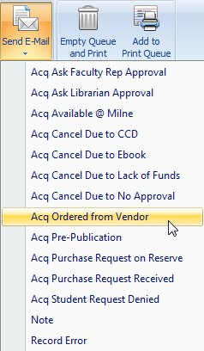
Notes:
[TIM]
Very cool, but let’s get back to our example…
The acquisitions staff know that this Tim fellow has never steered them wrong, so after evaluating the request they decide to purchase it.
With GIST, acquisitions staff use email routing to move requests through the workflow.
[CLICK]
You’ll note that there are several other emails that begin with Acq—this is to separate the acquisitions emails from the ILL emails.
In this case, they will want to use Acq Ordered from Vendor to both notify me that my request is being purchased, but to also move it to the next status of “Purchase Request Ordered from Vendor”

Slide 23
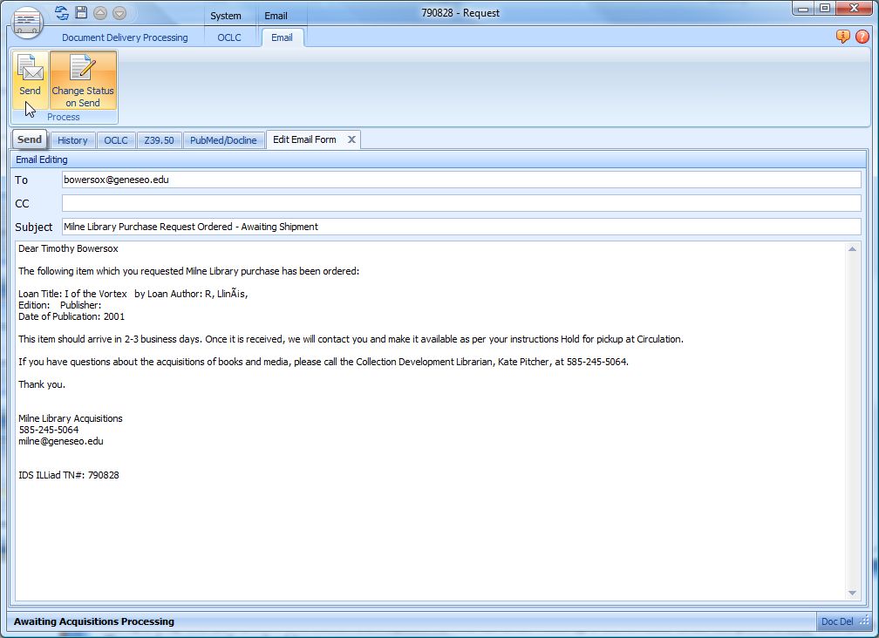
Notes:
[TIM]
This opens up the Edit Email Form within the request. As with all email routing, a customized email template is used that pulls in:
The user’s name and email address
The author and title of the item
And the name, phone number, and email address of your Acquisitions contact.
For the purpose of GIST, these emails are all sent from your acquisitions contact, so ILL will not be dealing with any correspondence.
Also, the email templates use the DocDelContact fields from your LocalInfo table.
The final step in this workflow is to simply click the Send button. This sends the email and updates the request.

Slide 24
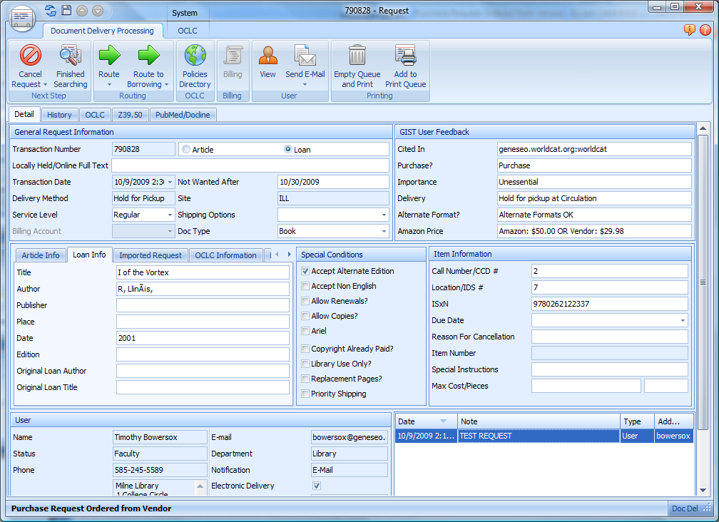
Notes:
[TIM]
Any questions about the customized layout, routing rules, or emails?

Slide 25
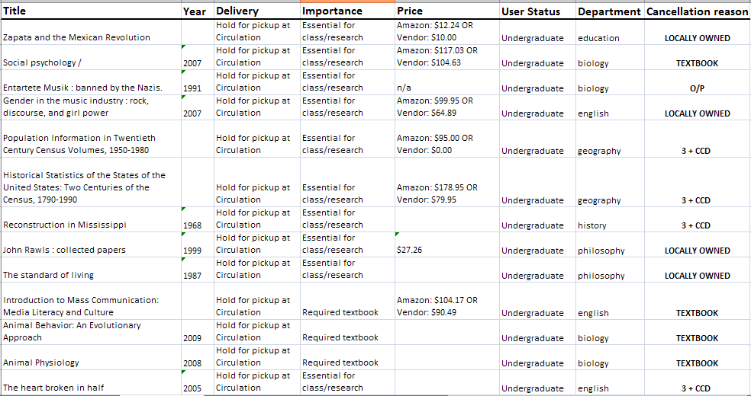
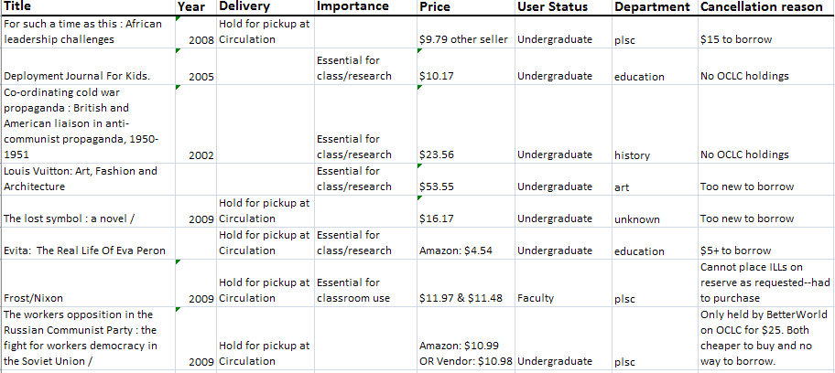
ILL & ACQ Workflow
GIST Request
Interlibrary Loan / IDS
Cancel or Unfilled
Filled
Borrow
Acquisitions
Filled
Buy
Cancel or Borrow
Requests are Transferable
ACQ requests routed to ILL
18 total
24 % of student purchase requests
ILL requests routed to ACQ
8 total
0.38% of ILL requests
Notes:
[KATE]
GIST requests can be either an ILL or Acquisitions request. For Geneseo, if the user recommends the library purchase the work, then the request is automatically routed into an acquisitions queue in ILLiad’s Document Delivery Module. CLICK
However, at any point in time, library staff can re-route the request into an ILL or from ILL to an Acquisitions request. For instance, if the cost to borrow something is higher than purchasing it, it can become an acquisitions request by simply clicking on ILLiad’s route to, and direct it into an acquisitions processing queue. CLICK
Leveraging the strengths and flexibility of ILLiad is important not only in transferring requests between library services, it also helps to have parallel and empowering strategies. One is filling requests for materials that are available full text…

Slide 26
ILL & GIST Workflow
Purchasing
Acquisitions
Awaiting Acquisitions Processing
Review Required
Review needed – request can be automatically routed in these queue because of department affiliation.
Email sent via ILLiad, request is routed to specific pending queues
Awaiting Librarian Approval
If approved, process as purchase request.
If not, cancel or borrow.
Processing Purchase Requests
User, department & budget validation.
Check holdings in GIST Item Information.
Copy ISBN – search in Amazon, etc. to place order.
Copy OCLC number to download record and attach holdings.
Email sent via ILLiad, request is routed to Purchase Request Ordered from Vendor
Purchase Request Ordered from Vendor
When item is received, Email sent via ILLiad, request is routed to Request Finished
Awaiting Faculty Rep
If approved, process as purchase request.
If not, cancel or borrow.
Request Finished
Item made available as per user preference; Hold for Pickup, Shelved in Library, Placed on Reserve
Notes:
This is the process flowchart of our acquisitions ordering and user notification process using ILLiad’s Document delivery.

Slide 27
ILL & GIST Workflow
Cancelling Purchasing Options
Acquisitions
Awaiting Acquisitions Processing
Processing Purchase Requests
User, department & budget validation.
Check holdings in GIST Item Information.
Copy ISBN – search in Amazon, etc. to place order.
Copy OCLC number to download record and attach holdings.
Email sent via ILLiad, request is routed to Purchase Request Ordered from Vendor
Purchase Request Ordered from Vendor
When item is received, Email sent via ILLiad, request is routed to Request Finished
Duplicate Holdings
If title is owned by more than 3 Cooperative Collection Development libraries request routes automatically to Purchase Request Exceeds CCD limit. Cancel or Buy Collection Development Librarian decides.
If cancelled, Email sent via ILLiad, request is routed to Cancelled by ILL Staff.
Request Finished
Item made available as per user preference; Hold for Pickup, Shelved in Library, Placed on Reserve
Cancel Request
Cancel Due to Lack of Funds
Email sent via ILLiad, request is routed to Cancelled by ILL Staff, or User asks to Borrow.
Cancel – Held Locally
Email sent via ILLiad, email has LC# and location, request is routed to Cancelled by ILL Staff.
Notes:
And lastly, there are cancelling requests, which take on a variety of new options. Each of these cancellations have data within the request to route the request to a specific queue, and email templates to make sending a notice and finishing the request a 2-3 second reality.

Slide 28
GIST Stats from Geneseo
Faculty Requests from September 1 – October 20, 2009
  39.77% response rate for rating item importance
Faculty requests
Total Faculty purchase requests | 101
Total Faculty loan requests | 440
% recommended for purchase | 22.95%
Faculty feedback
No response | 265
Essential for classroom use | 59
Essential for research | 50
Good for collection | 31
Nice to have | 21
Unessential | 9
Unsure | 5
Notes:
[KATE]
We’ve been using GIST with our faculty since September 1 and here are some stats
Pull out of ILLiad, use Access queries, do not need to use the ILS for pulling reports
[Review slide]

Slide 29
GIST Stats from Geneseo
Student Requests from October 1 – October 20, 2009
  29.78% response rate for rating item importance
Student requests
Total Student purchase requests | 75
Total Student loan requests | 1,662
% recommended for purchase | 4.51%
Student feedback
No response | 1,167
Essential for class/research | 442
Required textbook | 17
Unessential | 25
Unsure | 11
Notes:
[KATE]
On October 1, we implemented GIST for our students as well once we observed how smoothly things went with the faculty.
[Review Slide]

Slide 30
GIST Release Information
GIST 1.0 Released: August 15th, 2009
Current Version is 1.0.4
Documentation wiki: http://toolkit.idsproject.org/doku.php?id=wiki:gist
Feedback blog: http://gettingitsystemtoolkit.blogspot.com/
Obtain as much feedback as we can prior to and after release
Notes:
[MARK]

Slide 31
The Ideal Future of GIST
Version 2 Features
Gift Management Processing: Automate gift selection & acknowledgement processing with collection building profile services.
Also useful for weeding evaluation.
Budget Management: Grant, individual, and department budgets can be shown and selected i.e.: This item costs $45.43; your department book budget is $567, do you want to continue with this order? Includes budget and account transaction tracking, review & approvals systems.
Other Data Services: Articles, Book Burro, IDS Project Data, Copyright Clearance, book jobbers, videos, OCLC Holdings & record download to ILS.
Work with vendors to add more services and API connectors with book jobbers, etc. You can help!
Notes:
[MARK]

Slide 32
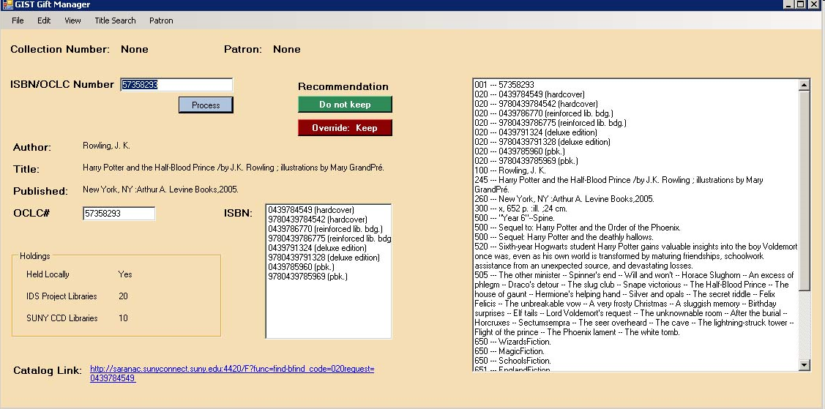
GIFT & Weed Manager Component in Alpha
Weed = remove holdings & OCLC symbol, statistics, etc.
Keep & Catalog = add donated work, attach symbol, download record, etc.
Don’t Acquire = create donor letter when finished, statistics, etc.

Slide 33
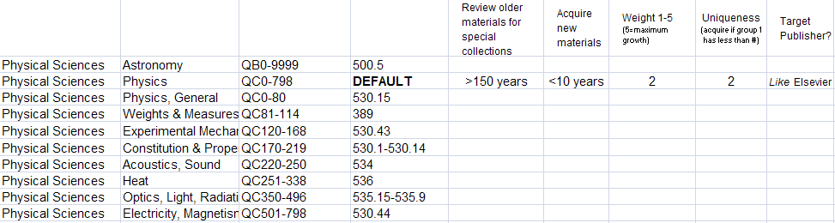
GIST GM Workflow Map
GIST GM
Gift Processing
De-selection Processing
Search &/or Enter Donor Name
(Anonymous used if no donor)
Wand in ISBN# or enter OCLC# (Search?)
Wand in ISBN# or enter OCLC#
(Search?)
Collection Building Profile
Modified Conspectus Configuration File
Review Required
Weed Item
Do not Accept
Accept
Review
Email sent
Librarian?
Remove Holdings from ILS
List is being created for donor letter and statistics? What data needed? Import to Library Thing?
Detach OCLC symbol
NO
YES
Statistics? # or LC conspectus?
Book Sale, Better World Books, B-Logistics, etc.
Attach holdings, download record, create spine label, barcode
Manual process: Withdrawn stamp
Book sale, Better World Books, B-Logistics, etc.
Notes:
Add search to worldcat api search.
Tap into your email client – which creates a pending status.
Do you want to package the ISBN list to sell in Amazon Marketplace? Design requirement 2.5.
De-selection:
Review may need a printout but we think it’s a version 2.5
Need number of titles, what LC areas.

Slide 34
Getting It System Toolkit (GIST)
http://idsproject.org/Tools/GIST.aspx
GIST Team (SUNY Geneseo)
Tim Bowersox, GIST Web Interface and ILLiad Workflow Designer
Cyril Oberlander, Project Consultant
Kate Pitcher, GIST Acquisition and Collection Development Designer
Ed Rivenburgh, Project Sponsor
Mark Sullivan, Project Manager & Geneseo Programmer
GIST Grant Funding
Rochester Regional Library Council – Regional Bibliographic Databases & Interlibrary Resources Sharing Grant
Worldcat API Programming Consultants
Kyle Banerjee, Digital Services Program Manager at the Orbis Cascade Alliance
Terry Reese, Oregon State University

