Slide 1
The Unfilled Processing
Queue: Who needs it?
The why and the wherefore of an essential but problematic queue.
Marta Ambroziak - Metro | Christopher White - Eastern | Christine Sisak - Western

Slide 2
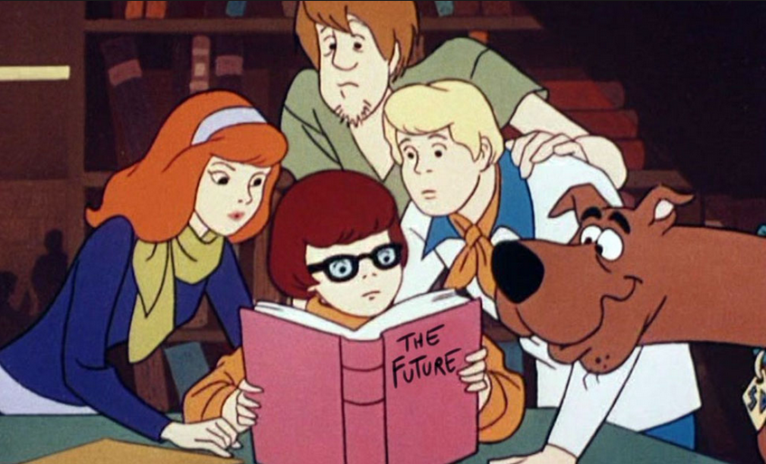
Agenda
Where to locate?
Why did they come back?
Now what?

Slide 3
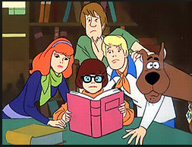
Unfilled - Where?
The Awaiting Unfilled Processing Queue
Screen shot
Notes:
Locate them in the Awaiting Unfilled Processing Queue on the Borrowing Side

Slide 4
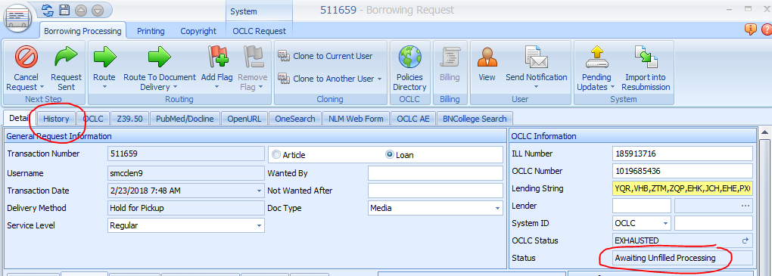
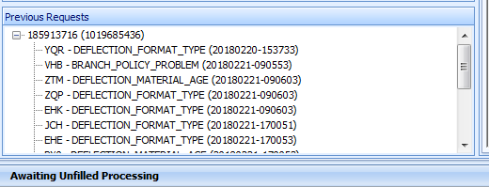
Unfilled - Where into Why?
The History Tab
Screen shot
Notes:
So, if you open the request up and click on the History Tab you will find at the bottom, a Previous Request box.
This will reveal:
The ILL # - and in this case it was 185913716. But you could have multiples listed if you’ve put this request in more than once.
And it also reveals which library answered which way to your request - or - WHY they cancelled. You can see YQR, ZQP and a few others have a deflection of Format Type. VHB has a branch policy problem, and ZTM has a material age deflection set up.

Slide 5
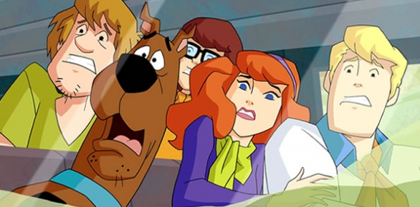
Unfilled -
Why do transactions end up in unfilled?
theouthousers.com
Problems with Info in Request -- bad citation, wrong OCLC #, wrong format, etc.
No library will lend -- item checked out, embargoed or holding library non-lender.
Filled - but second ILL request generated.
Notes:
So, why do they end up in Unfilled? Here are a few reasons, and we’ll go over these in more detail and how you might go about resolving them.

Slide 6
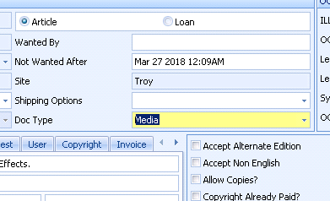
Problems with Info in the Request
Wrong OCLC record altogether
Wrong Format
Citation incorrect
Notes:
First up is problems with the Information in the Request. These could be:
The wrong format is selected for the item. Most popular would be your BOOK request went out under the INTERNET RESOURCE record. Lending E-Books is rare. Not many can due to licensing and lack of technology.
Another is the Wrong OCLC record altogether. You have a Serial that change title 6 times in the last ten years and you’ve chosen the wrong one. OR - you have similar titles, but the wrong title. OR - Your patron sent the request on the OCLC number that had the least holdings in the world, and yet it’s a popular item held by thousands and someone didn’t catch it.
And the last is the Citation information just isn’t correct. Automation is awesome, until this happens and the Lending libraries on the other end wound up with a bad citation, and no one Conditionaled you back to let you know.

Slide 7
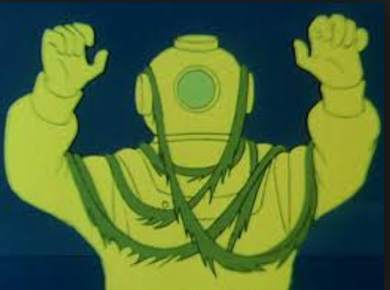
No library will copy/scan.
Embargos
PrePubs
No one owns
Resubmit again
Cancel in OCLC and make your patron wait
Purchase it
Further research into who might own it
Notes:
For Articles or Book Chapters it could come back Unfilled because:
The Library you asked had an E-Journal holding that had an Embargo period
Along the same lines… it’s a pre-pub
Or no one owns the volume and year you need. Think of the really old titles, or those newsletter-y type publications from the mid-80s an 90s.
Unable to copy - tight binding
So, in these cases, you could:
Resubmit it again, maybe under a different record - Serial vs. Electronic
You could Cancel in OCLC and make your patron wait to re-request again (if it’s a pre-pub)
OR you could purchase it
Or do further research into who might own it, if no library does - the organization, the publisher??

Slide 8
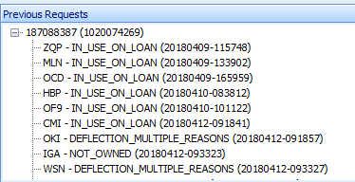
No one will loan (2018 Book)
Non-circulating
Checked out
Lost
Resubmit again
Cancel in OCLC and make your patron wait
Or Purchase it
Notes:
On the flip side - Loans will come back if no one will or can loan them.
Common reasons:
Non-circulating
Due to year of publication; format (think E-Book); rarity; licensing; policy issues (like AV materials or Course Reserves)
Already checked out
Not on Shelf
So, in these cases, you could:
Resubmit it again and hope someone supplies it eventually
You could Cancel in OCLC and make your patron wait to re-request again - as in the case of a new publication
OR purchase it

Slide 9
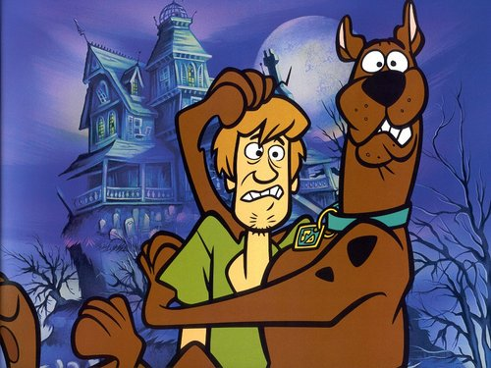
My Requests Are Unfilled! Now What?!
Notes:
So, your requests are Unfilled, and you know why.
Now, what’s your next step in ILLiad?

Slide 10
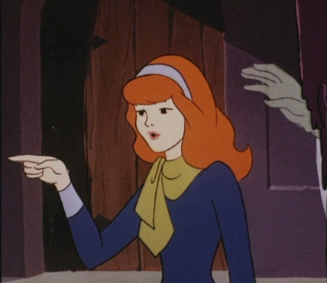
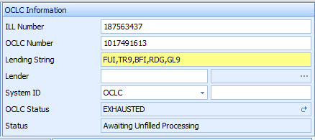
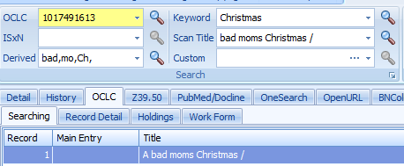
Unfilled - Re-Requesting
How to Re-Request
Notes:
You can re-request the item.
Open it in the Awaiting Unfilled Processing Queue
After making any corrections in your citation, searching out the correct format, or just trying to get that new book from someone else, search your record up in OCLC
Locate Holdings
Create your Work Form
Send your Request
And then Click Request Sent
This should cancel out the old OCLC request in WorldShare and produce a new one.

Slide 11
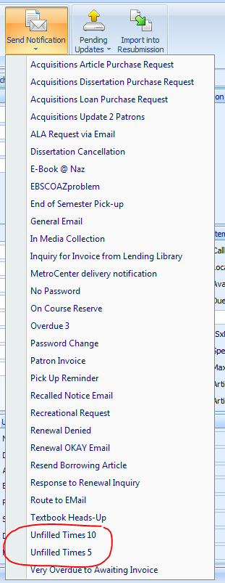
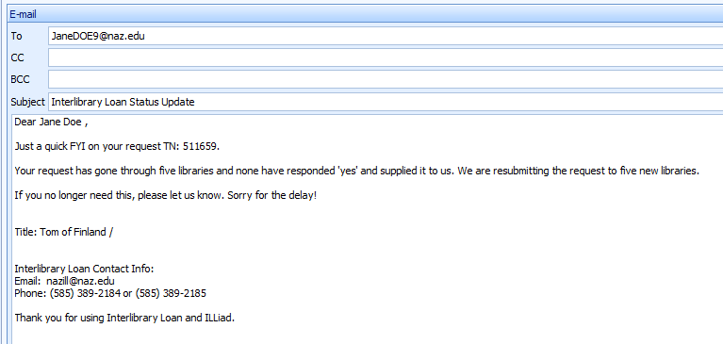
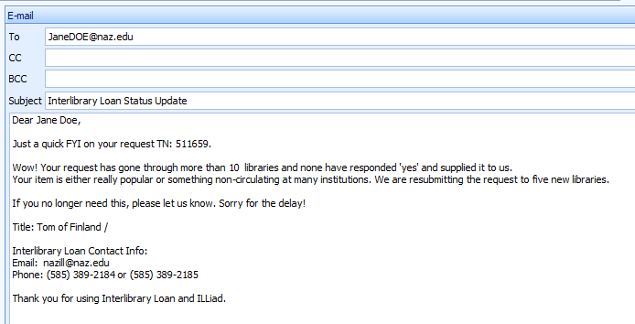
Unfilled Courtesy Email to go with the Re-Request
Notes:
At Nazareth College, if it’s a harder to get item, and it’s gone through 5 libraries with a “NO” response, we’ll send them an FYI email that we’re resubmitting to five new libraries and if they don’t need it, to please let us know.
If it’s gone through 10 libraries, we’ll send them the “WOW!” Email, of Wow! Your request has gone through more than 10 libraries and none have responded ‘yes’ and supplied it to us. The item is either really popular or something non circulating at many institutions.
Again, we tell them we’re retrying and again, ask them if they no longer need it, to please let us know.

Slide 12
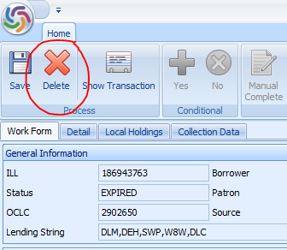
Unfilled -Cancel & Purchase
Notes:
Another option, if you can’t get a library to supply is the Cancel and Purchase scenario.
You will want to:
Open the request from the Awaiting Unfilled Processing queue
Click on the OCLC Request tab and Click SHOW
Click Delete to get this request out of WorldShare - since you aren’t getting it from another library
Now, you can follow your library’s Acquisitions or Purchasing process - whether getting it from Get It Now, Reprints, or purchasing directly from a vendor. Some libraries route these over to Document Delivery for their Acquisitions staff to handle, and some do not.
The Key is to GET IT OUT OF OCLC!

Slide 13
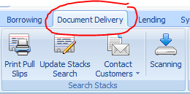
Unfilled -Cancel & Fill
Notes:
Another option, if you can’t get a library to supply but you find out it’s in your own collection or in an Open Source collection.
You will want to:
Open the request from the Awaiting Unfilled Processing queue
Click on the OCLC Request tab and Click SHOW
Click Delete to get this request out of WorldShare - since you filling it yourself.
Now, you can follow your library’s Document Delivery process
The Key is to GET IT OUT OF OCLC!

Slide 14
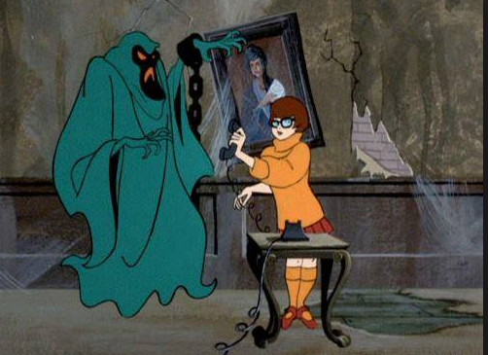
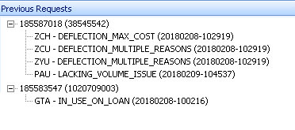
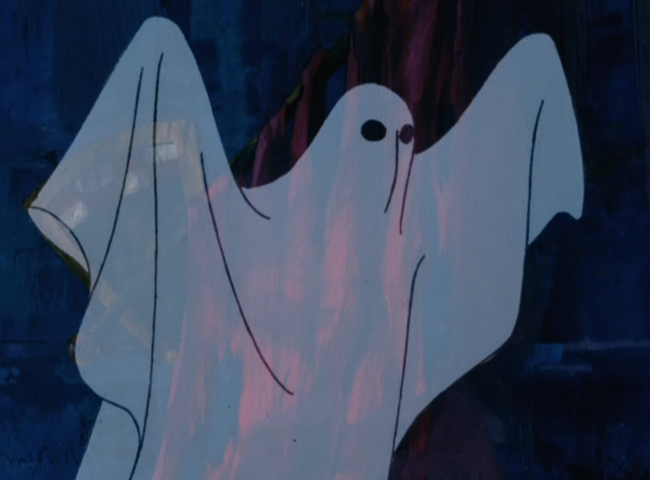
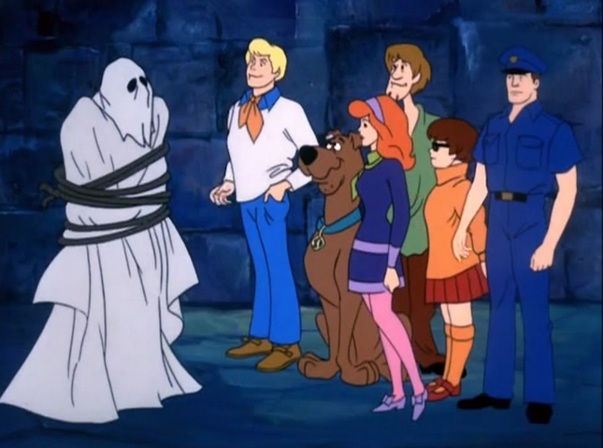
If you DON’T get it out of OCLC - BEWARE The Ghost Request!
Notes:
So, what happens if you DON’T get it out of OCLC?
You get the UNFILLED Ghost Request haunting you!

Slide 15
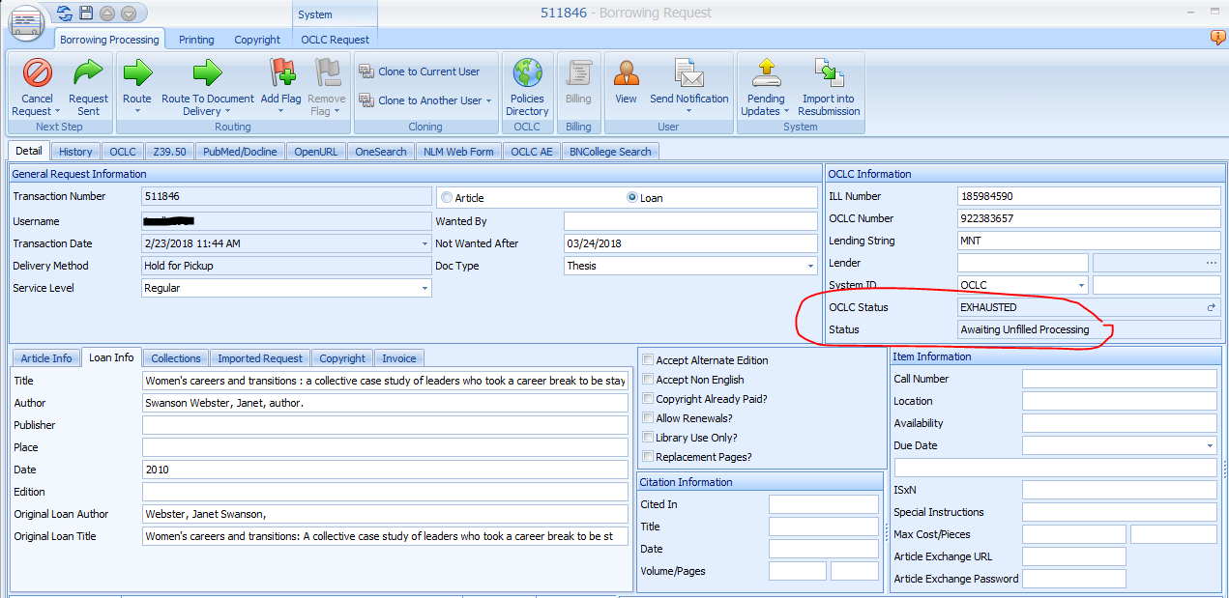
Unfilled - Avoid being haunted by the Awaiting Unfilled Ghost!!
The Case of the Purchase/Cancel Scenario
Notes:
These happen frequently on:
A Purchase/Cancel Scenario
Or the filled through Document Delivery Scenario - You get so excited that you found it in your collection, or through Open Source, that you forget to get rid of it out of OCLC and you fill it - putting it into Delivered to Web.
Or it could be a Resubmit Glitch! You did what you were supposed to do to resubmit a new request and OCLC had a glitch and your old request and your new request are now residing in OCLC at the same time, sending conflicting messages.

Slide 16
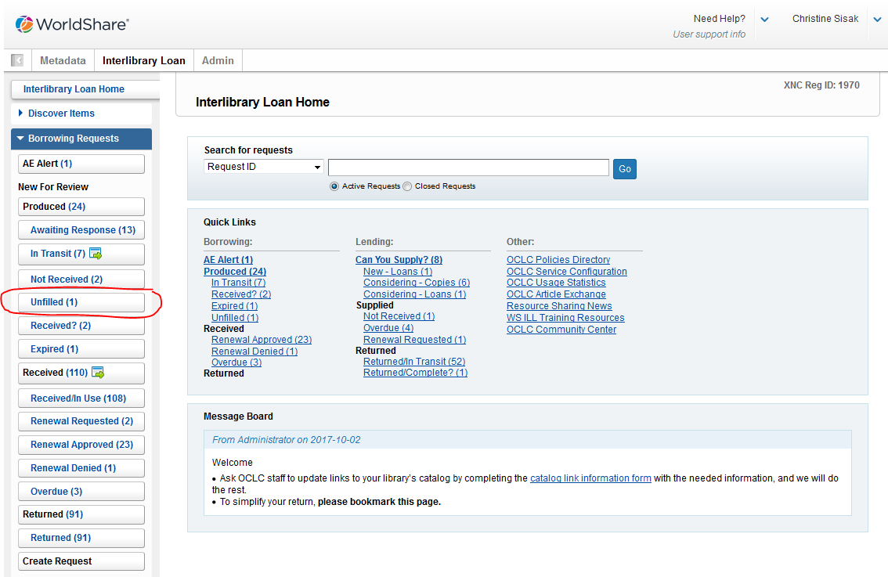
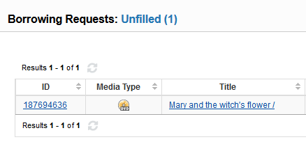
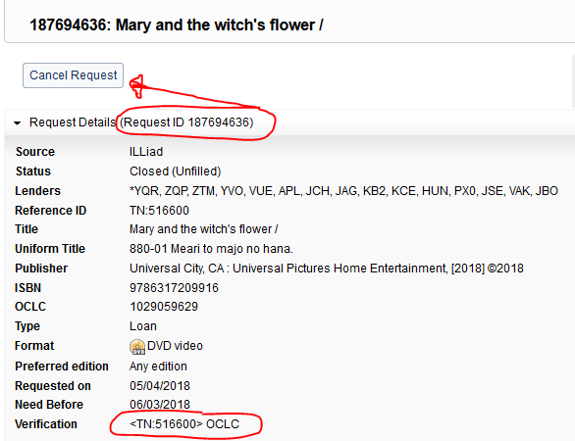
Using Worldshare to scare the ghost out of ILLiad
Notes:
There are two ways to exhume the ghosts!
The first is using Worldshare.
Log in
On the left menu bar, under Borrowing Requests, locate Unfilled
Locate the ILL number that matches the old (and unfilled) ILL number
Open the request up and BE SURE THE TN NUMBER and ILL NUMBER MATCH the ghost request and not your live request.
Click the Cancel Request button and it should be gone.

Slide 17
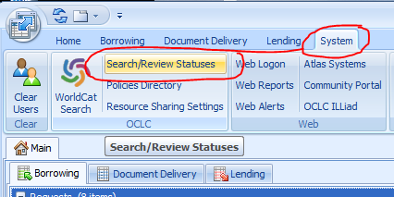
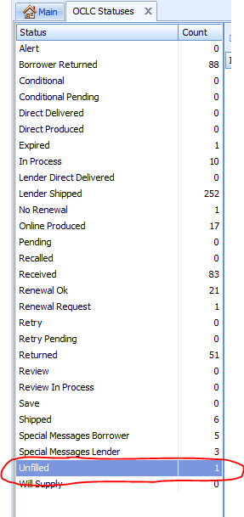
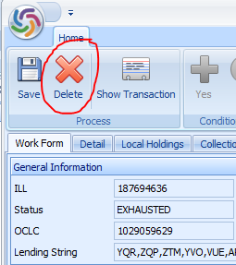
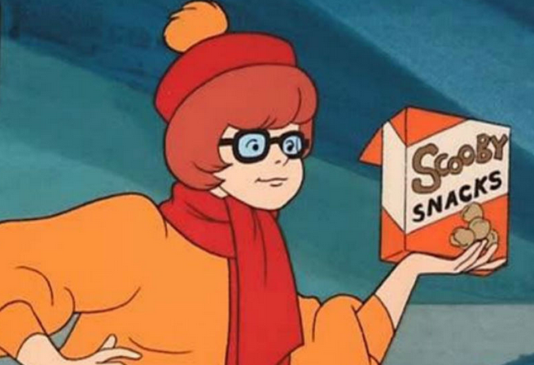
Using ILLiad to scare the ghost out of ILLiad
Notes:
The second way is to go in through ILLiad - though sometimes it’s not as intuitive as to which request is the ghost and which is not.
In ILLiad:
Open the System Tab
Click Search/Review Statuses
Locate the Unfilled category
Locate the ILL Number of the ghost culprit
Double check the TN to be sure it’s the ghost TN number and then click Delete.

Slide 18
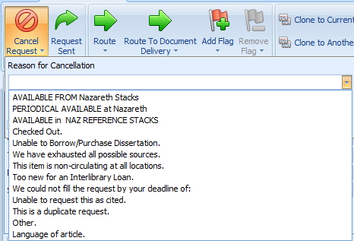
Unfilled -Cancel Completely back to Customer
Notes:
And finally, there is the option of Cancelling it completely back to the Customer.
When you pull down the Cancel Request, select the reason for cancelling and either send the email, or not…
ILLiad will cancel this out of OCLC.
Now….

Slide 19
Discussion
OCLC zero holdings
When customer service comes in!
Notes:
How does your library handle cancelling back to customers when the item is not found anywhere?
Where do you go from here with your customers?

Slide 20
Well Done

