Slide 1
TIPS AND TRICKS FOR INTERNATIONAL ILL
Silvia Cho
Ron Figueroa
Stephanie Helsher
Jay Kibby
Beth Posner
Elise Thornley

Slide 2
Tools to find materials
• Old material in public domain:
•Archive.org
•Hathitrust
•Gallica
• Open Access publishing:
•DOAJ (set up in link resolver)
•Google search (OA journals, institutional repositories, author pages, social networking sites).
•Spanish and Portuguese journals: Dialnet, Redalyc, SciELO
https://airastana.com/uae/Information/Travel-to-Kazakhstan/Visa-Free-
Travel-to-Kazakhstan
Notes:
Silvia (8-10 minutes)
Dialnet, redalyc, Scielo: not necessarily in DOAJ.

Slide 3
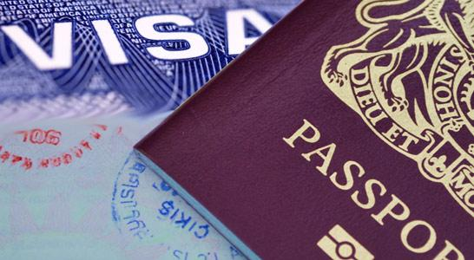
Tools to find materials
Systems requiring pre-registration
Library or System | Loans | Copies | E-delivery | IFLA accepted | Pre-registration
NDL online (Japan) | Y | Y | N | N Credit card or wire transfer only | Y
National Library of Russia | Y | Y | Y (email or FTP) | N Credit card only | Y
BL online (UK) | For business accounts only (100+ orders/yr) | Y | Y | N, but accepts IFM (And credit card, U.S.-based check) | Y
Biblioteca Nacional de España | Y | Y | Y | Y | Y
Notes:
8-10 minutes.

Slide 4
Tools to find materials
Systems requiring pre-registration (continued)
Library or System | Loans | Copies | Electronic Delivery | IFLA accepted | Pre-registration required
SUDOC/SUPEB | Y | Y | Depends on the library | Depends on the library; specify in request notes | Y
Bibliothèque Nationale de France | N | Y | Y | N Cr card or bank transfer only | Y

Slide 5
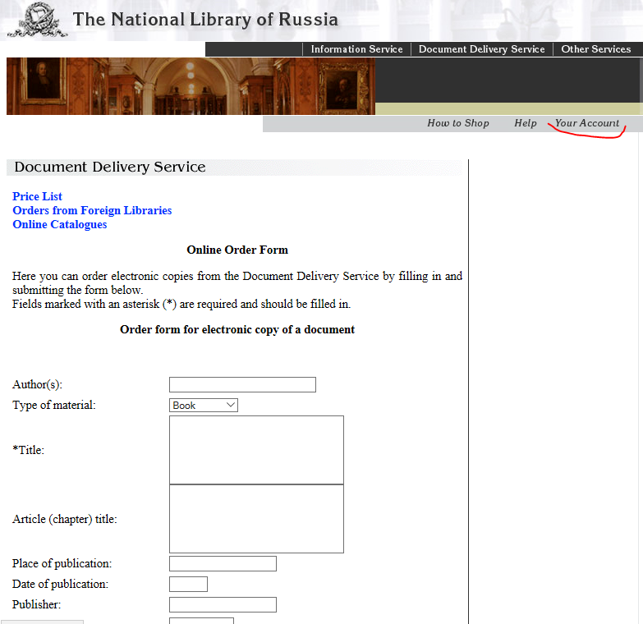
Tools to find materials

Slide 6
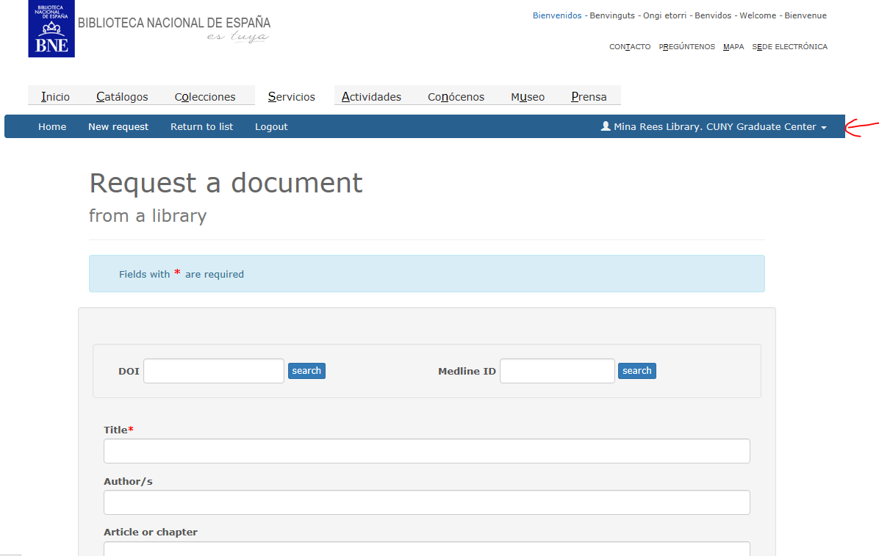

Slide 7
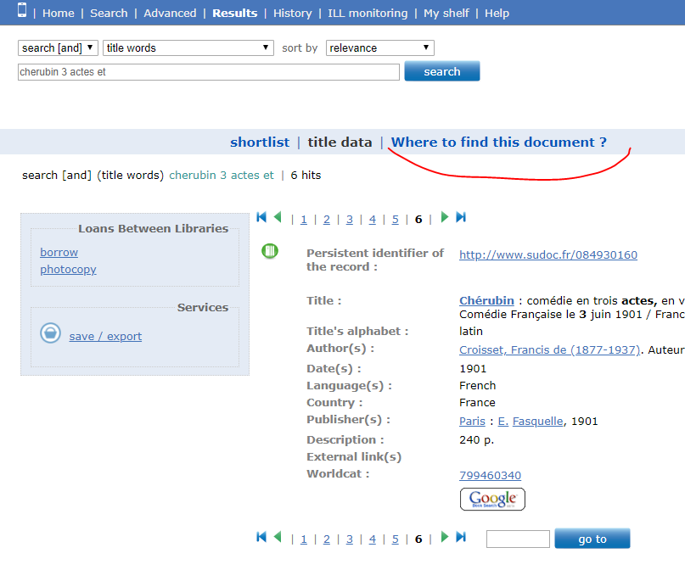

Slide 8
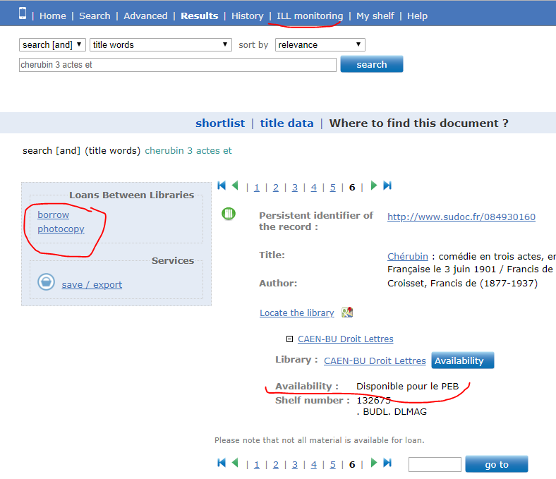

Slide 10
Tools to find materials
Discovery and location systems (and policies directories!)
Library or System | Loans | Copies | IFLA accepted | Pre-registration required
Sbn.it* (Italy) | Y | Y | Depends on the library; ask in email | N
GVK^ (Germany) | Y | Y | Depends on the library; ask in email | N
Cinii (Japan): Cinii Books, Cinii Articles | Y | Y | Depends on the library; look in the directory | Y
...and many more at: shareill.org > Finding aids and tools
Notes:
Show sample screenshots: GBL. Sbn.it, CiNii
^: Mention new German Copyright Act (also see presentation, OCLC): the german copyright law changed at March 2018 and since then it isn’t allowed to copy newspaper or magazine articles any more for german libraries. We’re trying to find a solution with the german copyright clearance center (VG Word). But at the moment all german libraries can’t deliver copies of newspaper articles if they are not public domain and this starts 70years after the authors death.

Slide 11
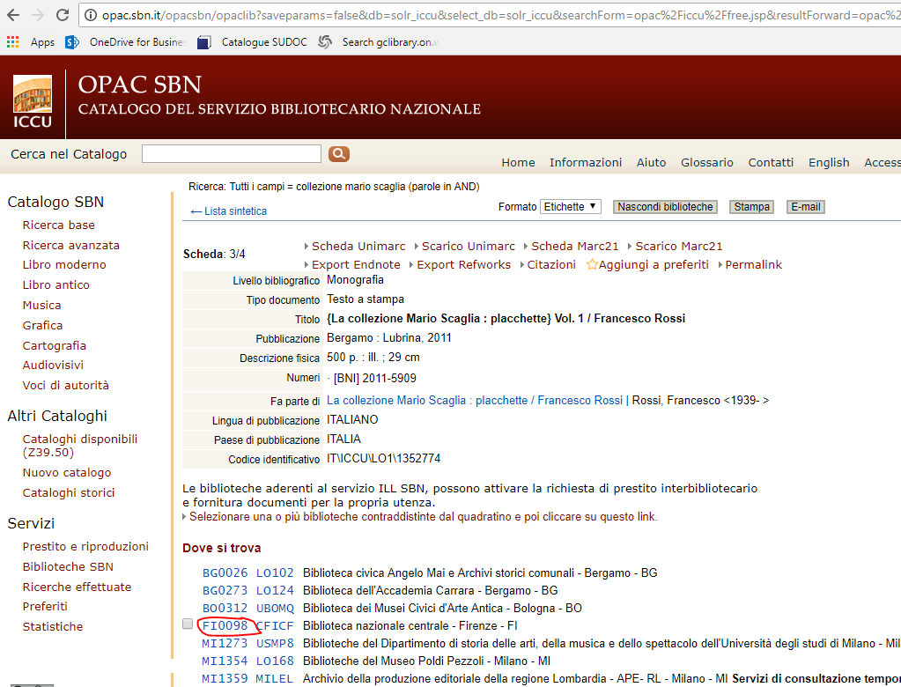
Notes:
Show sample screenshots: GBL. Sbn.it, CiNii
^: Mention new German Copyright Act (also see presentation, OCLC): the german copyright law changed at March 2018 and since then it isn’t allowed to copy newspaper or magazine articles any more for german libraries. We’re trying to find a solution with the german copyright clearance center (VG Word). But at the moment all german libraries can’t deliver copies of newspaper articles if they are not public domain and this starts 70years after the authors death.

Slide 12
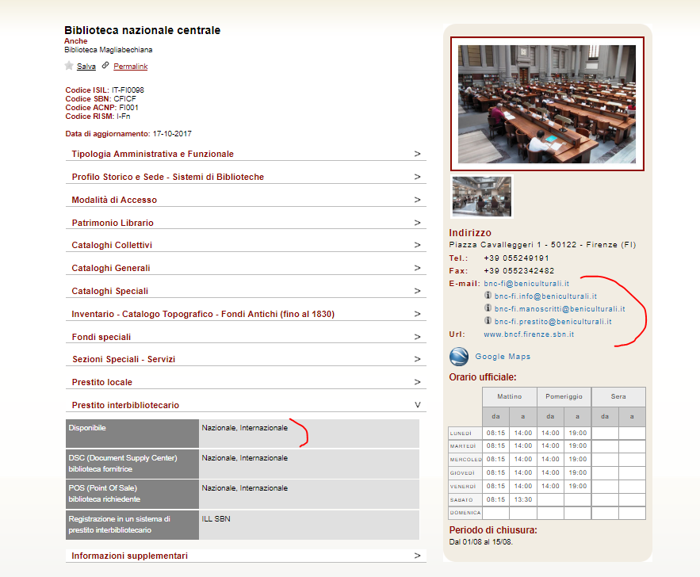
Notes:
Show sample screenshots: GBL. Sbn.it, CiNii
^: Mention new German Copyright Act (also see presentation, OCLC): the german copyright law changed at March 2018 and since then it isn’t allowed to copy newspaper or magazine articles any more for german libraries. We’re trying to find a solution with the german copyright clearance center (VG Word). But at the moment all german libraries can’t deliver copies of newspaper articles if they are not public domain and this starts 70years after the authors death.

Slide 13
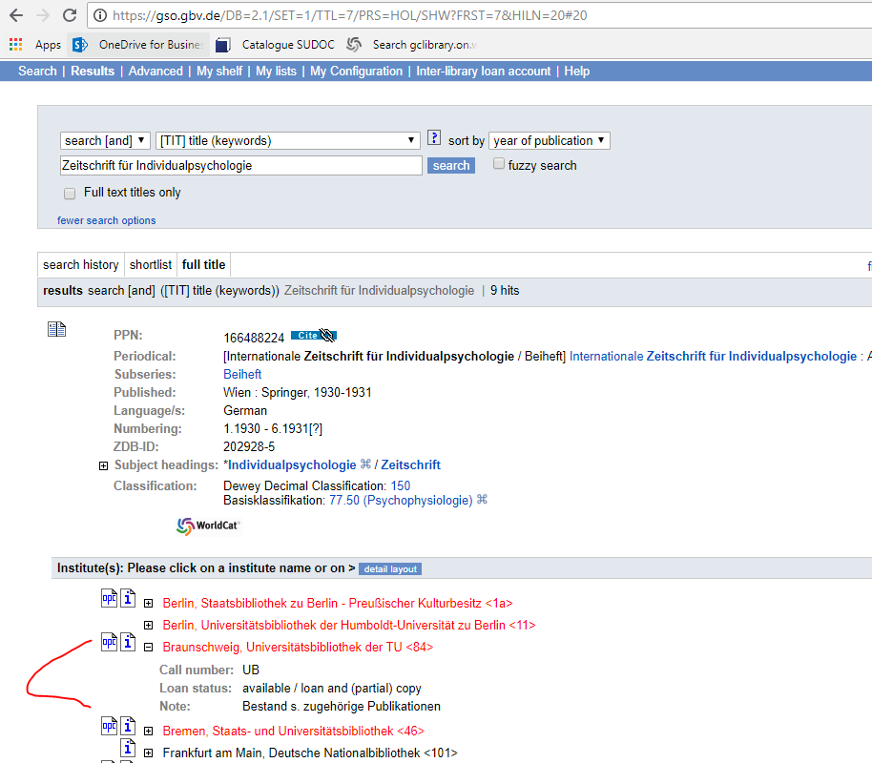
Notes:
Show sample screenshots: GBL. Sbn.it, CiNii
^: Mention new German Copyright Act (also see presentation, OCLC): the german copyright law changed at March 2018 and since then it isn’t allowed to copy newspaper or magazine articles any more for german libraries. We’re trying to find a solution with the german copyright clearance center (VG Word). But at the moment all german libraries can’t deliver copies of newspaper articles if they are not public domain and this starts 70years after the authors death.

Slide 14
More tools to find materials
Discovery systems
•CCN (Catalogo Coletivo Nacional, Brazil): http://ccn.ibict.br/busca.jsf
•Cobiss.net (Eastern Europe)
•Elibrary.ru
•KISS, Dbpia (Korea)
•CALIS (China)
•Dissertations in India : http://shodhganga.inflibnet.ac.in/
•Tina Baich, Heather Weltin, (2012) "Going global: an international survey of lending and borrowing across borders", Interlending & Document Supply, Vol. 40 Issue: 1, pp.37-42, https://doi.org/10.1108/02641611211214279 .
•Shareill.org

Slide 15
Tools to find materials
Not turning up anything? Try--
•Relatively recent? Try contacting the author or publisher
•Slavic Reference Service
•East Asian Gateway: http://www.library.pitt.edu/eal-gateway-service
http://twomenandalittlefarm.blogspot.com/2016/05/directional-sign-post-inspiration.html

Slide 16
Submitting Requests
OCLC libraries
Suppliers (uppercase)
Non-suppliers
Policies Directory
Other libraries
Library Websites
Catalogs
ILL homepage
Contact emails
Reference questions page
http://www.thebluediamondgallery.com/handwriting/s/submit.html

Slide 17
Language Tips for Submitting Requests
Look for English language website - flag in top corner
Can email in English or there may be local staff/students who speak other languages
Or, just add a greeting or sign off saying thanks in other languages
Google translate can help you understand webpage wording or to translate an email response but it’s not good enough to use to write an email
https://pixabay.com/en/welcome-words-greeting-language-905562/

Slide 18
Workflows in ILLiad for non-OCLC libraries
Borrowing:
Finding email/phone contact for lending institutions
Try to see if there’s any information on a webpage about lending policies before contacting
Include as much bib info in email as possible, and ask for info on policies, costs, etc
Follow up contact (if no response)
Noting all details in request notes/cc’ing involved in processing
Receiving in ILLiad/flagging for special return processing
Lending:
If you have an ILL webpage for patrons, include a place for (all) borrowers to contact your library
If contacted by email about lending, be sure to include important info about turnaround times, fees, and other expectations up front. Get contact info for shipping!
Logon page: https://illiad.lib.binghamton.edu/illiad/Lending/illiadlending.dll
Notes:
Work in progress!! Need to add images also :)

Slide 19
IFLA vouchers
IFLA: International Federation of Library Associations
https://www.ifla.org/
https://www.ifla.org/voucher-scheme
This international association developed a way for libraries to operate with each other without having to deal with currency exchanges
There are multiple ways to purchase IFLA vouchers
US & Canada: OCLC
Japan: Japanese Library Association
Switzerland: Swiss Association Library & Information Management
All other countries: Directly from IFLA (headquarters are in the Netherlands)

Slide 20
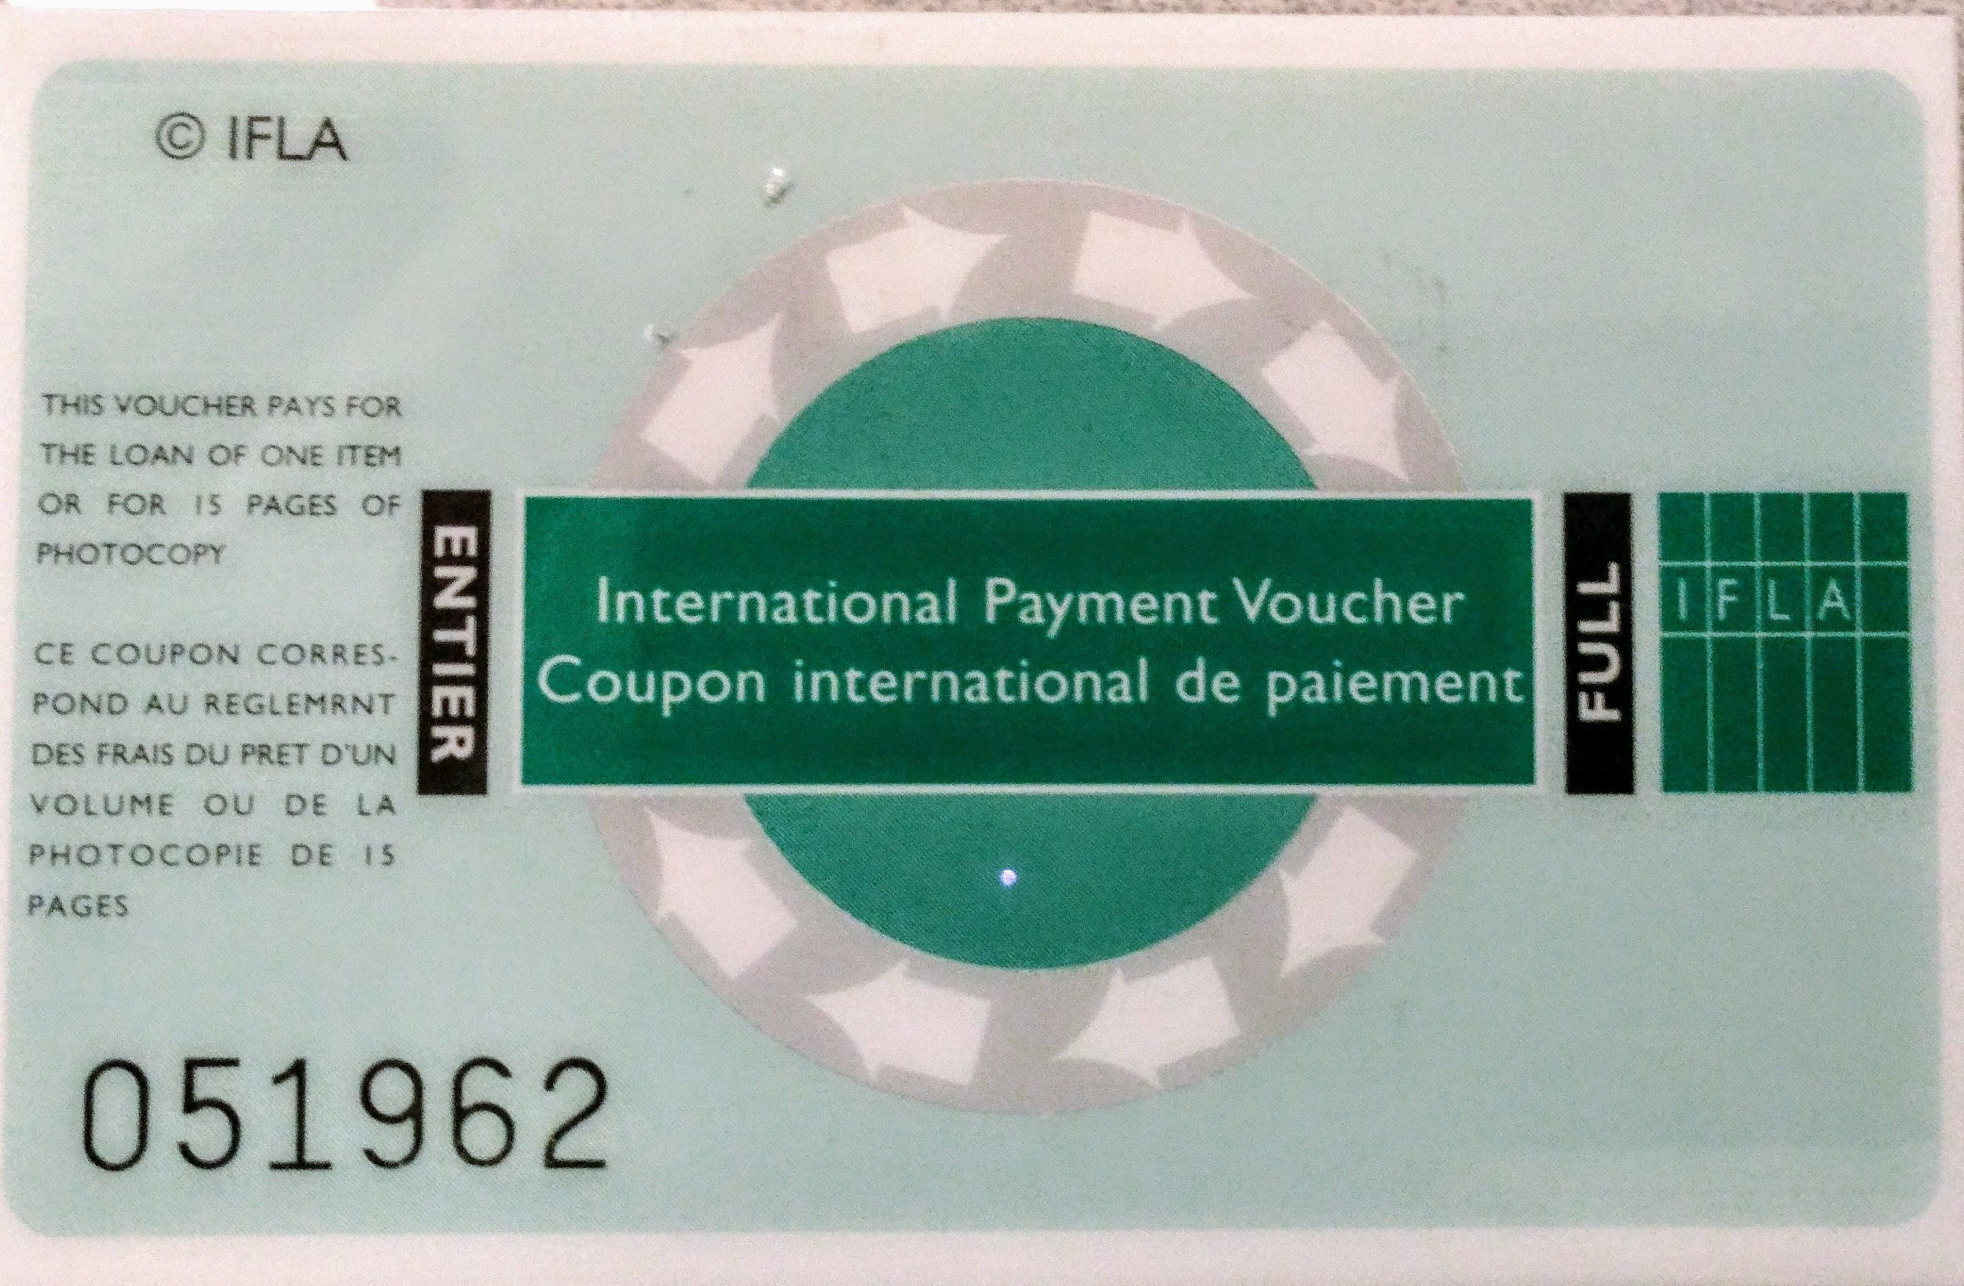
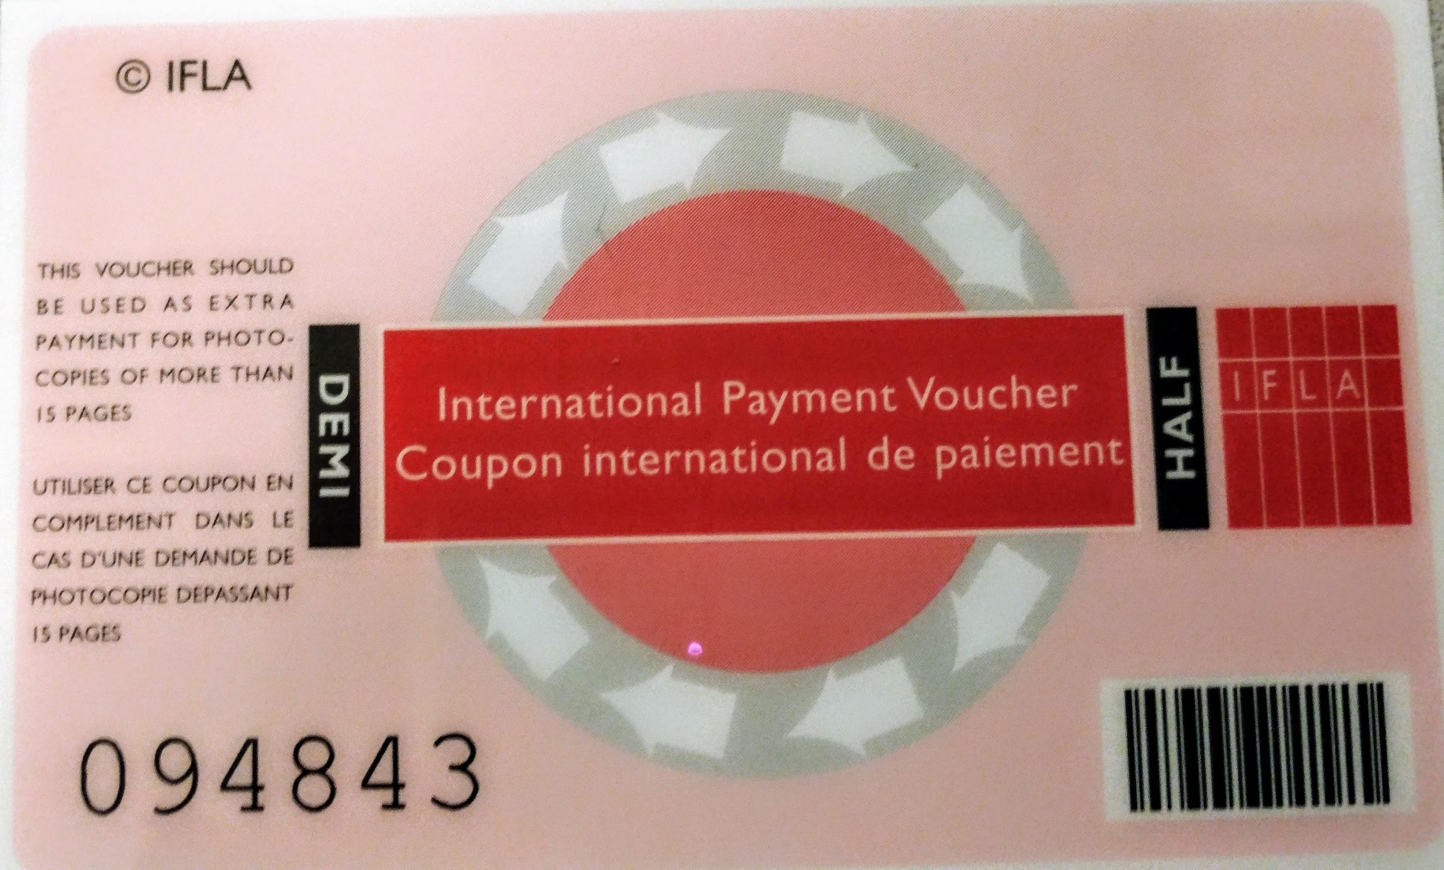
IFLA vouchers
Full IFLA Voucher
Currently worth $12 USD or 8 EUR
Half IFLA Voucher
Currently worth $6 USD or 4 EUR
Like a Forever stamp, the current price of IFLA vouchers does not impact vouchers already bought & paid for. Older vouchers have as much value as new vouchers

Slide 21
IFLA vouchers
Two Options for Purchasing from OCLC
Order form: https://www.oclc.org/content/forms/worldwide/en/ifla-vouchers.html
Vouchers ordered through the order form can be billed via monthly OCLC bill, or invoiced separately
ILLiad/WorldShare Workform
Submit a blank workform to the lender VOUCH, indicating how many of each you need
This type of request is paid for via IFM
Make sure your Max Cost is high enough to cover the cost of the vouchers!

Slide 22
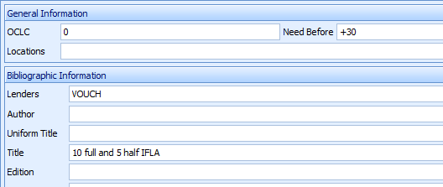
IFLA vouchers
In the OCLC Search Tab
In the Work Form

Slide 23
IFLA vouchers
Managing payments & billing
How much to charge?
Tracking
For Lending, we’ve set up IFLA as a Default Billing Category for both articles and loans.
In Borrowing, we add the IFLA price for the transaction to the “Special Instructions” field. We are in the habit of looking here for information on return shipments; we ship the item back with the payment.
Customization Manager default billing categories

Slide 24
Shipping methods
Articles v. Loans
Different copyright laws and restrictions make for different possibilities
German, Danish and British libraries
Mailing articles
Faxing Articles
MyBib
Some libraries may prefer to scan an entire book for you!
Notes:
Binghamton - Ships USPS/UPS (with tracking); we also receive through DHL and Fedex pretty frequently

Slide 25
Shipping methods
Items to include for every shipment, regardless of the courier
Box!
Plastic wrapping
Tracking
“No commercial value”
To denote the higher standard of packaging requirements to our students, we established an “Airmail” Default Shipping Loan Category

Slide 26
Shipping methods
Couriers
We currently only have experience with USPS Airmail
DHL, UPS, FedEx
Some libraries may try to arrange shipping for you/ have specific requests in their borrowing notes
Please make sure that you send it to us by TRACEABLE mail with an invoice value of $1. If you wish to send it by courier, please make sure you send it as DDP (Delivery Duty Paid) so that all shipping costs, including taxes, are covered by you.In addition please write "NO COMMERCIAL VALUE" on the parcel. IF YOU CAN"T COMPLY WITH THE ABOVE PLEASE PASS ON TO NEXT LENDER, DO NOT SUPPY.We will not pay for lost book which had no tracking number.
Conditional Note: Bedingung - Fehlende Copyright-Angaben We can send, but according to the new german copyright law we need a written declaration in the Borrower's Notes, that the article will be only used noncommercial. Delivery via fax or via airmail.. Bemerkungen: will be faxed 26.6.2018

Slide 27
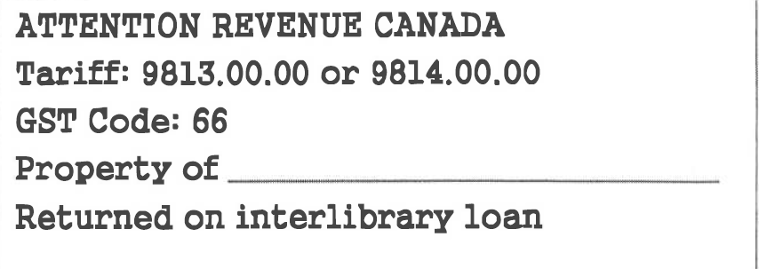
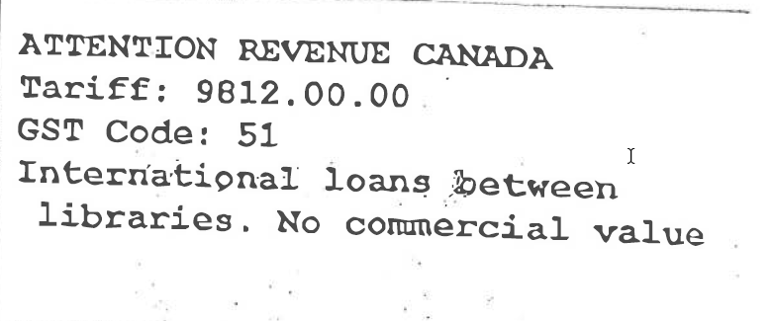
Shipping methods
Canadian Tariff Labels
Borrowing items being returned to Canadian home institution
Lending items being sent to requesting Canadian library

Slide 28
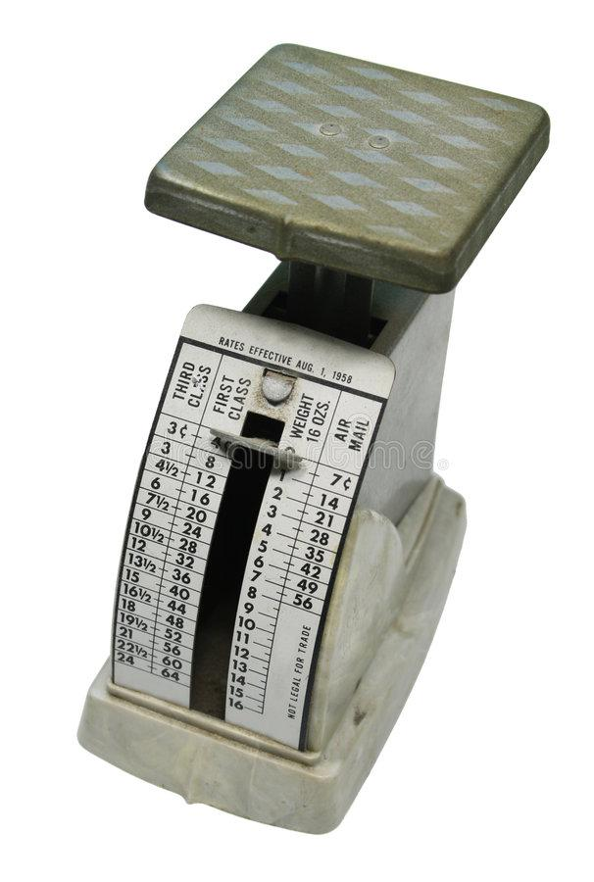
Customs form
Available at https://cns.usps.com/cfo-web/labelInformation.shtml
Information entered electronically
Tip: Enter from Policies Directory, not ILLiad (also a good time to update address in ILLiad!)
Fields change based on country
Example - Postal code required in Canada, but not in Germany
Use either personal or institutional name
Weight
Have a scale? Enter accurate weight from scale.
No scale? Enter 1 lb. Most materials will be less than this.
If over 1 lb. - price will be adjusted when shipped

Slide 29
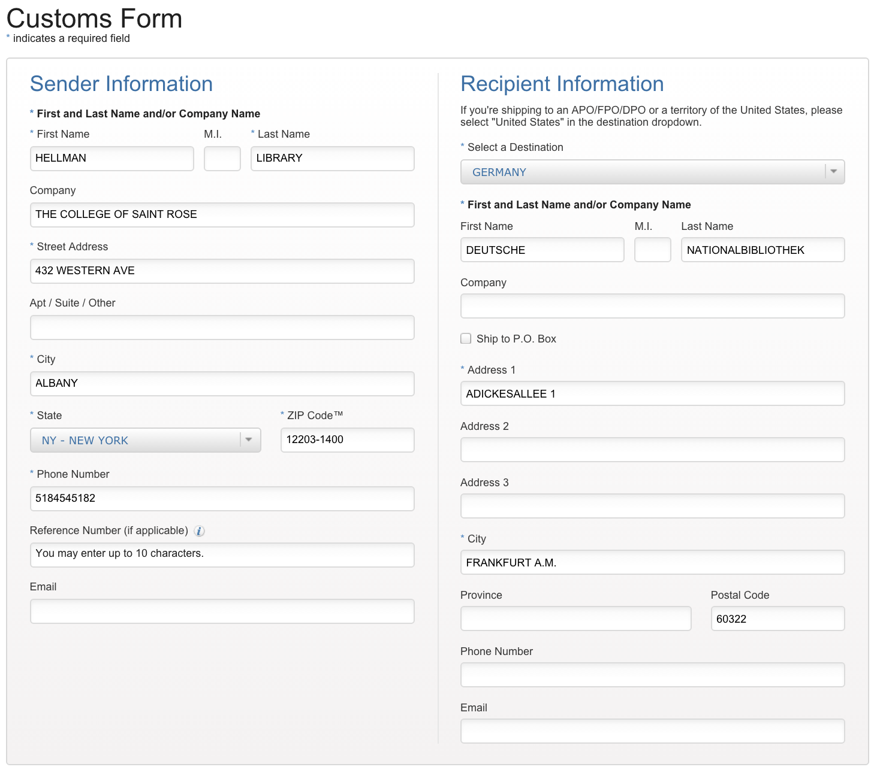
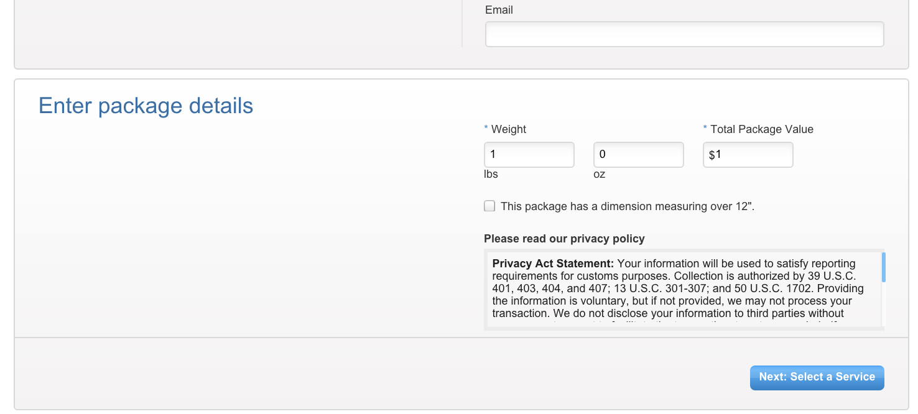
Customs Form

Slide 30
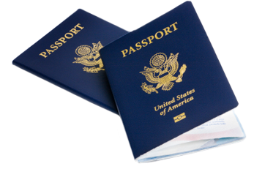
Customs Form
Choose service
First-Class Package International Service, Priority Mail International, Priority Mail Express International
Enter package information
Contents: Document
Content Description: Library book
Item Information
Detailed Description: Library book
Item Value: $1 (it doesn’t hurt to check with your post office or mail room)
Country of Origin
Use bibliographic information from behind title page
Weight
Earlier selection listed next to entry field

Slide 31
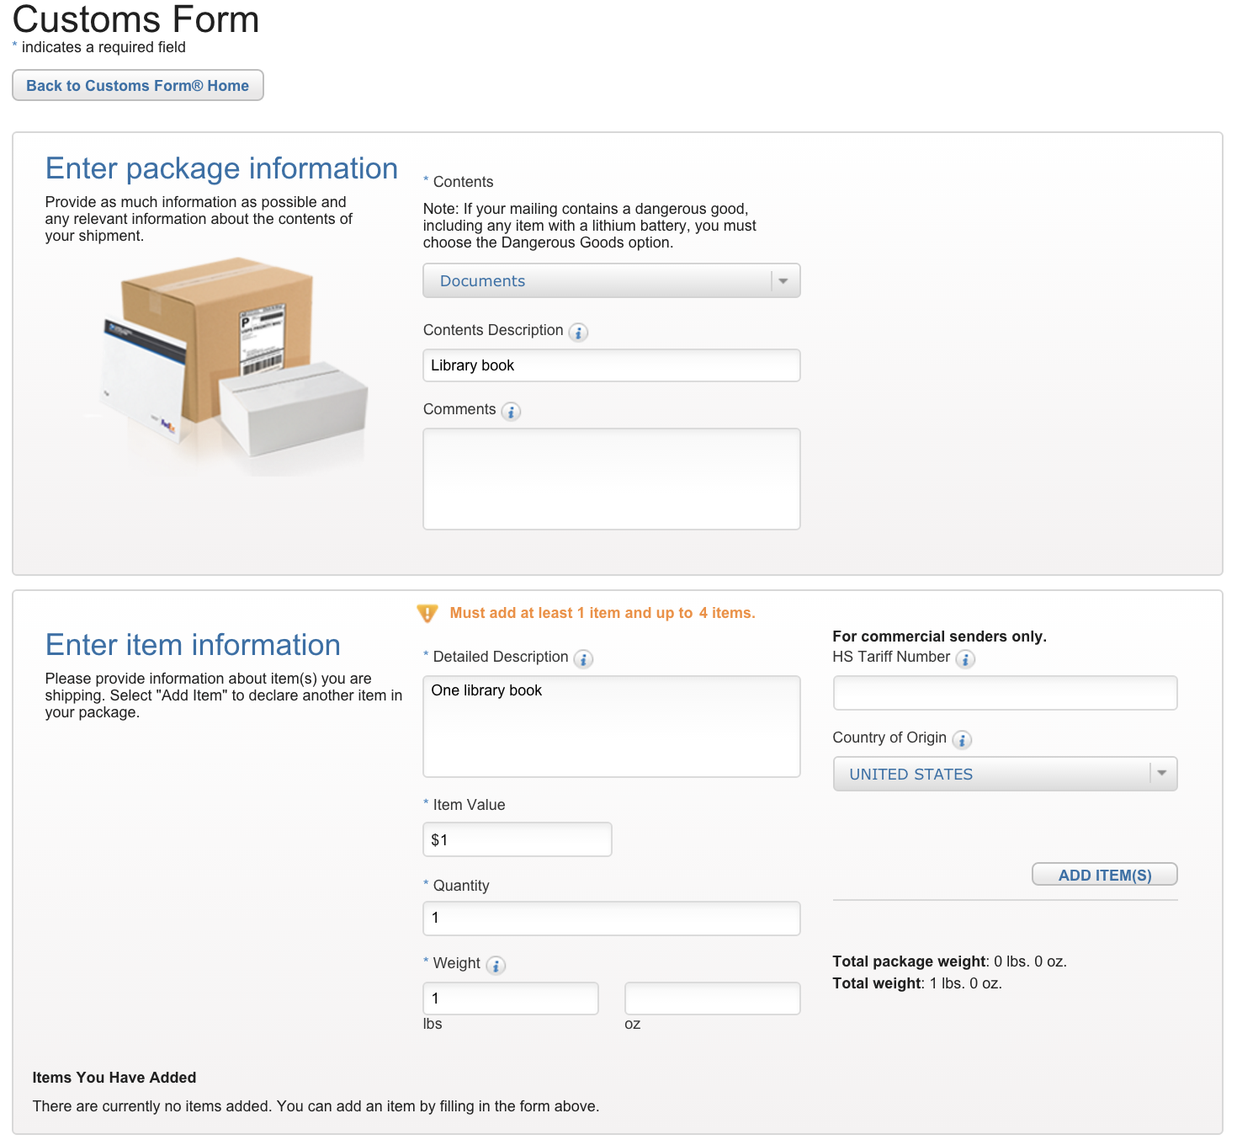
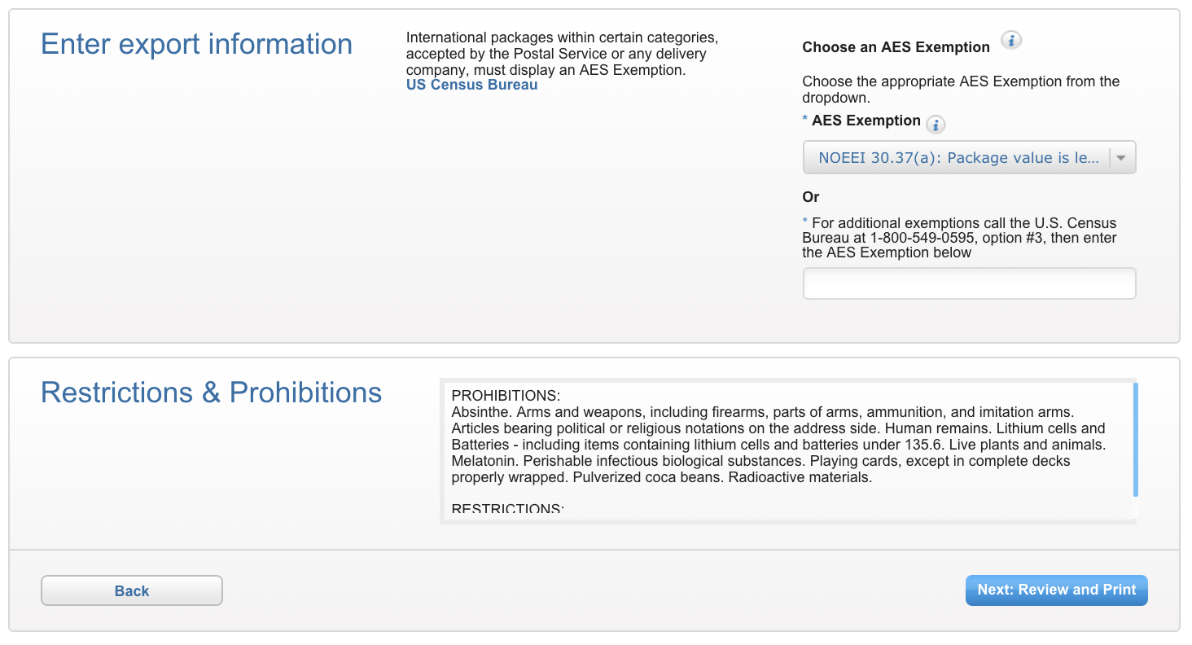
Customs Form

Slide 32
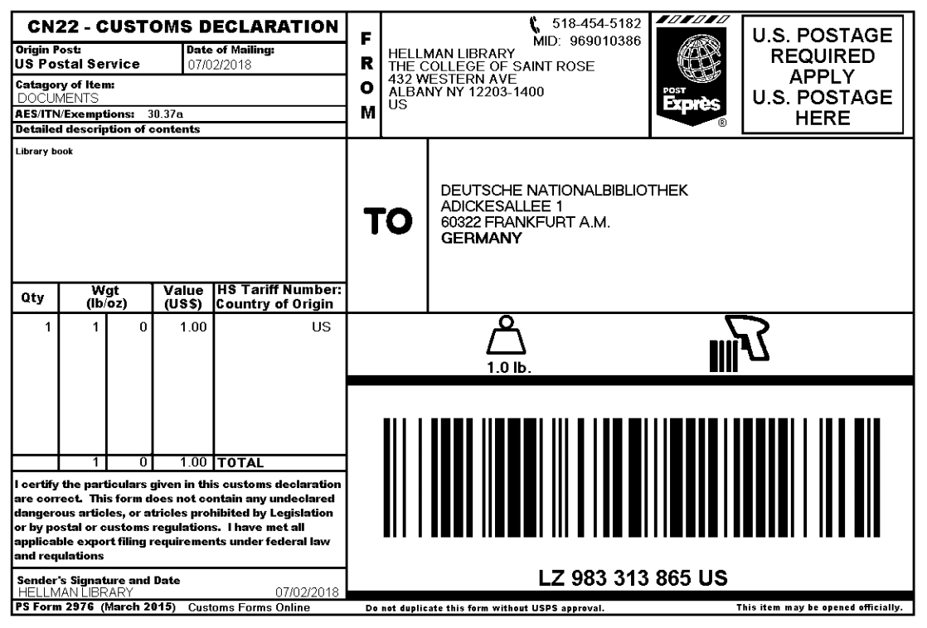
Customs Form

Slide 33
Thank you!
Questions?

