Slide 1
Welcome
IDS Project Members
To the Fall 2020
Virtual User Group!

Slide 2
Agenda
1:00pm-1:15pm Welcome and Update
1:15pm-1:30pm Director Q&A
1:30pm-2:15pm Presentation: Telling the Story of ILL/LRS...
2020 Resource Sharing Statistics in Context
2:15pm-2:30pm Break or Breakout Room Chat
2:30pm-3:00pm Workflow Overview: Adding and Deleting IDS Project
Members 3:00pm-3:15pm Break or Breakout Room Chat
3:15pm-4:00pm Discussion: Resource Sharing/Services during COVID-19
4:00pm-4:15pm Wrap-up

Slide 3
IDS Community

Slide 4
directors
Jessica McGivney, Director of Regional User Groups
Beth Posner, Director of Mentors
Logan Rath, Director of Online Learning
Jennifer Acker, Project Manager

Slide 5
Admin updates
ALIAS and Alma
Ex Libris has updated their publishing profiles so that you can now export both the IZ and NZ in the same file.
Mike Mulligan has been working on cleaning up the data from Alma so that we get better date information for ALIAS to use
362, 949 field issues
Publisher/Aggregator Data

Slide 6
IDS Project Membership Growth

Slide 7
Mentors:
Jennifer Acker (Hudson Valley Community College)
Silvia Cho (CUNY Graduate Center)
John De La Fontaine (Occidental College)
Ronald Figueroa (Syracuse University)
Heather Gad (SUNY Oneonta)
Timothy Jackson (SUNY)
Jay Kibby (Drexel University)
Will Koch (CUNY Brooklyn College)
Jessica McGivney, Director of Regional User Groups (SUNY Farmingdale)
Melissa Perez (University of Texas San Antonio)
Beth Posner, Director of Mentors(CUNY Graduate Center)
Logan Rath, Director of Online Learning (SUNY Brockport)
Sarah Shank (Ithaca College)
Chris Sisak (Nazareth College)
Elise Thornley (Binghamton University)
Heidi Webb (Upstate Medical)
Chris White (Sage Colleges)

Slide 8
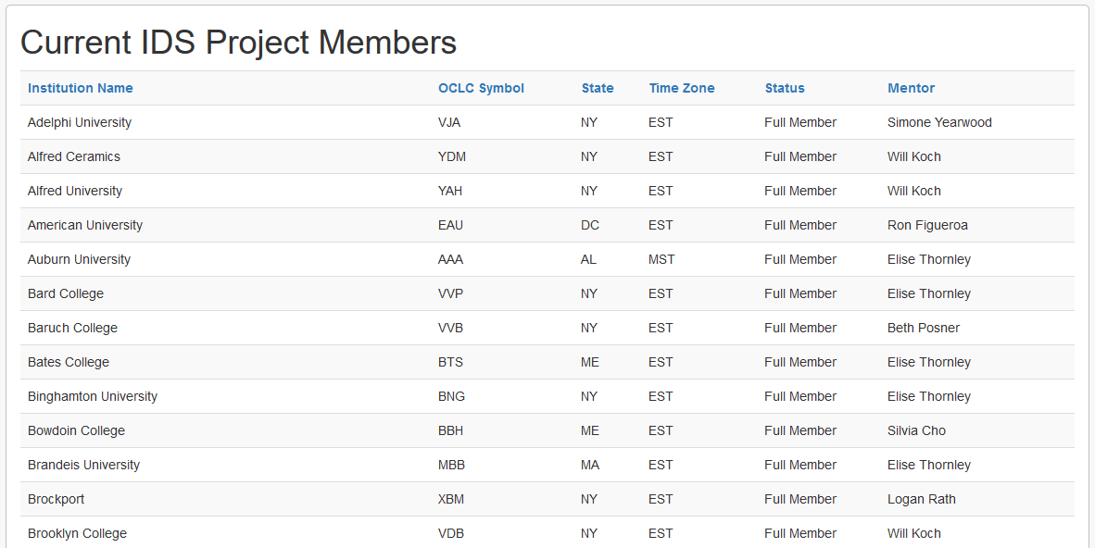
https://www.idsproject.org/About/memberlist.aspx

Slide 9
IDS Technology

Slide 10
Decision support Pipeline

Slide 11
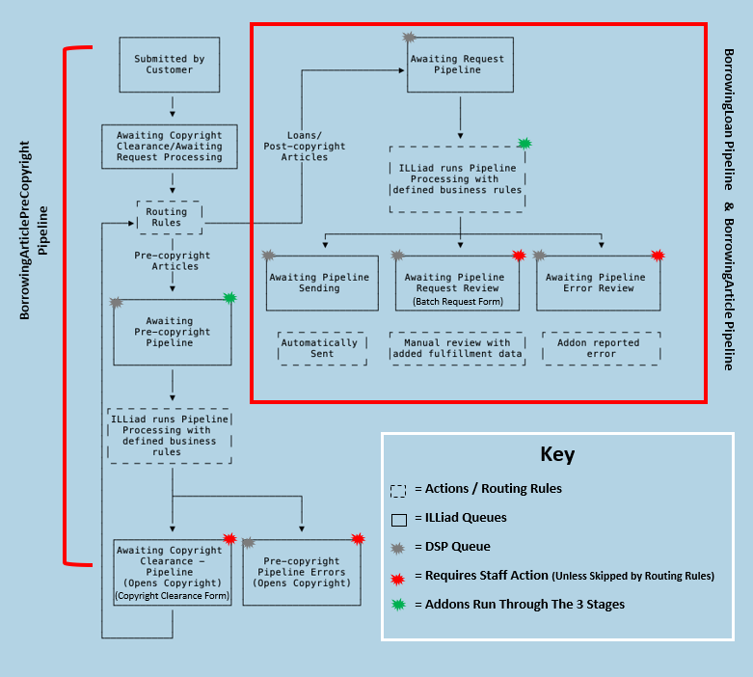

Slide 12
DSP and IDS Logic
Article Gateway works on Awaiting Copyright Clearance queue
A routing is required to move requests out of the ACC queue to the Awaiting Pre-Copyright Pipeline
DSP addons, such as DOI Import and Open Access Button run at this point
Requests are processed then moved to Awaiting Copyright Clearance – Pipeline or completed if an OA item is available
IDS Logic: Requests are updated with a set text value in the CitedPages field then sent back to Awaiting Copyright Clearance
The CitedPages field value prevents the routing from moving the request back into the pipeline.
Article Gateway then continues to process the requests.

Slide 13
DSP Routing Rule

Slide 14
DSP Logic Rule
##################
## Copyright Pipeline ##
##################
LogicRule_1:
Enabled: "1"
RuleName: "CopyrightPipelineRouter"
PreventReruns: "1"
NVTGCList:
- ILL
ProcessTypeList:
- "Borrowing"
RequestTypeList:
- "Article"
TransactionStatusList:
- "Awaiting Copyright Clearance - Pipeline"
RouteTo: "Awaiting Copyright Clearance"
AddNote: "DSP Completed by Logic Rules"
SetFields:
- CitedPages: "DSP Complete"

Slide 15
DSP and IDS logic
If you are interested in using DSP and Article Gateway together, please send an email to logic@idsproject.libanswers.com

Slide 16
Decision Support Pipeline
https://support.atlas-sys.com/hc/en-us/articles/360037905213-Decision-Support-Pipeline-Overview
https://support.atlas-sys.com/hc/en-us/articles/360037958113-Configuring-the-Decision-Support-Pipeline

Slide 17
IDS Conference 2021
Please send me an email (sullivm@geneseo.edu) if you are interested in working on the Conference Planning Team for 2021.
The 2021 conference will be virtual again this year.

Slide 18
Thank you!
https://github.com/idsproject

Slide 19
Agenda
1:00pm-1:15pm Welcome and Update
1:15pm-1:30pm Director Q&A
1:30pm-2:15pm Presentation: Telling the Story of ILL/LRS...
2020 Resource Sharing Statistics in Context
2:15pm-2:30pm Break or Breakout Room Chat
2:30pm-3:00pm Workflow Overview: Adding and Deleting IDS Project
Members 3:00pm-3:15pm Break or Breakout Room Chat
3:15pm-4:00pm Discussion: Resource Sharing/Services during COVID-19
4:00pm-4:15pm Wrap-up

Slide 20
