Slide 1
The Basics of Creating Accessible Documents for ILL Practitioners
IDS Project RUG Meeting Fall 2018
Tim Hickey
Resource Sharing Librarian
SUNY Purchase

Slide 2
Agenda
Scanning for Accessibility
Accessibility Reports
OCR
Tags and headings
Alternative text (Alt text)
Text to speech software

Slide 3
Interlibrary Loan Code for the United States
5.11 Deliver copies electronically whenever possible. Provide complete and legible copies, and adhere to any special scanning instructions of the requesting library.
When scanning, the supplying library should provide a copy that closely reproduces the original article or chapter in appearance, legibility, and completeness with appropriate attention paid to image color and clarity, margins, page orientation, and any accompanying references, plates, or appendices.

Slide 4
Characteristics of accessible documents
Text is identified via optical character recognition (OCR)
Text organization is recognized via tags and headings
Images, tables and other visual elements of the document are described in alt text

Slide 5
Scanning for accessibility
As US ILL Code makes clear we must strive to provide “a copy that closely reproduces the original article...”
If the text in a particular document has somehow become illegible because of highlighting, marginalia, tight binding or damaged pages, a lending library should avoid sending that article. That is, unless the borrowing library has no other options (lender of last resort for something rare in the system), and only after a the lending library has communicated the issue with the intended borrower.

Slide 6
Scanning for accessibility
When scanning from physical text to digital files always remember to “enhance” the scans with OCR. Depending on the scanning setup you use, this can be accomplished in different ways.
If you are using the Scannx system, make sure to select the “searchable PDF” in the scan setting under document format.
Other software setups will always have an option to recognize the text of documents you are scanning.

Slide 7
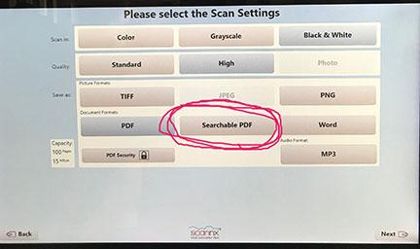
Select “Searchable PDF” as Document Format in Scannx

Slide 8
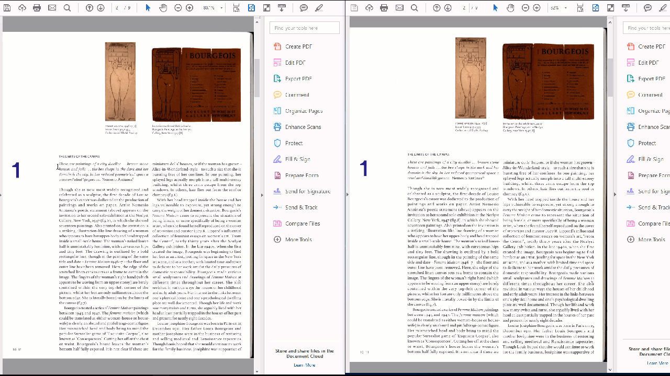
How to tell if a document is OCRd

Slide 9
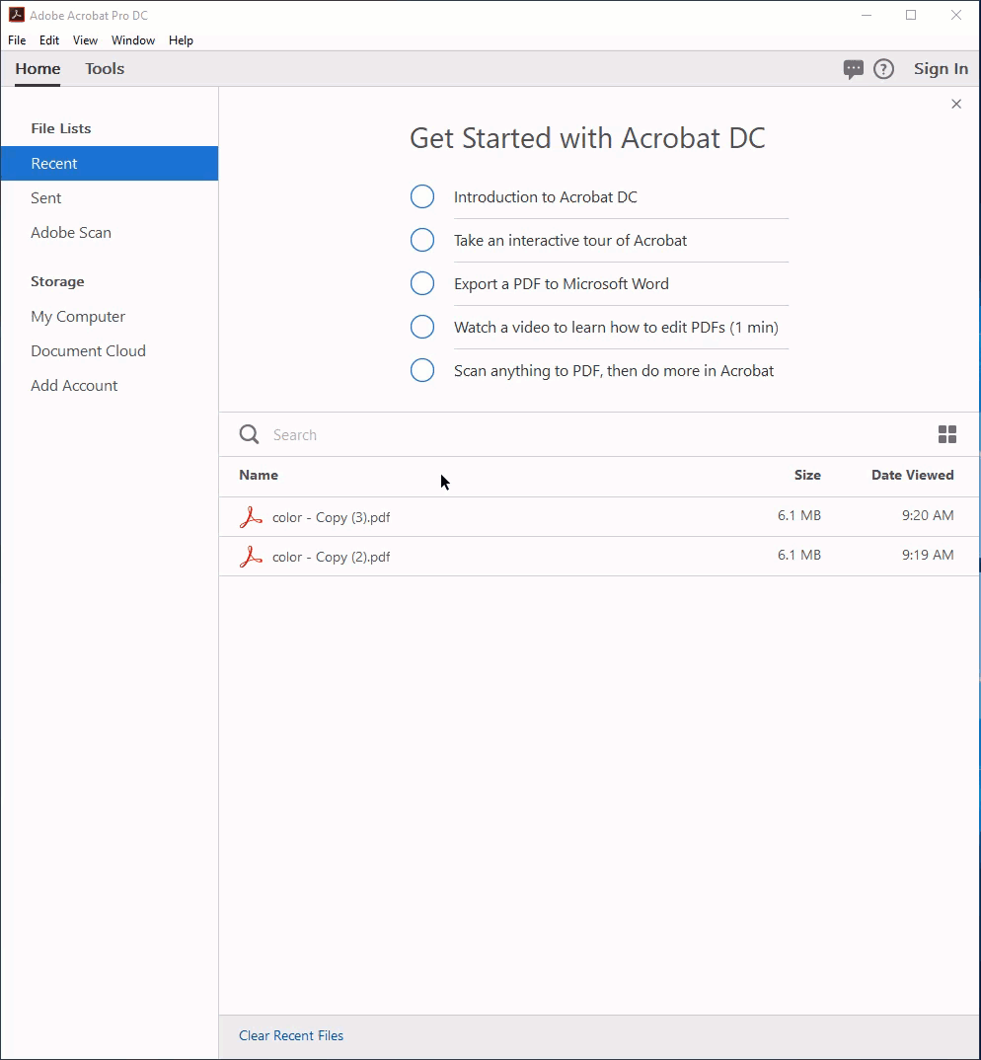
Scanning and OCR in Adobe Acrobat DC

Slide 10
OCR in Adobe Acrobat DC

Slide 11
Evaluating and correcting OCR

Slide 12
How to OCR a document that has already been scanned (Microsoft Word)

Slide 13
Tags, headings, and bookmarks
Creating searchable (with OCR) and legible PDFs or Word files of print items is the minimum we should do as ILL practitioners to create documents that are accessible to the widest range of users without further staff involvement.
If we want go a step beyond this, we can add structure to the PDF or Word file so that a user can skip around to different parts of a document by tabbing through content with tags, headings and/or bookmarks.
This is enhancement is more or less helpful to the end users depending on the complexity and length of the text. The longer and more complex a document is (lots of headings and subheading), the more useful providing these structures will be.

Slide 14
Creating bookmarks in Adobe Acrobat

Slide 15
Alternative text
Alt text (alternative text), also known as "alt attributes", “alt descriptions,” are used within HTML code to describe the appearance and function of an image on a page.
Alt text allows screen readers and text to speech software the ability to “announce” the images and other non-text visual components of a document
Alt text should be descriptive but concise.
What roles should ILL practitioners play in the creation of this image text?

Slide 16
Accessibility Reports in Adobe Acrobat DC
There are software tools to evaluate and repair accessibility issues in your scanned documents. Use Adobe Acrobat DCs accessibility reports via the action wizard or accessibility tools to quickly produce a report to show where your document needs accessibility improvements.

Slide 17
Accessibility Reports via the Action Wizard in Adobe Acrobat Pro

Slide 18
Full Accessibility Report

Slide 19
Screen readers
The point of these accessibility enhancements to documents is so that ultimately users can hear the text and not have to read it. There are different softwares to accomplish this.
You can create an audio file (mp3) directly from a scan using the Scannx kiosk. This is not recommended as it does not including any tagging or alt text for images, graphs or other non-text content
Read & Write Gold is screen reader software that allow you to convert text to speech . These options make headings, tags, and alt text useful to end users with more robust options for playback and export.

