Slide 1
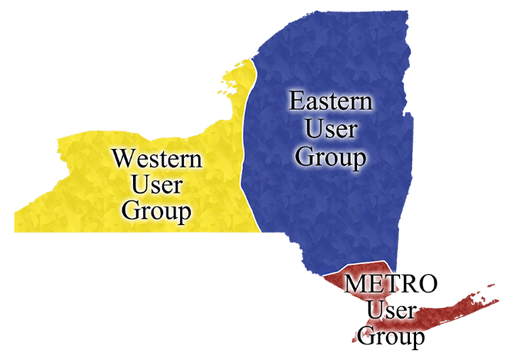
IDS Online Mentor Institute
…from great IDS members…
come great IDS Mentors!
Notes:
Mentors are experienced specialists in ILL/IT who share their knowledge of ILL workflows, best practices and technology with IDS members
As IDS membership grows, we need more mentors…so we ask all of you to think about joining us…or recommending a friend! We usually put out the call at the summer IDS Conference and the OMI starts in September.

Slide 2
OCLC 2018 Resource Sharing Conference …IDS OMI, RUGS and OLI
Notes:
The IDS Mentor program is a hallmark of The IDS Program…we just presented on it at the OCLC Resource Sharing Conference, along with the OLI and the RUGS
I hope you all know who your mentor is and are in contact with them whenever you have questions or could use advise or support…but, if not, please let us know and we will put you in touch with them!

Slide 3
IDS OMI Learning Goals
IDS is flexible
IDS is a team
IDS is results oriented
Experience is as important as expertise
Model problem solving and working together
Notes:
The mentor program started in 2005,
The first offline course was developed in 2011
And the current OMI is a 12 week, 6 module, online Canvas course that was developed by Chris Sisak in 2014
I’ve coordinated it for three cohorts now
Online discussions, assignments, library visits and calls
Our goal is to get people comfortable with helping IDS member library staff.
A mentor may not have a specific answer for every question…but they will be able to help by supporting, understanding the question and finding someone who can help, whether that be in thr IDS Workflow Toolkit, on LibAnswers, someone in IDS or someone in OCLC support.

Slide 4
IDS OMI/Mentor Benefits
Get to know and learn from IDS colleagues…to be part of and to build our IDS community;
Conference fee to OCLC Resource Sharing Conference paid by IDS Project;
Conference fee and hotel accommodations to Annual IDS Conference paid by IDS Project;
Access to the Atlas Systems training videos;
Exciting places to visit, with all expenses paid trip, when mentoring a library;
Opportunities to present, publish and teach;
Opportunities to visit other institutions and work with great ILL practitioners statewide;
Mentors can expect to have a fun time working collaboratively with like-minded individuals;
Very snazzy IDS Project swag: binders, shirts, mugs, hats, etc!
Notes:
Review the benefits
Ask for testimonials from mentors who are at the RUG
End with a reminder to contact us if you want to be connected to your mentor or if you are interested in becoming a mentor yourself.

