Slide 1
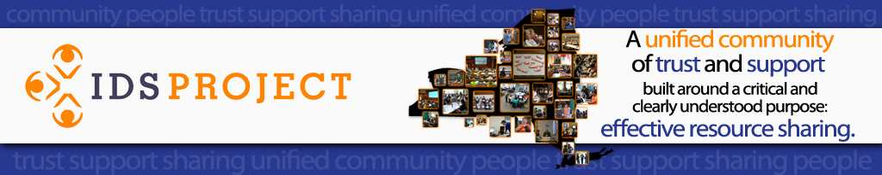
Resource Sharing in Alma and Thoughts on the Near Future of Resource Sharing
Shannon Pritting, SUNY Libraries Consortium

Slide 2
So, what’s happening now in Resource Sharing
ILLiad is going away in at most 2-3 years.
Development is, in essence, stopped for ILLiad.
OCLC is developing Tipasa to be a potential web-based replacement for ILLiad.
Many academic libraries are adopting Library Services Platforms.
  Alma is the industry leader for LSPs in academic libraries and is growing most quickly, especially with consortial installations.
Many academic libraries are adopting integrated discovery layers with enhanced resource sharing capabilities, especially in consortial environments.

Slide 3

What are our choices?
Alma works for intra-consortial borrowing for books and will soon be expanding to borrowing books between consortia.
Resource sharing for articles is being more thoroughly developed in Alma.
Tipasa is the application that is being proposed as “best of breed” that can connect to the OCLC WRS network, docline, Rapid, and other systems.
No other applications are currently in development with the same scope of ILLiad/Tipasa to act as the comprehensive resource sharing broker system.
  Is this because we haven’t asked this of other systems, as we were comfortable with ILLiad and where it was headed?

Slide 4
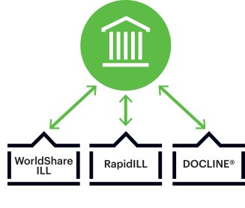
What are our options, and is it just about applications?
All of us currently pay for access to the WRS network, and ILLiad (and maybe soon to Tipasa).
There is currently limited connection to the WRS network from other applications—mostly as ILLiad has done this connecting so well?
Our discussion needs to focus on the entire Resource Sharing ecosystem, not just applications.
https://www.oclc.org/en/resource-sharing.html

Slide 5

Whose Knowledgebase is the Best?
Worldcat is still by far the best knowledgebase for books and other traditional collection materials.
The better question is whether Worldcat is still the most comprehensive knowledgebase for Resource Sharing, as many campuses don’t maintain electronic holdings (journals or ebooks) in OCLC.
What’s the solution for an all-encompassing Knowledgebase, or do we continue to stitch together holdings in different systems, which will require a versatile system that can make working with these knowledgebases easy?

Slide 6

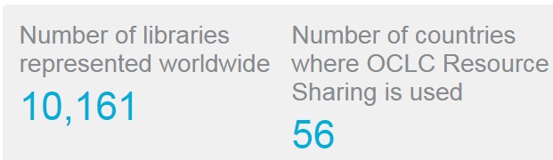
OCLC and Worldshare/Worldcat
Most SUNY Libraries subscribe to WSILL.
Most Libraries subscribe to WSILL and ILLiad.
Access to large network of holdings and libraries.
http://www.oclc.org/en/worldshare-ill/statistics.html

Slide 7



Whose Knowledgebase is What You Need?
Many campuses may want to use this time to determine what knowledgebases they really need access to, and what knowledgebases best fit their need for the future?
  For example, if articles are becoming a higher percentage of the library volume, then is now a good time to consider something different?

Slide 8

Now, to the Application(s)
Most of us are moving from a mature client to a web-based system.
Both have positives, but typically the staff experience is much more powerful in a client.
Web-based systems are often click-heavy, but with potential for automation to take out steps in processes or eliminate mediation altogether.
Increasingly, resource sharing is requiring more work in multiple applications. Many libraries, it’s heavy use of books in Alma, and then articles in ILLiad.

Slide 9
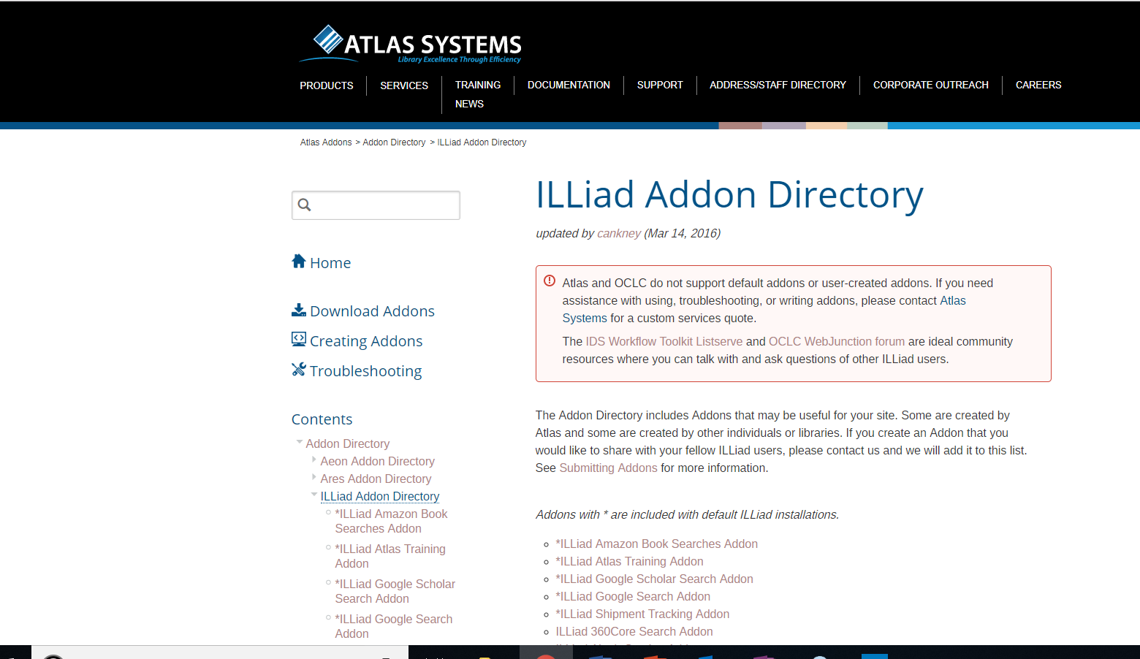
When and why did ILLiad become a resource sharing fan favorite?
Use of APIs can make addon development much easier.
Addons can show areas where there’s room for improvement through APIs.
In Alma, there’s already a great community where campuses have extended Alma through API usage.
Notes:
Image from: https://prometheus.atlas-sys.com/display/ILLiadAddons/ILLiad+Addon+Directory

Slide 10
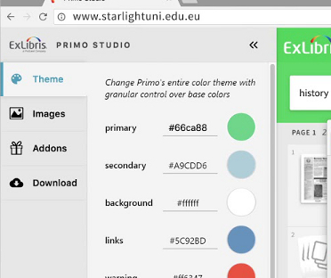
My Experience at Developers’ Day
There’s a lot of untapped potential for maxing out Alma for resource sharing using APIs.
Many campuses have developed localized workflows around Alma to be extremely efficient in other functional areas.
Why aren’t we asking for Primo Studio for resource sharing?
Alma is now mature enough where the community will start pushing the product--and resource sharing should be at the heart of this.
This was like being at an ILLiad conference 4-5 years ago.
Notes:
Image from: https://www.exlibrisgroup.com/wp-content/uploads/2018/05/Primo-Studio-screenshot-sized-for-demo-center.jpg

Slide 11

What we need to do in order to get the system we want.
If we don’t provide a vision of resource sharing for future, what we’ll get is, in essence, a long and drawn out system migration.
We need to make sure that Alma or Tipasa doesn’t become the 2014 version of ILLiad, which we all wanted to continue to improve anyway.
Keep learning more about Alma and Tipasa and how integrated it can be, not about minimally reproducing workflows.
Resource Sharing will be more and more about connecting networks and systems, and less about workflows.
Notes:
Image from: https://prometheus.atlas-sys.com/display/illiad/ILLiad+8.7+Home

Slide 12


Questions to begin asking ourselves
How many applications and workflows do we want to manage?
Can we get one application to do it all for us?
  If so, can it send work from other systems/applications back and forth without staff mediation?
What else do we want out of our systems for the next five years?
Where does your specific library want to grow in resource sharing?

Slide 13

Is the the age of platforms an age of middleware?
As systems get more complex, and capable of more integration, should we be looking to partner to create better middleware or ask the vendors to identify partners for us?
How many applications do you want your staff (or worse, patrons) to have to use and learn?
ILL staff and librarians are rightfully wary of platforms and system change as the type of integration needed to be effective in resource sharing at a high volume requires meaningful connections, not standard pass throughs at a single point in the process.
Notes:
https://www.pinterest.com/pin/730779477004645197/

Slide 14
Do we need to ask for Tipasa to be really well developed middleware, as well as being a refined application?

Slide 15
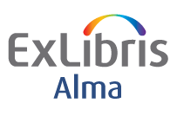
Current Status of Resource Sharing in Alma
Resource Sharing is supported today in a range of different workflows and involves a variety of different systems. Main workflow types include:
•Broker based integrated workflow, involving systems such as ILLiad, Relais ILL/D2D, Inn-Reach or national and regional systems
•Peer to peer consortial borrowing, implemented by NA consortia
•Peer to peer resource sharing by non consortial libraries, such as Australian libraries relaying requests through Libraries Australia Document Delivery (LADD).
•Fulfillment Network, which allows for direct services between libraries including direct requesting and walk in services.
•Automated Fulfillment Network, in which the patron places the request and Alma will route it to the appropriate member library.

Slide 16
Resource Sharing Network (Peer to Peer)
Focus is currently on having this set up within consortia.
First resource sharing option developed by ExLibris.
Option used by most consortia.
Resource sharing option selected by SUNY Libraries Consortium.
Currently, very rarely used for article resource sharing.

Slide 17
Resource Sharing Network
The patron’s home institution is the patron’s service provider.
The patron’s home institution staff uses its own availability information, priorities and workflow considerations
The patron’s home institution is accountable for the loaned item from the perspective of the resource owning library
The home institution may activate a load balancing process to select the appropriate supplier
The pickup location is always at the patron’s home institution.

Slide 18

Resource Sharing in Alma
Borrower
?
Lender
Institution
Institution
Resource Sharing Library
Stub item – owned by resource sharing library
Resource Sharing Library

Slide 19
Fulfillment Networks
Only in production for a few years.
Allows direct requesting by patrons for walk-in pick up and can be mixed with resource sharing to push a hold request to resource sharing.
Requires selecting campus in Primo.

Slide 20
Fulfillment Network - Workflows
  A single institution may participate in multiple fulfillment networks
  Functional Highlights
    Walk-In Loans
    Direct Requesting
    Pick up Anywhere
    Consortial patron record in Primo

Slide 21

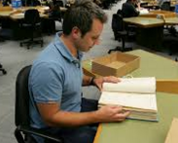


Fulfillment Network Workflow
Request
Abel, Brian
We all lost the cold war

Slide 22
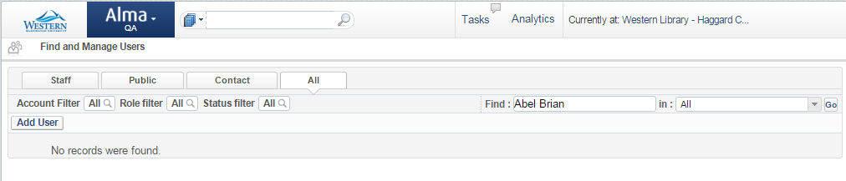
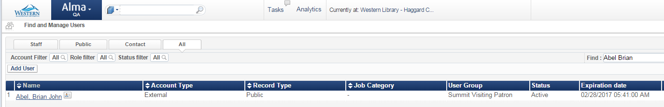
Patron Information is Copied to Lending Library

Slide 23
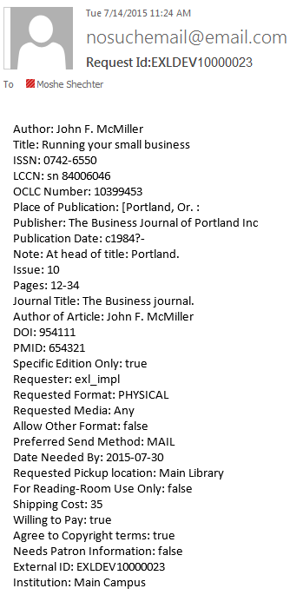




Push to ILLiad

Slide 24
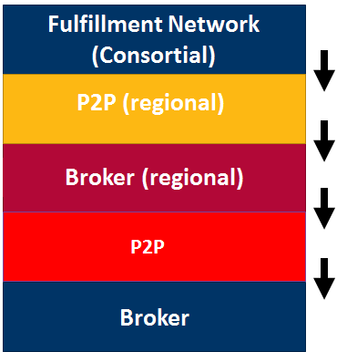
Bringing It Together – The Hybrid Rota

Slide 25
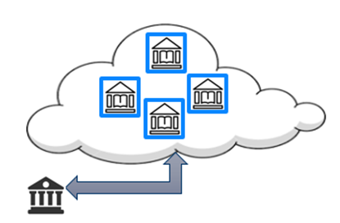
Roadmap: Global Partner List
•A list of partner records that is shared and exposed to all Alma institutions via the Community Zone
•Every institution will be able to contribute partners to the community list and/or update their
information.
•Every institution that defines a new
resource sharing library will be able
to contribute its information to the
community.

Slide 26
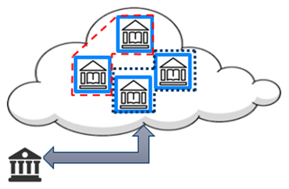
Roadmap: Global Partner List
•An institution will be able to attach attributes that describe its preferences for resource sharing.
•All community partners that share the same attributes will automatically be considered
partners of that institution
•An institution will maintain the
independence to remove some
partners from its automatic rota
template and/or to change its
priority.

Slide 27
Future Potential: Leveraging the Alma Cloud Data
•The library has a list of partners they work with regularly, but there may be additional resources that are owned by other libraries in Alma’s cloud.
•It should be possible to suggest these other libraries as options (assuming the other library is willing...)
•The Alma locate profiles will locate based on electronic coverage & license information

Slide 28
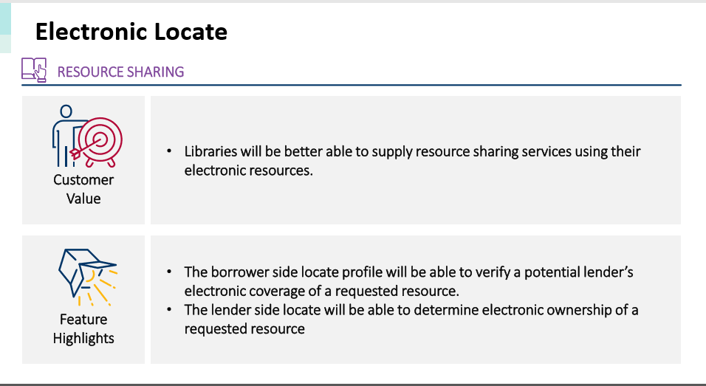
2018 Roadmap Highlights: Slide 18
From: https://knowledge.exlibrisgroup.com/@api/deki/files/66457/Alma_Roadmap_Highlights_2018.pdf?revision=1

Slide 29
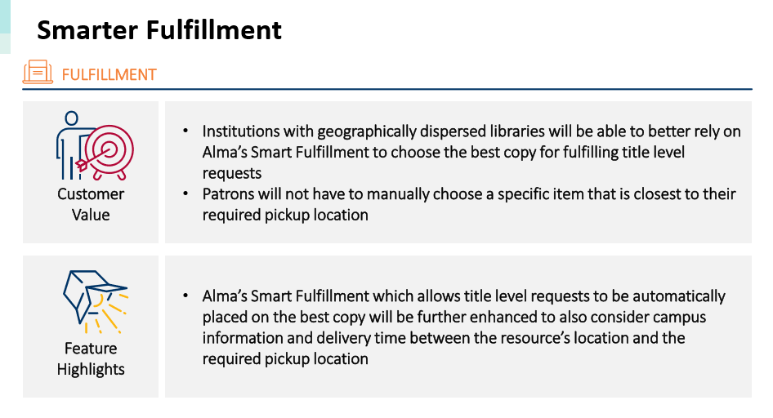
Slide 23
https://knowledge.exlibrisgroup.com/@api/deki/files/66457/Alma_Roadmap_Highlights_2018.pdf?revision=1
Slide 23

Slide 30
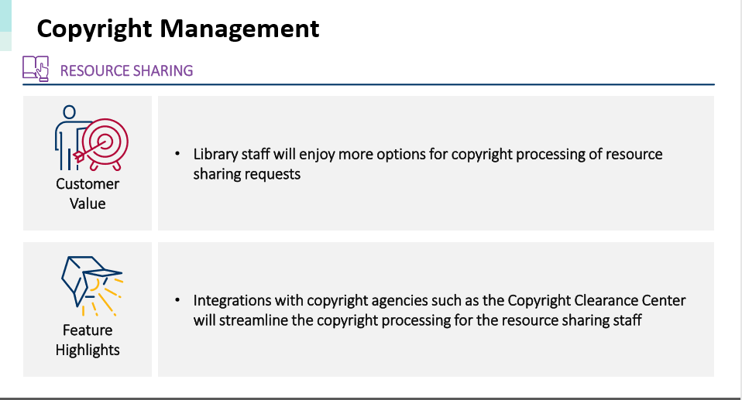
Slide 61
https://knowledge.exlibrisgroup.com/@api/deki/files/66457/Alma_Roadmap_Highlights_2018.pdf?revision=1

Slide 31
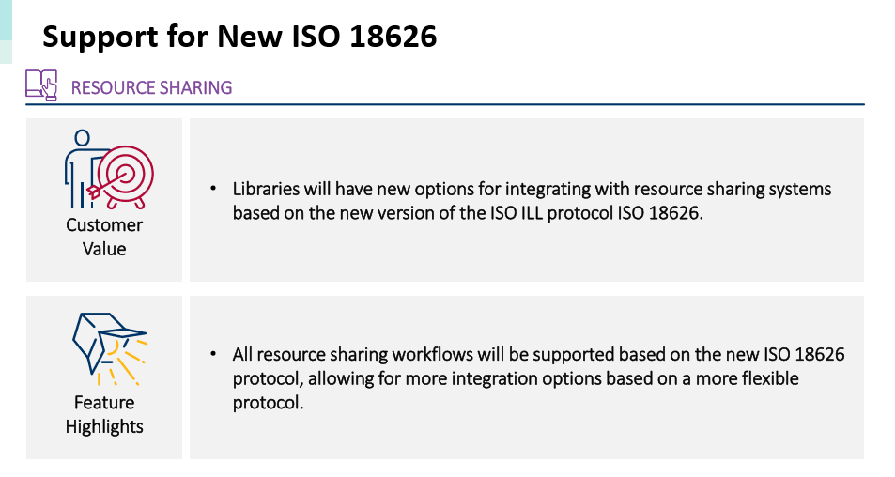
Slide 59

Slide 32
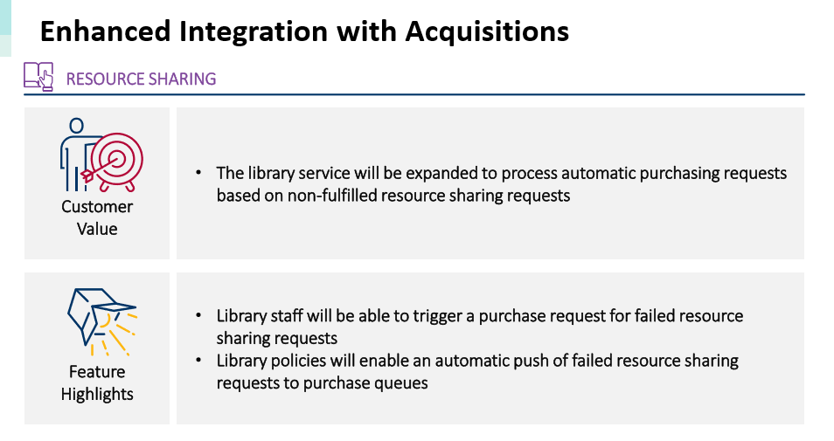
Slide 60
From: https://knowledge.exlibrisgroup.com/@api/deki/files/66457/Alma_Roadmap_Highlights_2018.pdf?revision=1

Slide 33
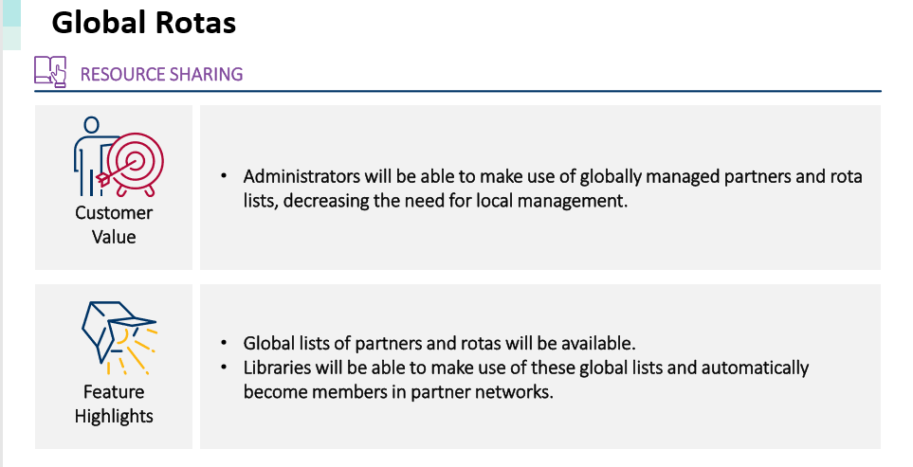
Slide 99: H2 2019/2020
From: https://knowledge.exlibrisgroup.com/@api/deki/files/66457/Alma_Roadmap_Highlights_2018.pdf?revision=1

Slide 34
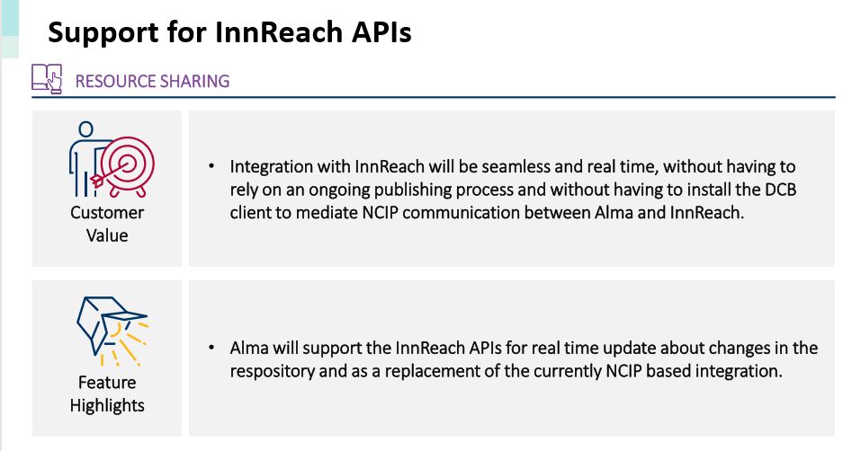
Slide 100
From: https://knowledge.exlibrisgroup.com/@api/deki/files/66457/Alma_Roadmap_Highlights_2018.pdf?revision=1

Slide 35
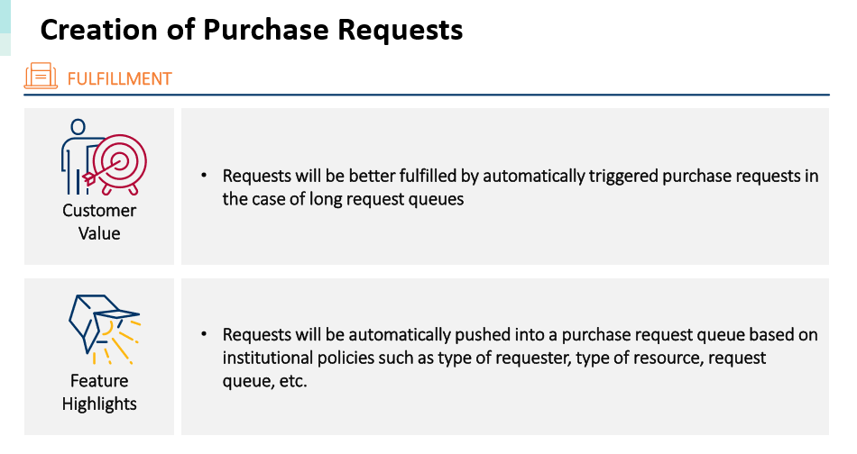
Slide 104
From: https://knowledge.exlibrisgroup.com/@api/deki/files/66457/Alma_Roadmap_Highlights_2018.pdf?revision=1

Slide 36
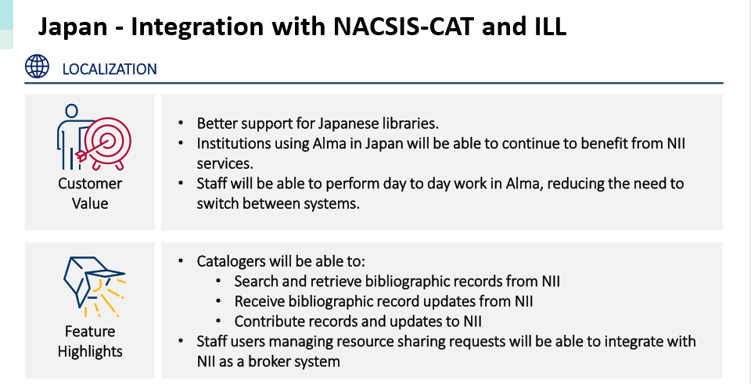
Slide 115
From: https://knowledge.exlibrisgroup.com/@api/deki/files/66457/Alma_Roadmap_Highlights_2018.pdf?revision=1

Slide 37
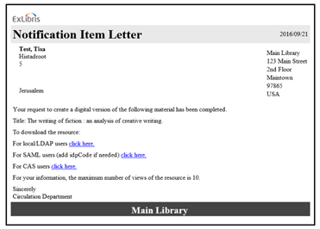
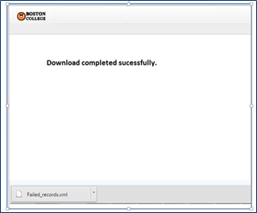
Future Potential: Leveraging the Alma Cloud Data
•Digital content will be delivered as emails with links to Alma managed temporary digital copies

Slide 38
So, what does this mean?
Alma will soon have the basic core of an article resource sharing system.
Many new features planned that show that Alma is a system that can become a robust resource sharing system on its own, or plug into other systems.

Slide 39
Final Thoughts
It’s been a great era with Atlas growing as the best of breed resource sharing development grouped.
  And they were focused on resource sharing, which was/is GREAT!
Our resource sharing applications will (unless something changes) be provided by larger organizations that have a lot of other software development.
  This too can be great, but requires that we significantly change how we work with our vendors.

