Slide 1
Client Addons

Slide 2
Client Addon vs. Routing Rule
Client Addon
Can route to different queue or function(Borrowing, Doc Del, Lending)
Can Daisy Chain (can run through multiple routing functions or queues)
Can use data from ILLiad Request and other sources (websites, APIs, etc.)
Runs when Request is opened
NCIP connection to library catalog for checking out, creating temp records, etc.
Routing Rule
Can route to different queue or function(Borrowing, Doc Del, Lending)
Runs automatically
Can’t Daisy Chain
Uses data from ILLiad Request only

Slide 3
Client addon vs. Logic rules
Client Addon
Works on single request when the request is opened
Staff initiated versus automatically running in background
Best cost (e.g. Pricing of Get It Now, Reprints Desk, Amazon, Better Worlds Books)
Consortium to link out to other software (e.g. Borrow Direct)
Logic Rule
Can route request to new queue based on request data
Automatically runs on all requests that fit criteria
Can check availability, cancel requests
Automate routing for best price and automate purchasing
Can Daisy Chain routing to new queues

Slide 4
Why Use client Addons
Manually check things for best options, prices
Provide information from multiple locations and systems in website view
Creating Temp Records with unique information, such as barcodes
Fill in webforms for searching or gathering other information

Slide 5
Client Addon Installation
https://prometheus.atlas-sys.com/display/ILLiadAddons/ILLiad+Addon+Directory
https://www.screencast.com/t/KCSaSEMzo

Slide 6
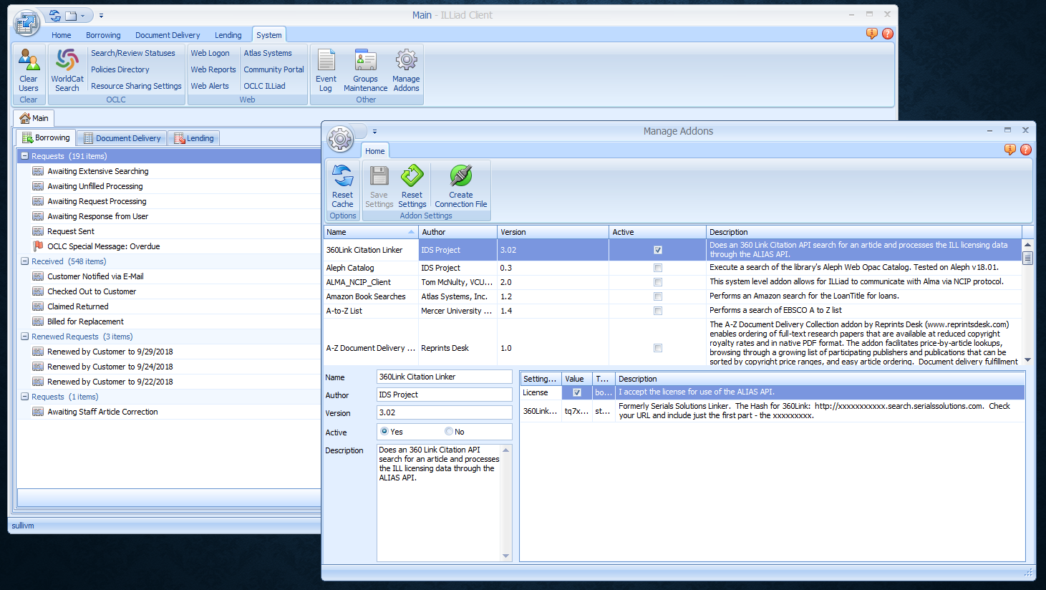
ILLiad Addon Management

Slide 7
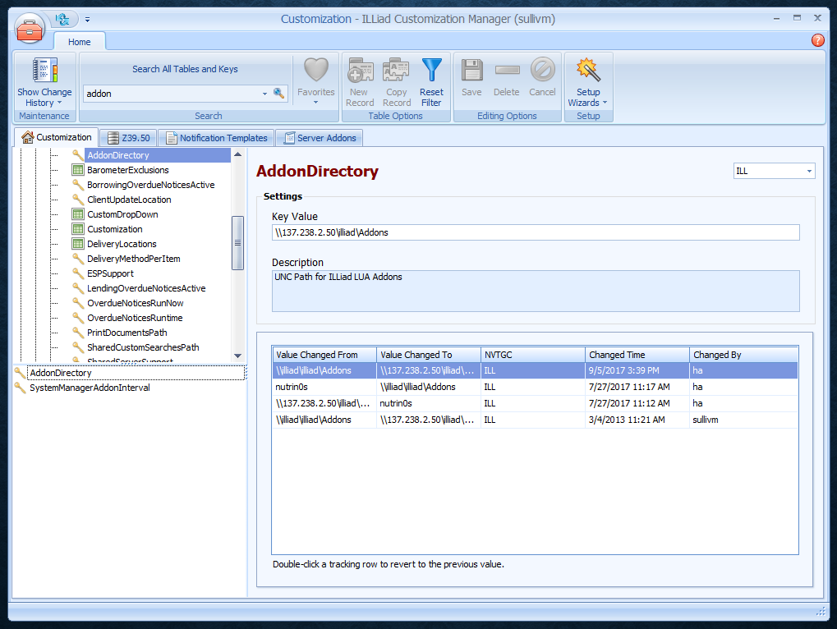
Customization Manager

Slide 8
Lua Code
function Init()
if settings.scriptActive then
if GetFieldValue("Transaction", "RequestType") == "Loan" then
interfaceMngr = GetInterfaceManager();
-- Create browser
BWBForm.Form = interfaceMngr:CreateForm("Better World Books", "Script");
BWBForm.Browser = BWBForm.Form:CreateBrowser("Better World Books", "BWB", "Better World Books");
BWBForm.Browser.TextVisible = false;
BWBForm.Browser.WebBrowser.ScriptErrorsSuppressed = true;
BWBForm.RibbonPage = BWBForm.Form:GetRibbonPage("Better World Books");
BWBForm.RibbonPage:CreateButton("Search", GetClientImage("Search32"), "Search", "Better World Books");
BWBForm.Form:Show();
if settings.autoSearch then
Search();
end
end
end
end

Slide 9
function Search()
if GetFieldValue("Transaction", "ISSN") ~= "" then
BWBForm.Browser:Navigate("http://www.betterworldbooks.com/List.aspx?SearchTerm=" .. GetFieldValue("Transaction", "ISSN"));
else
BWBForm.Browser:Navigate("http://www.betterworldbooks.com/List.aspx?SearchTerm=" .. GetFieldValue("Transaction", "LoanTitle"));
end
end

Slide 10
Creating your own addon
http://www.idsproject.org/Addons/Generic.zip
Unzip into your Addons folder (C:\Program Files (x86)\ILLiad\Addons)
Go into ILLiad Addon Management in the client
Click on Generic (Refresh Cache if ILLiad isn’t showing addon)
Edit URL and Title
Save
Open Request to test

Slide 11
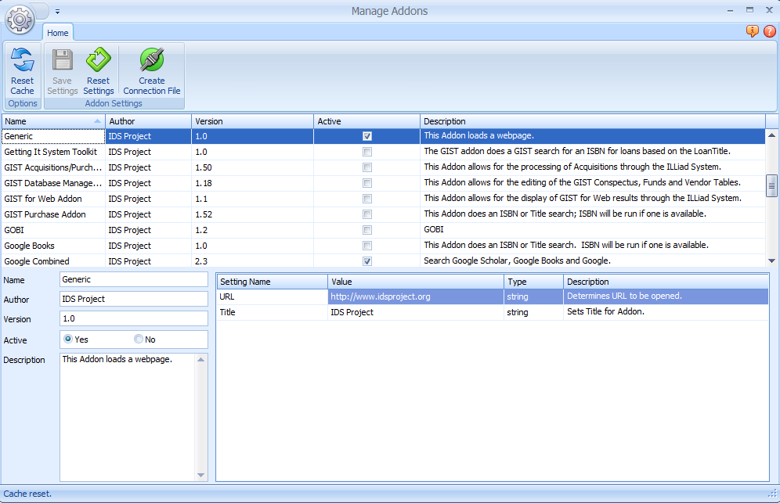

Slide 13
Addons used by members
NCIP
CRL Search
Hathi Trust
360 Link Citation Search
EBSCO A-Z List
Amazon
Better World Books
Google
Proquest Dissertation Search
Reprints Desk
Netflix Search?

Slide 14
Thank you!
https://github.com/idsproject

